Slide 1
TextScope:
Enhance Human Perception via
Intelligent Text Retrieval and Mining
ChengXiang (“Cheng”) Zhai
Department of Computer Science
(Carl R. Woese Institute for Genomic Biology
School of Information Sciences
Department of Statistics)
University of Illinois at Urbana-Champaign
czhai@illinois.edu
http://czhai.cs.illinois.edu/
Distinguished Lecture Series, University of North Carolina, Charlotte, Feb. 22, 2019

Slide 2







Text data grow quickly and cover all kinds of topics
How can we turn “big text data” into “big knowledge”?
WWW
Email
Government
Personal
Enterprise
Literature
News
Social Media
…

Slide 3
Big Data-Enabled Artificial Intelligence
Autonomous AI: Intelligent systems to replace humans
Training Data
(Supervised) Machine Learning
Big Data
Observations of World
Human
(Unsupervised) Machine Learning
Data Mining
Intelligence
Assistive AI: Intelligent systems to assist humans

Slide 4
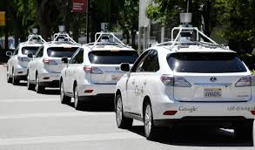

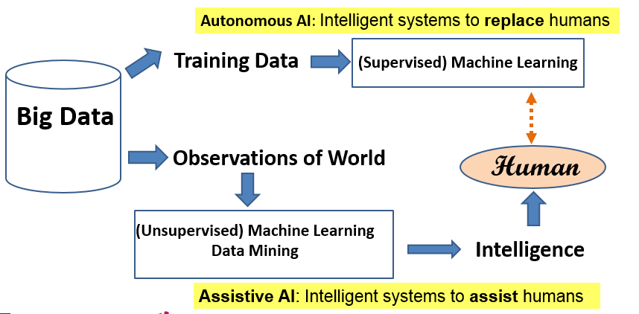
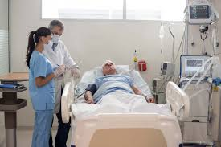

Autonomous AI vs. Assistive AI
Autonomous AI
Simple tasks, Big training data available, Limited domain
Intelligence(Machine) ≤ Intelligence (Human)
Any domain, All kinds of data
Text Data
TextScope
This Talk
“Data Scope” to enhance human perception, Complex tasks
Intelligence (Machine + Human) > Intelligence(Human)
Assistive AI

Slide 5




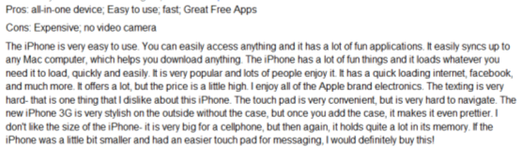

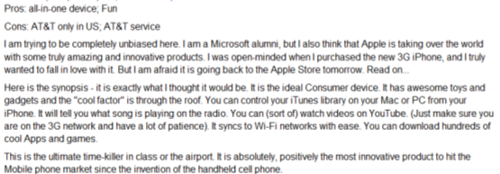
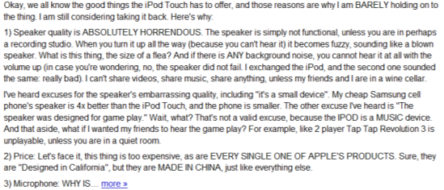
Humans as Subjective & Intelligent “Sensors”
Sense
Report
Real World
Sensor
Data
Weather
Thermometer
3°C , 15°F, …
Locations
Geo Sensor
41°N and 120°W ….
Network Sensor
01000100011100
Networks
Perceive
Express
“Human Sensor”

Slide 6
Unique Value of Text Data
Useful in all big data applications (since humans are involved in all application domains and they generate text data)
Especially useful for mining knowledge about people’s behavior, attitude, and opinions
  The subjectivity of human sensors creates both challenges in accurately understanding the truth behind text data and also opportunities to mine properties about the sensors themselves.
Directly express knowledge about our world ➔ Small text data are also useful!

Slide 7
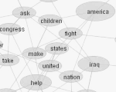

Opportunities of Text Mining Applications
+ Non-Text Data
4. Infer other real-world variables
(predictive analytics)
2. Mining content of text data
Real World
Observed World
Text Data
+ Context
Perceive
Express
(Perspective)
(English)
3. Mining knowledge
about the observer
1. Mining knowledge
about language

Slide 8


Challenges in Understanding Text Data (NLP)
A dog is chasing a boy on the playground
Lexical
analysis
(part-of-speech
tagging)
Det
Noun
Aux
Verb
Det
Noun
Prep
Det
Noun
Semantic
analysis
Noun Phrase
Noun Phrase
Complex Verb
Noun Phrase
Dog(d1).
Boy(b1).
Playground(p1).
Chasing(d1,b1,p1).
Prep Phrase
Verb Phrase
Syntactic analysis
(Parsing)
Verb Phrase
+
Sentence
A person saying this may
be reminding another person to
get the dog back.
Scared(x) if Chasing(_,x,_).
Scared(b1)
Pragmatic analysis
(speech act)
Inference

Slide 9
NLP is hard!
Natural language is designed to make human communication efficient. As a result,
  we omit a lot of common sense knowledge, which we assume the hearer/reader possesses.
  we keep a lot of ambiguities, which we assume the hearer/reader knows how to resolve.
This makes EVERY step in NLP hard
  Ambiguity is a killer!
  Common sense reasoning is pre-required.

Slide 10
Examples of Challenges
Word-level ambiguity:
  “root” has multiple meanings (ambiguous sense)
Syntactic ambiguity:
  “natural language processing” (modification)
  “A man saw a boy with a telescope.” (PP Attachment)
Anaphora resolution: “John persuaded Bill to buy a TV for himself.” (himself = John or Bill?)
Presupposition: “He has quit smoking” implies that he smoked before.

Slide 11
Grand Challenge:
How can we leverage imperfect NLP to build a perfect application?
Answer: Having humans in the loop!

Slide 12


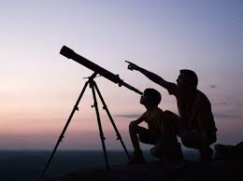
TextScope to enhance human perception
TextScope
Microscope
Telescope
  Intelligent Interactive Retrieval & Text Analysis
  for Task Support and Decision Making

Slide 13


TextScope in Action: intelligent interactive decision support
TextScope
Predicted Values
of Real World Variables
Predictive
Model
Multiple
Predictors
(Features)
Learning to interact
Domain Knowledge
…
Optimal Decision Making
Prediction
…
Text + Non-Text
Sensor 1
Joint Mining of Non-Text
and Text
Real World
Non-Text
Data
Interactive
text analysis
Sensor k
…
Text
Data
Interactive information retrieval
Natural language processing

Slide 14
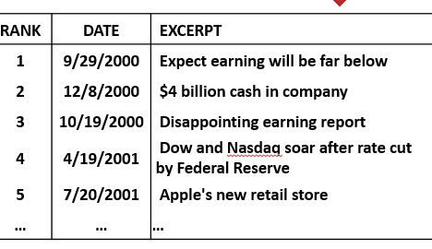
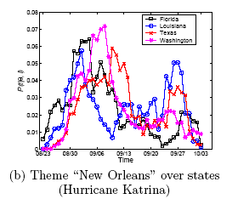
Envisioned Interface of TextScope:
Intelligent & Interactive Information Retrieval + Text Mining
Task Panel
TextScope
…
Topic Analyzer
Opinion
Prediction
Event Radar
Search Box
Microsoft (MSFT,) Google, IBM (IBM) and other cloud-computing rivals of Amazon Web Services are bracing for an AWS "partnership" announcement with VMware expected to be announced Thursday. …
TrainableFilter1
TrainableFilter2
…
Select Time
Select Region
MyWorkSpace
Project 1
Alert A
Alert B ...

Slide 15
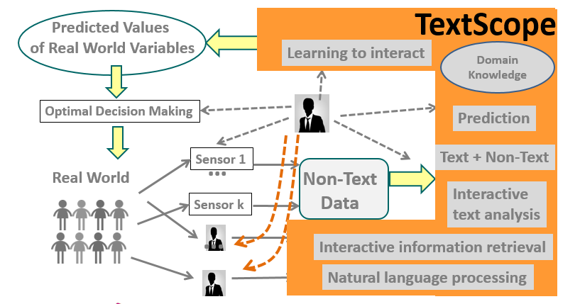

Application 1: Aviation Safety
Anomalous events &
causes
Aviation Administrator
Aviation Safety

Slide 16

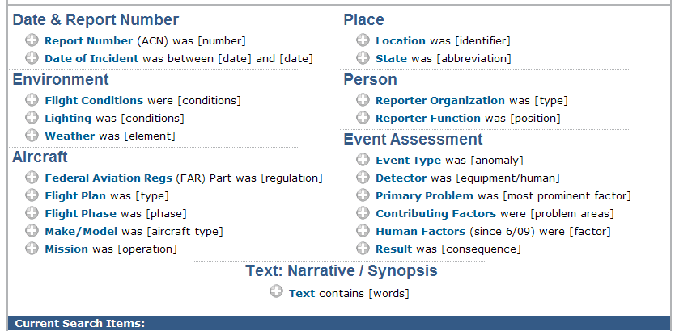
Abundance of text data in the aviation domain
Collecting reports since 1976
>860,000 reports as of Dec. 2009

Slide 17
Lots of useful knowledge buried in text
ASRS Report ACN: 928983 (Date: 201101, Time: 1801-2400. …)
We were delayed inbound for about 2 hours and 20 minutes. On the approach there was ice that accumulated on the aircraft. … The Captain wrote up … The flight crew [who picked up the plane] the following morning notified us of an incorrect remark section write up. I believe a few years ago, there was a different procedure for writing up aborted takeoffs. I think there was some confusion as to what the proper write-up for the aborted takeoff was. A contributing factor for this incorrect entry into the log may have been fatigue. I had personally been awake for about 14 hours and still had another leg to do. …Also a contributing factor is that this event does not happen regularly…. A more thorough review and adherence to the operations manual section regarding aircraft status would have prevented this, [as well as], a better recognition of the onset of fatigue. The manual is sometimes so large that finding pertinent data is difficult. Even after it was determined that the event had occurred, it took me 15 to 20 minutes to find the section regarding aborted takeoffs.

Slide 18
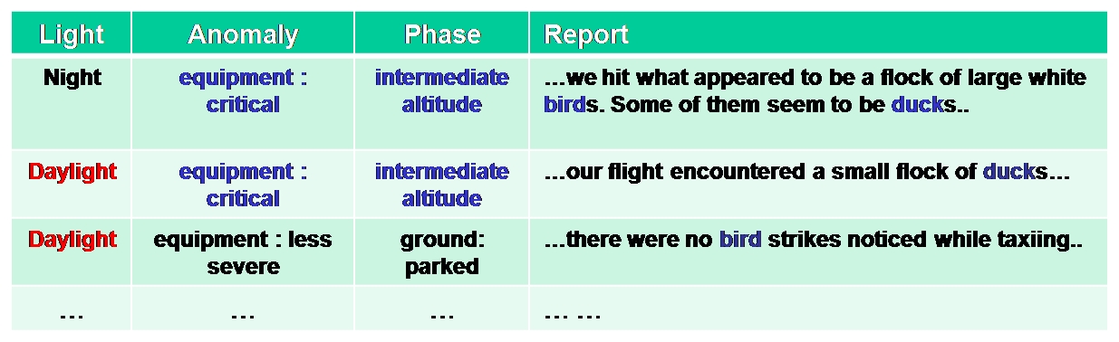
Interactive Analysis of Multidimensional Text Databases [Yu et al. 2009]
Analyst
…
Analysis Support
Multidimensional OLAP, Ranking, Comparison, Cause Analysis, …
Topic
Topic
turbulence
Topic Cube
Representation
birds
Encounter
undershoot
Deviation
overshoot
1998
98.02
98.01
1999
99.02
LAX
SJC
MIA
AUS
99.01
Time
CA
FL
TX
Time
Location
Location
drill-down
roll-up
Multidimensional
Text Database
Yintao Yu, Cindy X. Lin, Yizhou Sun, Chen Chen, Jiawei Han, Binbin Liao, Tianyi Wu, ChengXiang Zhai, Duo Zhang, and Bo Zhao, “iNextCube: Information Network-Enhanced Text Cube", Proc. 2009 Int. Conf. on Very Large Data Bases (VLDB'09) (system demo), 2009
Notes:
18

Slide 19
Topic Cube Construction [Zhang et al. 2010]
ALL
Anomaly Altitude Deviation
Anomaly Maintenance Problem
Anomaly Inflight Encounter
……
……
Undershoot
……
Overshoot
Improper Documentation
……
Improper Maintenance
Birds
……
Turbulence
Time | Loc | Env | … | Narrative
98.01 | TX | Daylight | …
98.01 | LA | Daylight | …
98.01 | LA | Night | …
99.02 | FL | Night | …
Altitude 0.03
Ft 0.02
Climb 0.01
… ….
Topics in daylight
Descent 0.06
Cloud 0.03
Ft 0.01
… ….
Altitude 0.04
Ft 0.03
Instruct 0.01
… ….
Topics in night
Descent 0.05
System 0.02
View 0.01
… ….
Duo Zhang, ChengXiang Zhai, Jiawei Han, Ashok Srivastava, Nikunj Oza. Topic Modeling for OLAP on Multidimensional Text Databases: Topic Cube and its Applications, Statistical Analysis and Data Mining, Vol. 2, pp.378-395, 2010.

Slide 20

Comparison of distributions of anomalies in FL, TX, and CA
Improper Documentation
(Florida)
Turbulence
(Texas)
Notes:
20

Slide 21
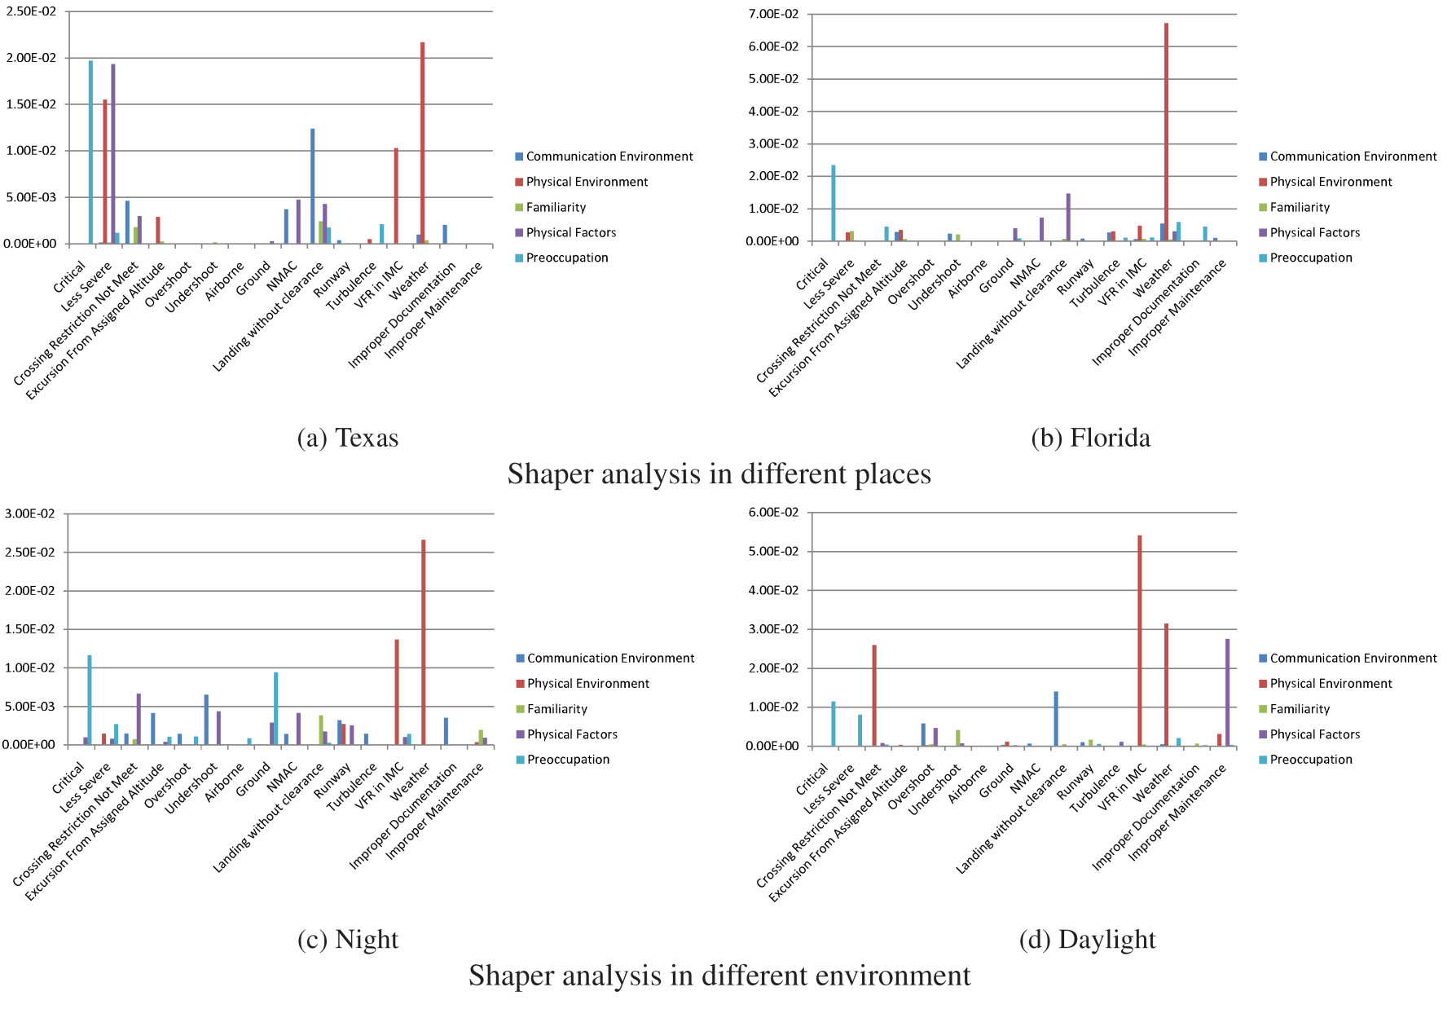
Comparative Analysis of Shaping Factors: Texas vs. Florida
Texas
Florida
Improper Documentation
Turbulence
Notes:
“Physical Environment” is the main cause for anomalous events “Weather” and “VFR in IMC”
“Physical Factors” causes more anomaly during night rather than daylight
“Communication environment”causes “Landing without clearance” more in Texas than in Florida
21

Slide 22
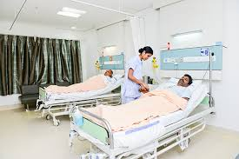
Application 2: Medical & Health
Application 2: Medical & Health
Diagnosis, optimal treatment
Side effects of drugs, …
Physicians, Patients, Researchers…
Medical & Health

Slide 23
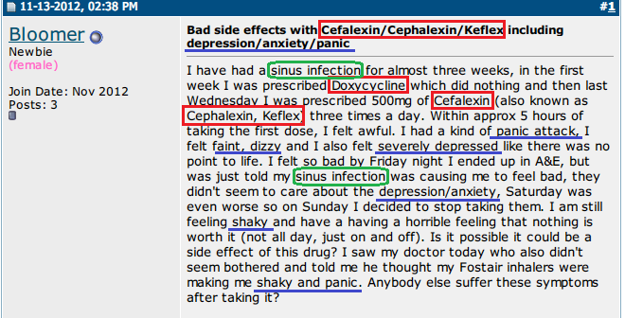
1. Extraction of Adverse Drug Reactions from Forums
Green: Disease symptoms
Blue: Side effect symptoms
Red: Drug
TextScope
Drug: Cefalexin
ADR:
panic attack
faint
….

Slide 24
A Probabilistic Model for ADR Extraction [Wang et al. 14]
Challenge: how do we separate treated symptoms from side-effect symptoms?
Solution: leverage knowledge about known symptoms of diseases treated by a drug
Probabilistic model
  Assume forum posts are generated from a mixture language model
  Most words are generated using a background language model
  Treated (disease) symptoms and side-effect symptoms are generated from separate models, enabled by the use of external knowledge about known disease symptoms
  Fitting the model to the forum data allows us to learn the side-effect symptom distributions
Sheng Wang et al. 2014. SideEffectPTM: an unsupervised topic model to mine adverse drug reactions from health forums. In ACM BCB 2014.

Slide 25
Sample ADRs Discovered [Wang et al. 14]
Drug(Freq) | Drug Use | Symptoms in Descending Order
Zoloft (84) | antidepressant | weigh gain, weight, depression, side effects, mgs, gain weight, anxiety, nausea, head, brain, pregnancy, pregnant, headaches, depressed, tired
Ativan (33) | anxiety disorders | Ativan, sleep, Seroquel, doc prescribed seroqual, raising blood sugar levels, anti-psychotic drug, diabetic, constipation, diabetes, 10mg, benzo, addicted
Topamax (20) | anticonvulsant | Topmax, liver, side effects, migraines, headaches, weight, Topamax, pdoc, neurologist, supplement, sleep, fatigue, seizures, liver problems, kidney stones
Ephedrine (2) | stimulant | dizziness, stomach, Benadryl, dizzy, tired, lethargic, tapering, tremors, panic attach, head
Unreported to FDA
Sheng Wang et al. 2014. SideEffectPTM: an unsupervised topic model to mine adverse drug reactions from health forums. In ACM BCB 2014.

Slide 26
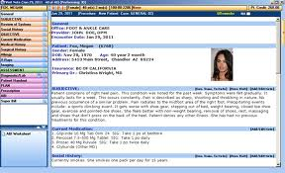
2. Analysis of Electronic Medical Records (EMRs)
Disease Profile
EMRs (Patient Records)
TextScope
Typical symptoms: P(Symptom|Disease)
Typical treatments: P(Treatment|Disease)
Effectiveness of treatment
Subcategories of disease
… …

Slide 27

The Conditional Symptom-Treatment Model [Wang et al. 16]
Typical symptoms
of disease d
Typical treatments
of disease d
Likelihood of
patient t having disease d
Symptom
Disease
All diseases
of patient t
Treatment
Observed Patient Record
S. Wang, E. Huang, R. Zhang, X. Zhang, B. Liu. X. Zhou, C. Zhai, A Conditional Probabilistic Model for Joint Analysis of Symptoms, Diseases, and Herbs in Traditional Chinese Medicine Patient Records, IEEE BIBM 2016.
Notes:
We show the probability of patient t having symptom s and being prescribed herb h with disease diagnoses Dt.
Here Pr(s,h|t) is the probability of of patient t having symptom s and being prescribed herb h.
Dt is the set of diseases this patient have, which is also observed in the record.
Pr(d|t) is the likelihood of patient t having disease d.
Pr(s|d) is the typical symptoms of disease d.
Pr(h|d) is the typical herbs of disease d.
The goal of optimization is to find optimial Pr(s|d), Pr(h|d) and Pr(d|t) so that the probability of all the observed {Pr(s,h|t)} would be maximzied.
We use EM algorithm to optimize this loss function. The optimization is fast and can be scaled to thousands of medical record.
More details about the models are in the paper.

Slide 28
Evaluation: Traditional Chinese Medicine(TCM) EMRs
10,907 patients TCM records in digestive system treatment
3,000 symptoms, 97 diseases and 652 herbs
Ground truth: 27,285 manually curated herb-symptom relationship.
Notes:
While we envision that our method would be used to mine a large number of patient records from multiple physicians, direct experimentation with such a mixed dataset would make it difficult to choose the most suitable physician to assess the data mining results. This is because different
physicians tend to have varying opinions due to the differences in their training and experiences.
Thus, we decided to evaluate the proposed model using patient records from a single physician. This way, the physician can judge to what extent
the mined results match the his reasoning and experience.
Specifically, we used 10,907 anonymous electronic medical records provided by a TCM physician whose specialization is in digestive system treatments. We normalized the symptom and herb terms to obtain 9,530 records with 3,000 symptoms, 97 diseases, and 652 herbs.
The most frequently occurring disease is “chronic gastritis” and the most frequently occurring symptom is “abdominal pain and chills.”
To quantitatively evaluate our model, we collected a set of herb-symptom relationship annotations, manually curated by TCM experts. These nnotations contain 27,285 herb-symptom relationships. The symptoms and herbs of 1,624 of these relationships appear in our dataset. Consequently, we evaluate how our method can accurately identify this subset of 1,624 relationships.

Slide 29
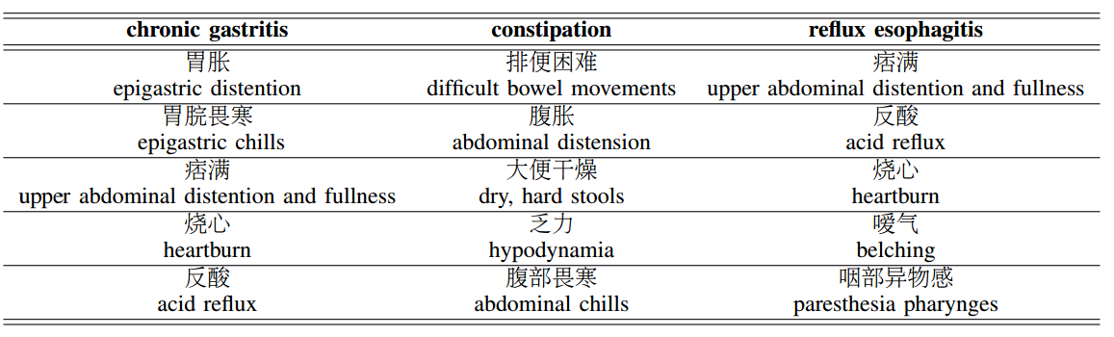
“Typical Symptoms” of 3 Diseases: p(s|d)
Notes:
We show three sample conditional symptom distributions with the highest entropy values among all 100 disease profiles learned with our model. The entropy of a distribution measures its information content. Thus, the higher the entropy, the more informative the distribution.
Here we show the top five symptoms, sorted by decreasing probability, for three different diseases. The physician judged these symptoms to be typical symptoms for the corresponding disease. Indeed, the relevance of these symptoms to the disease is often obvious. For example, “difficult
bowel movements,” “abdominal distension,” and “dry, hard stools” are common symptoms for “constipation.” The fact that our model was able to learn these associations automatically from the dataset clearly demonstrates the effectiveness of the model for mining medical knowledge. Our model can also differentiate between similar diseases, such as “reflux esophagitis” and “chronic gastritis,” which share symptoms such as “acid reflux” and “heartburn.” We discover “paresthesia pharynges” and “discomfort in upper respiratory tract” for “reflux esophagitis,” while these symptoms do not appear for “chronic gastritis.”
Remarkably, many of these symptoms are unique TCM symptoms and are not well-studied in western medicine. For example, the model discovered that “dark, purplish tongue” is associated with “coronary heart disease.” Our physician verified these unique TCM symptoms for their corresponding diseases. This result further shows the effectiveness of using our model in revealing TCM knowledge from medical records. Our model can provide useful TCM symptoms to facilitate differential diagnosis and precision herb prescription.

Slide 30
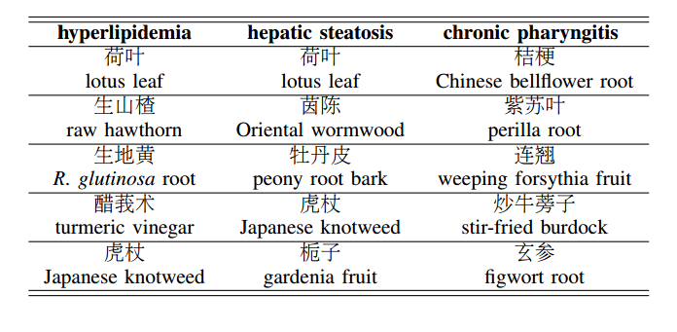
“Typical Herbs” Prescribed for 3 Diseases: p(h|d)
Notes:
We show the top five herbs of selected herb distributions for three different diseases. These herbs are unique to TCM and are unused by western medicine. There is evidence showing the empirical effectiveness of these herbs, of which a deeper understanding can improve our overall medicinal knowledge. We can see that our model successfully discovered many herbs with known relations to these different diseases
. For example, our model asserts that “lotus leaves” and “fresh hawthorn” can be used to treat “hyperlipidemia,” which can be verified by existing TCM knowledge and recent studies.
In addition to supporting existing knowledge, our model can also find novel herb prescription knowledge. For instance, our model determines that “turmeric root” can be used to treat “hypertension.” A recent work showed that curcumin, an active ingredient of turmeric root, can be used to treat idiopathic pulmonary arterial hypertension, a type of genetic hypertension. With further analysis on multiple visits of a given patient, we can assess the effectiveness of specific herbs prescribed for a disease. This is an important future direction we wish to pursue.

Slide 31
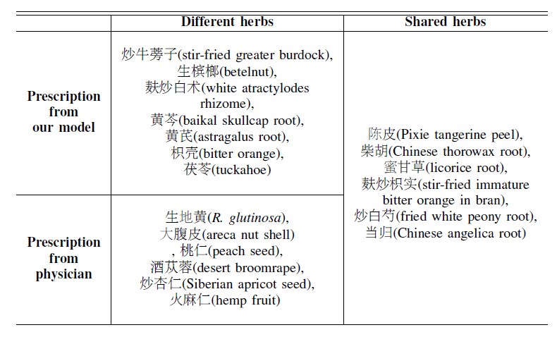
Algorithm-Recommended Herbs vs.
Physician-Prescribed Herbs
Model
Shared
Difference
Physician

Slide 32

Application 3: Business intelligence
Application 3: Business Intelligence
Business intelligence
Consumer trends…
Business analysts, Market researcher…
Products

Slide 33




Latent Aspect Rating Analysis (LARA) [Wang et al. 10]
TextScope
How to infer aspect ratings?
How to infer aspect weights?
Value Location Service …
Value Location Service …
Hongning Wang, Yue Lu, ChengXiang Zhai. Latent Aspect Rating Analysis on Review Text Data: A Rating Regression Approach, Proceedings of the 17th ACM SIGKDD International Conference on Knowledge Discovery and Data Mining (KDD'10), pages 115-124, 2010.

Slide 34
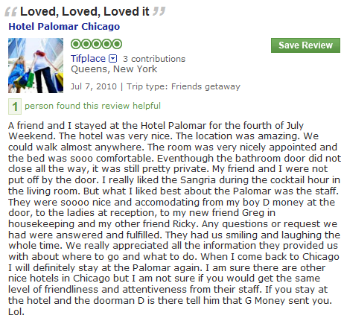
Solving LARA in two stages:
Aspect Segmentation + Rating Regression
Aspect Segmentation
+
Latent Rating Regression
Reviews + overall ratings
Aspect segments
Term Weights
Aspect Rating
Aspect Weight
location:1
amazing:1
walk:1
anywhere:1
0.0
2.9
0.1
0.9
3.9
0.2
room:1
nicely:1
appointed:1
comfortable:1
0.1
1.7
0.1
3.9
4.8
0.2
nice:1
accommodating:1
smile:1
friendliness:1
attentiveness:1
2.1
1.2
1.7
2.2
0.6
5.8
0.6
Observed
Latent!

Slide 35

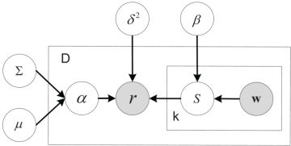


Latent Rating Regression [Wang et al. 2010]
Aspect segments
Term Weights
Aspect Rating
Aspect Weight
location:1
amazing:1
walk:1
anywhere:1
0.0
0.9
0.1
0.3
1.3
0.2
room:1
nicely:1
appointed:1
comfortable:1
0.1
0.7
0.1
0.9
1.8
0.2
nice:1
accommodating:1
smile:1
friendliness:1
attentiveness:1
0.6
0.8
0.7
0.8
0.9
3.8
0.6
Conditional likelihood
Hongning Wang, Yue Lu, ChengXiang Zhai. Latent Aspect Rating Analysis on Review Text Data: A Rating Regression Approach, Proceedings of the 17th ACM SIGKDD International Conference on Knowledge Discovery and Data Mining (KDD'10), pages 115-124, 2010.

Slide 36




A Unified Generative Model for LARA
Entity
Review
Aspect Rating
Aspect Weight
Location
location
amazing
walk
anywhere
Excellent location in walking distance to Tiananmen Square and shopping streets. That’s the best part of this hotel! The rooms are getting really old. Bathroom was nasty. The fixtures were falling off, lots of cracks and everything looked dirty. I don’t think it worth the price. Service was the most disappointing part, especially the door men. this is not how you treat guests, this is not hospitality.
0.86
Room
room
dirty
appointed
smelly
Aspects
0.04
Service
terrible
front-desk
smile
unhelpful
0.10
Hongning Wang, Yue Lu, ChengXiang Zhai, Latent Aspect Rating Analysis without Aspect Keyword Supervision, Proceedings of KDD 2011, pages 618-626.

Slide 37
Decomposed ratings show difference between hotels with the same overall rating
(All 5 Stars hotels, ground-truth in parenthesis.)
Hotel | Value | Room | Location | Cleanliness
Grand Mirage Resort | 4.2(4.7) | 3.8(3.1) | 4.0(4.2) | 4.1(4.2)
Gold Coast Hotel | 4.3(4.0) | 3.9(3.3) | 3.7(3.1) | 4.2(4.7)
Eurostars Grand Marina Hotel | 3.7(3.8) | 4.4(3.8) | 4.1(4.9) | 4.5(4.8)

Slide 38
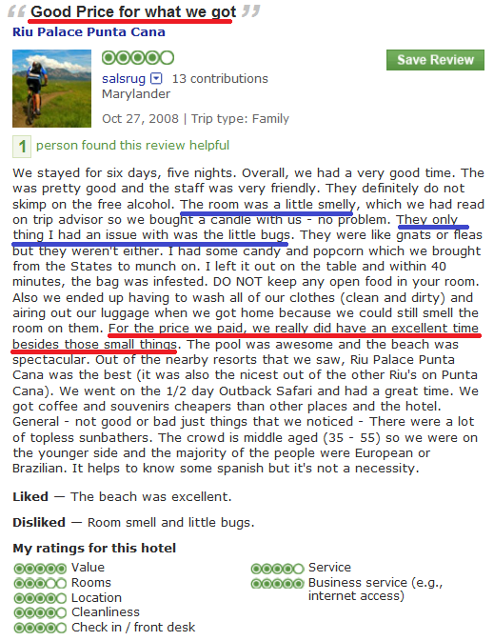
Decomposed ratings show detailed opinions of reviewers
Good price for what we got
Hotel Riu Palace Punta Cana
Reviewer | Value | Room | Location | Cleanliness
Mr.Saturday | 3.7(4.0) | 3.5(4.0) | 3.7(4.0) | 5.8(5.0)
Salsrug | 5.0(5.0) | 3.0(3.0) | 5.0(4.0) | 3.5(4.0)
“… For the price we paid,
we did have a good time besides those small things…. “

Slide 39
“By-product”: Aspect-Specific Sentiment Lexicon
Useful for tagging new review text (e.g., tweets)
Value | Rooms | Location | Cleanliness
resort 22.80 | view 28.05 | restaurant 24.47 | clean 55.35
value 19.64 | comfortable 23.15 | walk 18.89 | smell 14.38
excellent 19.54 | modern 15.82 | bus 14.32 | linen 14.25
worth 19.20 | quiet 15.37 | beach 14.11 | maintain 13.51
bad -24.09 | carpet -9.88 | wall -11.70 | smelly -0.53
money -11.02 | smell -8.83 | bad -5.40 | urine -0.43
terrible -10.01 | dirty -7.85 | road -2.90 | filthy -0.42
overprice -9.06 | stain -5.85 | website -1.67 | dingy -0.38
Positive
Negative

Slide 40
Enable comparative analysis of rating behavior & preferences
 | Expensive Hotel |  | Cheap Hotel
 | 5 Stars | 3 Stars | 5 Stars | 1 Star
Value | 0.134 | 0.148 | 0.171 | 0.093
Room | 0.098 | 0.162 | 0.126 | 0.121
Location | 0.171 | 0.074 | 0.161 | 0.082
Cleanliness | 0.081 | 0.163 | 0.116 | 0.294
Service | 0.251 | 0.101 | 0.101 | 0.049
People liking cheap hotels care most about “Value”
People liking expensive hotels
care most about “Service”
Less/no difference when they didn’t like a hotel:
All care a lot about “Cleanliness”

Slide 41
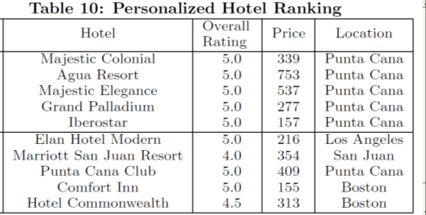
Enable personalized recommendation of entities
Non-Personalized:
Using all reviewers
Query: 0.9 value
0.1 others
Personalized: Using reviewers with similar weighting

Slide 42

Application 4: Stock Market
Market volatility
Stock trends, …
Stock traders, financial analysts,…
Events in Real World

Slide 43
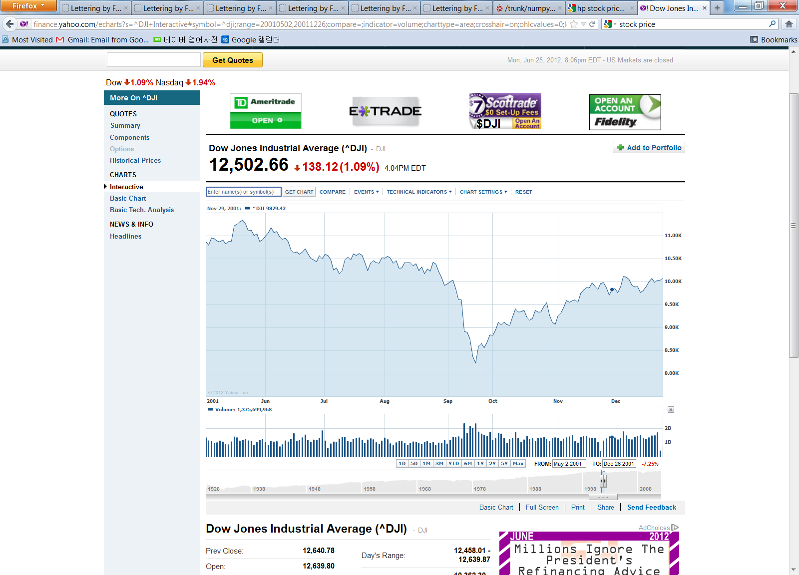
Text Mining for Understanding Time Series [Kim et al. CIKM’13]
What might have caused the stock market crash?
Sept 11 attack!
TextScope
Dow Jones Industrial Average [Source: Yahoo Finance]
…
Time
…
Time
Any clues in the companion news stream?
H. Kim, M. Castellanos, M. Hsu, C. Zhai, T. A. Rietz, D. Diermeier. Mining causal topics in text data: iterative topic modeling with time series feedback, Proceedings of ACM CIKM 2013, pp. 885-890, 2013.
Notes:
If we consider external factor, there are additional challenges.
For example, this is Dow Jones Industrial Average, average stock price.
Near September, stock price crash. Actually, this is 2001, and September 11 terrorist attack happened at that time.
Like this, these days, need for analyzing text data jointly with external temporal factor is increasing.
If we can understand why this happen, automatically find reasons, it would be very useful.

Slide 44
A General Framework for Causal Topic Modeling [Kim et al. CIKM’13]
Text Stream
Topic Modeling
Causal Topics
Topic 1
Topic 2
Topic 1
Topic 2
Sep
2001
Oct …
2001
Topic 3
Topic 4
Topic 3
Topic 4
Non-text
Time Series
Zoom into
Word Level
Feedback
as Prior
Split Words
Topic 1
W1 +
W2 --
W3 +
W4 --
W5
…
Topic 1-1
W1 +
W3 +
Causal
Words
Topic 1-2
W2 --
W4 --
H. Kim, M. Castellanos, M. Hsu, C. Zhai, T. A. Rietz, D. Diermeier. Mining causal topics in text data: iterative topic modeling with time series feedback, Proceedings of ACM CIKM 2013, pp. 885-890, 2013.

Slide 45
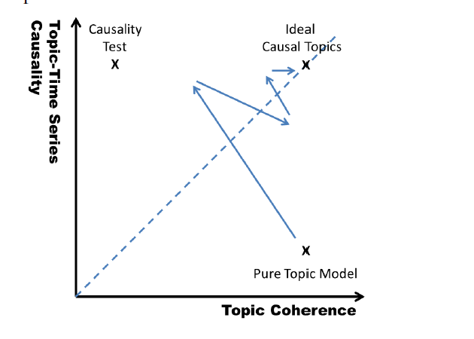
Heuristic Optimization of Causality + Coherence

Slide 46
Stock-Correlated Topics in New York Times: June 2000 ~ Dec. 2011
AAMRQ (American Airlines) | AAPL (Apple)
russia russian putin europe european germany bush gore presidential police court judge airlines airport air united trade terrorism food foods cheese nets scott basketball tennis williams open awards gay boy moss minnesota chechnya | paid notice st russia russian europe olympic games olympics she her ms oil ford prices black fashion blacks computer technology software internet com web football giants jets japan japanese plane …
Topics are biased toward each time series
Hyun Duk Kim, Malu Castellanos, Meichun Hsu, ChengXiang Zhai, Thomas A. Rietz, Daniel Diermeier. Mining causal topics in text data: iterative topic modeling with time series feedback, Proceedings of the 22nd ACM international conference on Information
and knowledge management (CIKM ’13), pp. 885-890, 2013.

Slide 47
“Causal Topics” in 2000 Presidential Election
Top Three Words in Significant Topics from NY Times
tax cut 1 screen pataki guiliani enthusiasm door symbolic oil energy prices news w top pres al vice love tucker presented partial abortion privatization court supreme abortion gun control nra
Text: NY Times (May 2000 - Oct. 2000)
Time Series: Iowa Electronic Market
http://tippie.uiowa.edu/iem/
Issues known to be
important in the
2000 presidential election

Slide 48
Retrieval with Time Series Query [Kim et al. ICTIR’13]
News
2000
2001 …
RANK | DATE | EXCERPT
1 | 9/29/2000 | Expect earning will be far below
2 | 12/8/2000 | $4 billion cash in company
3 | 10/19/2000 | Disappointing earning report
4 | 4/19/2001 | Dow and Nasdaq soar after rate cut by Federal Reserve
5 | 7/20/2001 | Apple's new retail store
… | … | …
Hyun Duk Kim, Danila Nikitin, ChengXiang Zhai, Malu Castellanos, and Meichun Hsu. 2013. Information Retrieval with Time Series Query. In Proceedings of the 2013 Conference on the Theory of Information Retrieval (ICTIR '13).

Slide 49
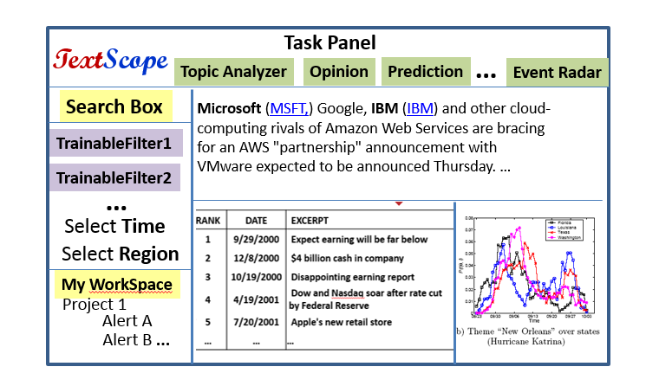

Outlook: Towards a General TextScope
Aviation Safety
Medical & Health
Products
Financial
Many others…

Slide 50
Major Challenges in Building a General TextScope
Different applications have different requirements ➔ Need abstraction
  What are the common analysis operators shared by multiple text analysis tasks?
  How can we design a general text analysis language covering many applications?
Retrieval and analysis need to be integrated ➔ A unified operator-based framework
  How can we formalize retrieval and analysis functions as multiple compatible general operators?
  How can we manage workflow?
How can we optimize human-computer collaboration?
  How can TextScope adapt to a user’s need dynamically and support personalization?
  How can humans train/teach TextScope with minimum effort?
How can we perform joint analysis of text and non-text data?
Implementation Challenges: Architecture of a general TextScope? Real-time response?

Slide 51
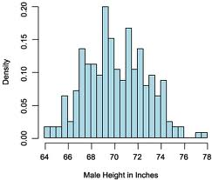

Some Possible Analysis Operators
Intersect
Select
Split
…
Union
Topic
Ranking
Interpret
Compare
Common | C1 | C2

Slide 52
Comparative Topic Analysis with CPLSA [Mei & Zhai 2006]
Choose a topic
View1
View2
View3
Draw a word from θ_{i}
Themes
Criticism of government response to the hurricane primarily consisted of criticism of its response to … The total shut-in oil production from the Gulf of Mexico … approximately 24% of the annual production and the shut-in gas production … Over seventy countries pledged monetary donations or other assistance. …
government 0.3
response 0.2..
Document
context:
Time = July 2005
Location = Texas
Author = xxx
Occup. = Sociologist
Age Group = 45+
…
government
government
response
donate 0.1
relief 0.05
help 0.02 ..
donate
donation
help
aid
New Orleans
city 0.2
new 0.1
orleans 0.05 ..
Orleans
new
Texas
July 2005
sociologist
Choose a view
Theme coverage:
……
Texas
July 2005
document
Choose a
Coverage
Qiaozhu Mei and ChengXiang Zhai. 2006. A mixture model for contextual text mining. In Proceedings KDD 2006, 649-655.

Slide 53
Comparing News Articles: Iraq War vs. Afghan War [Zhai et al. 04]
The common theme indicates that “United Nations” is involved in both wars
 | Cluster 1 | Cluster 2 | Cluster 3
Common Theme | united 0.042 nations 0.04 … | killed 0.035 month 0.032 deaths 0.023 … | …
Iraq Theme | n 0.03 Weapons 0.024 Inspections 0.023 … | troops 0.016 hoon 0.015 sanches 0.012 … | …
Afghan Theme | Northern 0.04 alliance 0.04 kabul 0.03 taleban 0.025 aid 0.02 … | taleban 0.026 rumsfeld 0.02 hotel 0.012 front 0.011 … | …
Collection-specific themes indicate different roles of “United Nations” in the two wars
ChengXiang Zhai, Atulya Velivelli, and Bei Yu. 2004. A cross-collection mixture model for comparative text mining. In Proceedings of KDD 2004, 743-748.

Slide 54
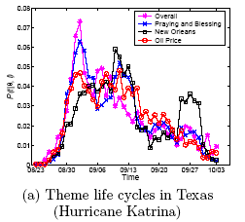
Topical Trends in Blogs: “Hurricane Katrina” [Mei et al. 06]
Oil Price
price 0.0772
oil 0.0643
gas 0.0454
increase 0.0210
product 0.0203
fuel 0.0188
company 0.0182
…
New Orleans
city 0.0634
orleans 0.0541
new 0.0342
louisiana 0.0235
flood 0.0227
evacuate 0.0211
storm 0.0177
…
Hurricane Rita
Qiaozhu Mei, Chao Liu, Hang Su, and ChengXiang Zhai. 2006. A probabilistic approach to spatiotemporal theme pattern mining on weblogs. In Proceedings of WWW 2006, 533-542
Notes:
The upper figure is the life cycles for different themes in Texas. The red line refers to a theme with the top probability words such as price, oil, gas, increase, etc, from which we know that it is talking about “oil price”. The blue one, on the other hand, talks about events that happened in the city “new orleans”. In the upper figure, we can see that both themes were getting hot during the first two weeks, and became weaker around the mid September. The theme New Orleans got strong again around the last week of September while the other theme dropped monotonically.
In the bottom figure, which is the life cycles for the same theme “New Orleans” in different states. We observe that this theme reaches
the highest probability first in Florida and Louisiana, followed by Washington and Texas, consecutively. During early September, this theme drops significantly in Louisiana while still strong in other states. We suppose this is because of the evacuation in Louisiana. Surprisingly, around late September, a re-arising pattern can be observed in most states, which is most significant in Louisiana. Since this is the time period in which Hurricane Rita arrived, we guess that Hurricane Rita has an impact on the discussion of Hurricane Katrina. This is reasonable since people
are likely to mention the two hurricanes together or make comparisons. We can find more clues to this hypothesis from Hurricane Rita data set.

Slide 55
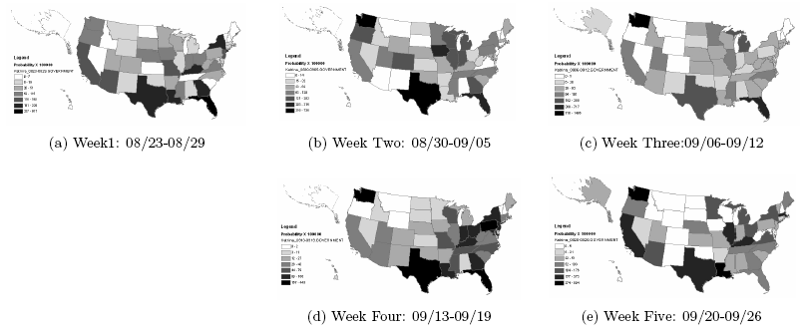
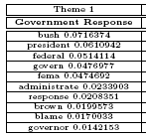
Spatiotemporal Trends of Topic “Government Response”
[Mei et al. 06]
Qiaozhu Mei, Chao Liu, Hang Su, and ChengXiang Zhai. 2006. A probabilistic approach to spatiotemporal theme pattern mining on weblogs. In Proceedings of WWW 2006, 533-542
Notes:
This slide shows the snapshot for theme ``Government Response'' over the first five weeks of Hurricane Katrina. The darker the color is, the hotter the discussion about this theme is. we observe that at the first week of Hurricane Katrina, the theme ``Government Response'‘ is the strongest in the southeast states, especially those along the Gulf of Mexico. In week 2, we can see the pattern that the theme is spreading towards the north and western states because the northern states are getting darker. In week 3, the theme is distributed even more uniformly, which means that it is spreading all over the states. However, in week 4, we observe that the theme converges to east states and southeast coast again. Interestingly, this week happens to overlap with the first week of Hurricane Rita, which may raise the public concern about government response again in those areas. In week 5, the theme becomes weak in most inland states and most of the remaining discussions are along the coasts.
Another interesting observation is that this theme is originally very strong in Louisiana (the one to the right of Texas, ), but dramatically weakened in Louisiana during week 2 and 3, and becomes strong again from the fourth week. Interestingly, Week 2 and 3 are consistent with the time of evacuation in Louisiana.

Slide 56
Event Impact Analysis: IR Research [Mei & Zhai 06]
vector 0.0514
concept 0.0298
extend 0.0297
model 0.0291
space 0.0236
boolean 0.0151
function 0.0123
feedback 0.0077
…
xml 0.0678
email 0.0197
model 0.0191
collect 0.0187
judgment 0.0102
rank 0.0097
subtopic 0.0079
…
Topic: retrieval models
SIGIR papers
term 0.1599
relevance 0.0752
weight 0.0660
feedback 0.0372
independence 0.0311
model 0.0310
frequent 0.0233
probabilistic 0.0188
document 0.0173
…
A seminal paper [Croft & Ponte 98]
1992
year
model 0.1687
language 0.0753
estimate 0.0520
parameter 0.0281
distribution 0.0268
…
Start of TREC
1998
probabilist 0.0778
model 0.0432
logic 0.0404
ir 0.0338
boolean 0.0281
…
Qiaozhu Mei and ChengXiang Zhai. 2006. A mixture model for contextual text mining. In Proceedings KDD 2006, 649-655.

Slide 57
Compound Analysis Operator: Comparison of K Topics
Select
Topic 1
…
Compare
Common | S1 | S2
Select
Topic k
Interpret
Interpret
Interpret

Slide 58
Compound Analysis Operator: Split and Compare
Split
…
Compare
Common | S1 | S2
Interpret
Interpret
Interpret

Slide 59
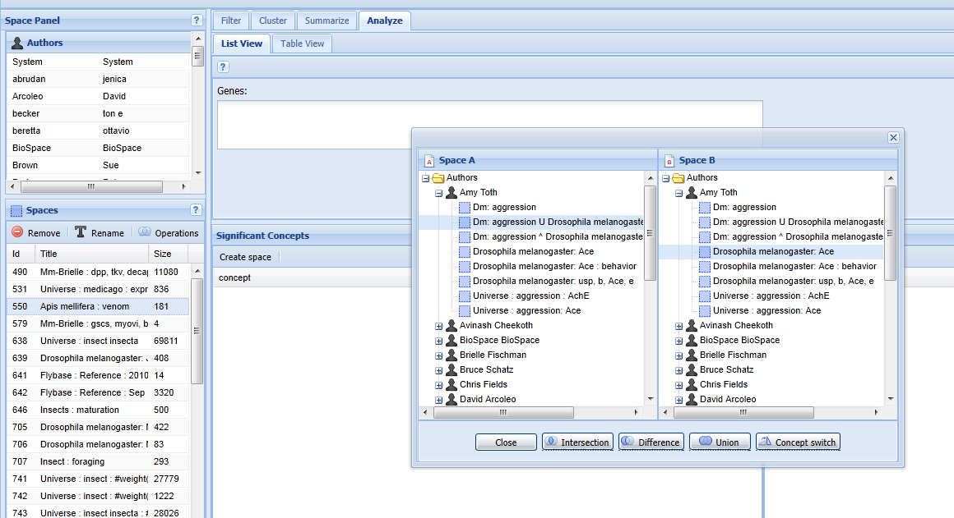
BeeSpace: Analysis Engine for Biologists [Sarma et al. 11]
Sarma, M.S., et al. (2011) BeeSpace Navigator: exploratory analysis of gene function using semantic indexing of biological literature. Nucleic Acids Research, 2011, 1-8, doi:10.1093/nar/gkr285.
Filter, Cluster, Summarize, Analyze
Persistent Workspace
Intersection, Difference, Union, …

Slide 60
Summary
Human as Subject Intelligent Sensor ➔ Broad applications of text data
  Applicable to all “big data” applications
  Especially useful for mining human behavior, preferences, and opinions
  Directly express knowledge (small text data are useful as well)
Difficulty in NLP ➔ Must have human in the loop, thus need to optimize the collaboration of humans and machines
  Let computers and humans do what they are good at respectively (supervised learning is a special case of human-computer collaboration!)
Vision of TextScope: many applications & many new challenges
  Integration of intelligent retrieval and text analysis
  Joint analysis of text and non-textual (context) data
  Optimization of the combined intelligence of computer and humans

Slide 61
Beyond TextScope: From Assistive AI to Autonomous AI
DataScope
Autonomous AI
Assistive AI
...
TextScope
Intelligent
Task Agents
…
…
Predicted Values
of Real World Variables
Predictive
Model
Multiple
Predictors
(Features)
Learning to interact
Domain Knowledge
…
Learning to explore
Optimal Decision Making
Prediction
Learning to collaborate
…
Text + Non-Text
Sensor 1
Joint Mining of Non-Text
and Text
Real World
Non-Text
Data
Analysis of
non-text data
Interactive
text analysis
Sensor k
…
Text
Data
Interactive information retrieval
Natural language processing

Slide 62
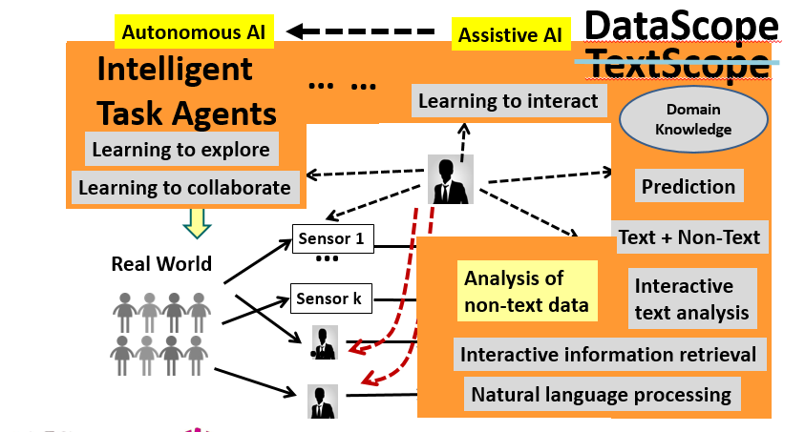
Long-Term Challenges
New Challenges
Minimize total effort of user
4. Optimization of Human-Computer Collaboration？
Minimize operation cost of system
5. Many New Machine Learning Challenges
Learn to model a task?
Learn to model a user?
Learn to model a system？
Learn to collaborate with users?
Continuous learning？
3. Knowledge Base？
2. Text + Non-Text Analysis？
6. General Systems?
7. Robustness and Security?
1. Data (Text) Understanding？

Slide 63
If time permitting, some on-going work on optimization of human-computer collaboration…

Slide 64
Optimization of Human-Computer Collaboration:
Human-Computer Interaction = Cooperative Game-Playing
Players: Player 1= computer system; Player 2= user
Rules of game:
  Player take turns to make “moves”
    User move = user action
    System move = show an “interface card”
  For each action taken by user, system responds by showing an interface card
  For each interface card shown, user responds by taking an action
  First move = User starts an application software with a particular configuration
  Last move = User stops using the system (with task either finished or not)
Objective: help the user complete the task with minimum effort & minimum operating cost for system

Slide 65
Example of cooperative game-playing: search engine
(Finish a user task
with minimum effort)
(Help user finish a task
with minimum effort, minimum system cost)
User
System
A₁ : Enter a query
Which information items to present?
How to present them?
Which items
to view?
R₁: results (i=1, 2, 3, …)
Which aspects/parts of the item
to show? How?
Interface Card
A₂ : View item
No
View more?
R₂: Item summary/preview
A₃ : Scroll down or click on
“Back”/”Next” button

Slide 66
Bayesian Decision Theory for Optimal Interactive Retrieval [Zhai 2016]
Observed
User Model
Knowledge State
(seen items,
readability level, …)
Situation: S
User: U
Interaction history: H
Current user action: A_{t}
Document collection: C
M=(K, θ_{U},B, T,… )
Task
Information
need
Browsing behavior
All possible responses:
r(A_{t})={r₁, …, r_{n}}
L(r_{i},M,S)
Loss Function
Optimal response: r* (minimum loss)
Bayes risk
Inferred
Observed
ChengXiang Zhai. Towards a game-theoretic framework for text data retrieval, IEEE Data Eng. Bull. 39(3): 51-62 (2016).

Slide 67

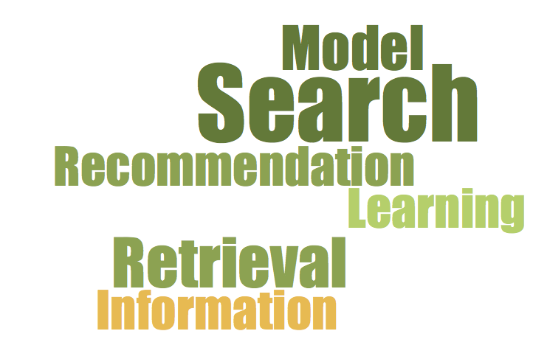
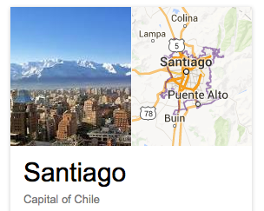
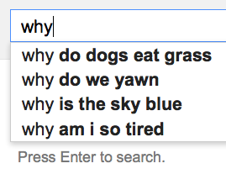
Example of Instantiation:
Information Card Model [Zhang & Zhai 15]
How to optimize the interface design?
… or a combination of some of these?
How to allocate screen space among different blocks?
Interface card model [Zhang & Zhai 15] enables generation of an
optimal adaptive interface automatically using an algorithm …
Yinan Zhang, ChengXiang Zhai, Information Retrieval as Card Playing: A Formal Model for Optimizing Interactive Retrieval Interface. In Proceedings of ACM SIGIR 2015, pp. 685-694.

Slide 68
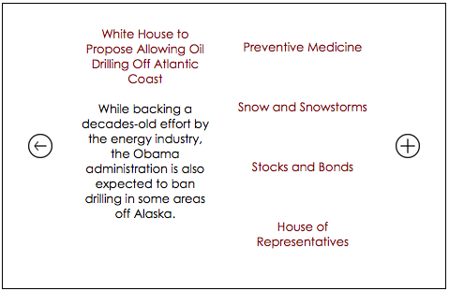
Sample Interface: Medium sized screen

Slide 69
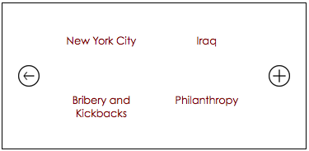

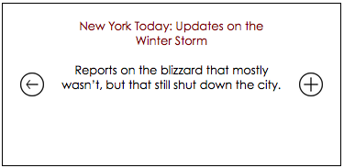
Sample Interface: Smaller screen

Slide 70
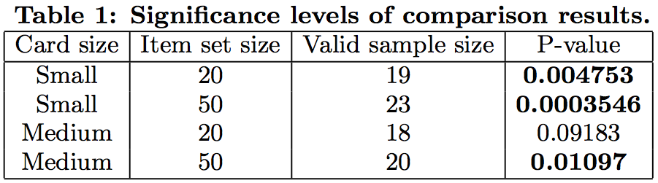
Algorithm-generated interface > Human-generated
[Zhang & Zhai 2015]
Smaller screen
+
More items
➔ More advantage
Yinan Zhang, ChengXiang Zhai, Information Retrieval as Card Playing: A Formal Model for Optimizing Interactive Retrieval Interface. In Proceedings of ACM SIGIR 2015, pp. 685-694.

Slide 71
References
H. Kim, M. Castellanos, M. Hsu, C. Zhai, T. A. Rietz, D. Diermeier. Mining causal topics in text data: iterative topic modeling with time series feedback, Proceedings of ACM CIKM 2013, pp. 885-890, 2013.
Hyun Duk Kim, Danila Nikitin, ChengXiang Zhai, Malu Castellanos, and Meichun Hsu. 2013. Information Retrieval with Time Series Query. In Proceedings of the 2013 Conference on the Theory of Information Retrieval (ICTIR '13).
Qiaozhu Mei, Chao Liu, Hang Su, and ChengXiang Zhai. 2006. A probabilistic approach to spatiotemporal theme pattern mining on weblogs. In Proceedings of WWW 2006, 533-542
Qiaozhu Mei and ChengXiang Zhai. 2006. A mixture model for contextual text mining. In Proceedings KDD 2006, 649-655.
Sarma, M.S., et al. (2011) BeeSpace Navigator: exploratory analysis of gene function using semantic indexing of biological literature. Nucleic Acids Research, 2011, 1-8, doi:10.1093/nar/gkr285.
Hongning Wang, Yue Lu, ChengXiang Zhai. Latent Aspect Rating Analysis on Review Text Data: A Rating Regression Approach, Proceedings of the 17th ACM SIGKDD International Conference on Knowledge Discovery and Data Mining (KDD'10), pages 115-124, 2010.
Hongning Wang, Yue Lu, ChengXiang Zhai, Latent Aspect Rating Analysis without Aspect Keyword Supervision, Proceedings of KDD 2011, pages 618-626.

Slide 72
References (cont.)
Sheng Wang et al. 2014. SideEffectPTM: an unsupervised topic model to mine adverse drug reactions from health forums. In ACM BCB 2014.
S. Wang, E. Huang, R. Zhang, X. Zhang, B. Liu. X. Zhou, C. Zhai, A Conditional Probabilistic Model for Joint Analysis of Symptoms, Diseases, and Herbs in Traditional Chinese Medicine Patient Records, IEEE BIBM 2016.
Yintao Yu, Cindy X. Lin, Yizhou Sun, Chen Chen, Jiawei Han, Binbin Liao, Tianyi Wu, ChengXiang Zhai, Duo Zhang, and Bo Zhao, “iNextCube: Information Network-Enhanced Text Cube", Proc. 2009 Int. Conf. on Very Large Data Bases (VLDB'09) (system demo), 2009
ChengXiang Zhai, Towards a game-theoretic framework for text data retrieval. IEEE Data Eng. Bull. 39(3): 51-62 (2016)
Duo Zhang, ChengXiang Zhai, Jiawei Han, Ashok Srivastava, Nikunj Oza. Topic Modeling for OLAP on Multidimensional Text Databases: Topic Cube and its Applications, Statistical Analysis and Data Mining, Vol. 2, pp.378-395, 2010.
Yinan Zhang, ChengXiang Zhai, Information Retrieval as Card Playing: A Formal Model for Optimizing Interactive Retrieval Interface. In Proceedings of ACM SIGIR 2015, pp. 685-694.

Slide 73











Acknowledgments
Collaborators: Many former and current TIMAN group members, UIUC colleagues, and many external collaborators
Funding

Slide 74
Looking forward to opportunities for collaboration!
Thank You!
More information about our work can be found at
http://timan.cs.uiuc.edu/
czhai@Illinois.edu

