Slide 1
Beyond Search: Statistical Topic Models for Text Analysis
ChengXiang Zhai
Department of Computer Science
University of Illinois at Urbana-Champaign
http://www.cs.uiuc.edu/homes/czhai

Slide 2

Search is a means to the end of finishing a task
Search
Information Synthesis
& Analysis
Task Completion
Search 1
Search 2
…
Decision Making
Learning
…
Information Interpretation
Information Synthesis
Potentially iterate…
Multiple Searches

Slide 3
Example Task 1: Comparing News Articles
Vietnam War
Afghan War
Iraq War
CNN
Fox
BBC
Before 9/11
During Iraq war
Post-Iraq war
US blog
European blog
Asian blog
What’s in common? What’s unique?
Common Themes | “Vietnam” specific | “Afghan” specific | “Iraq” specific
United nations | … | … | …
Death of people | … | … | …
… | … | … | …

Slide 4
Example Task 2: Compare Customer Reviews
IBM Laptop
Reviews
APPLE Laptop
Reviews
DELL Laptop
Reviews
Common Themes | “IBM” specific | “APPLE” specific | “DELL” specific
Battery Life | …. | … | ….
Hard disk | … | … | …
Speed | … | … | …
Which laptop to buy?

Slide 5
Example Task 3:
Identify Emerging Research Topics
What’s hot in database research?

Slide 6
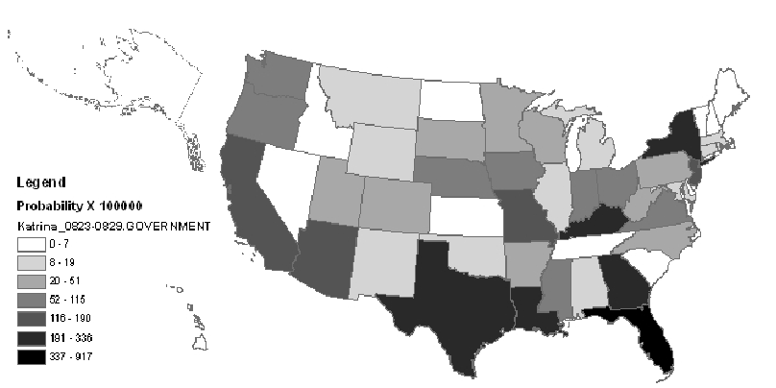
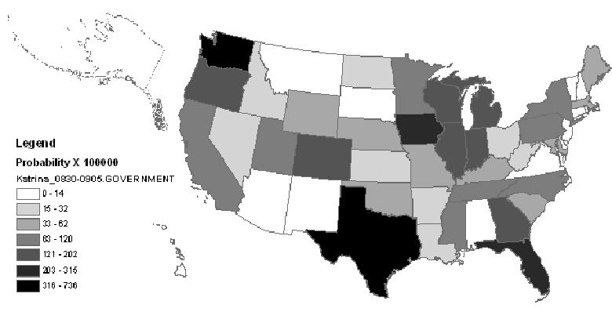
Example Task 4: Analysis of Topic Diffusion
One Week Later
How did a discussion of a topic in blogs spread?

Slide 7




Sample Task 5:
Opinion Analysis on Blog Articles
Query=“Da Vinci Code”
Tom Hanks, who is my favorite movie star act the leading role.
protesting... will lose your faith by watching the movie.
... so sick of people making such a big deal about a fiction book
a good book to past time.
What did people like/dislike about “Da Vinci Code”?

Slide 8
Questions
Can we model all these analysis problems in a general way?
Can we solve these problems with a unified approach?
How can we bring users into the loop?
Yes!
Yes!
Yes!
Solutions: Statistical Topic Models

Slide 9
Rest of the talk
Overview of Statistical Topic Models
Contextual Probabilistic Latent Semantic Analysis (CPLSA)
Text Analysis Enabled by CPLSA
From Search Engines to Analysis Engines

Slide 10
What is a Statistical LM?
A probability distribution over word sequences
  p(“Today is Wednesday”) ≈ 0.001
  p(“Today Wednesday is”) ≈ 0.0000000000001
  p(“The eigenvalue is positive”) ≈ 0.00001
Context/topic dependent!
Can also be regarded as a probabilistic mechanism for “generating” text, thus also called a “generative” model

Slide 11
The Simplest Language Model
(Unigram Model)
Generate a piece of text by generating each word independently
Thus, p(w₁ w₂ ... w_{n})=p(w₁)p(w₂)…p(w_{n})
Parameters: {p(w_{i})} p(w₁)+…+p(w_{N})=1 (N is voc. size)
Essentially a multinomial distribution over words
A piece of text can be regarded as a sample drawn according to this word distribution

Slide 12
Text Generation with Unigram LM
(Unigram) Language Model θ
p(w| θ)
Sampling
Document d
…
text 0.2
mining 0.1
assocation 0.01
clustering 0.02
…
food 0.00001
…
Text mining
paper
Topic 1:
Text mining
Given θ, p(d| θ) varies according to d
…
food 0.25
nutrition 0.1
healthy 0.05
diet 0.02
…
Topic 2:
Health
Food nutrition
paper

Slide 13
Estimation of Unigram LM
(Unigram) Language Model θ
p(w| θ)=?
Estimation
Document
…
text ?
mining ?
assocation ?
database ?
…
query ?
…
text 10
mining 5
association 3
database 3
algorithm 2
…
query 1
efficient 1
10/100
5/100
3/100
3/100
1/100
Total #words
=100
language model as topic representation?

Slide 14
Language Model as Text Representation:
Early Work
1961: H. P. Luhn’s early idea of using relative frequency to represent text [Luhn 61]
1976: Robertson & Sparck Jones’ BIR model [Robertson & Sparck Jones 76]
1989: Wong & Yao’s work on multinomial distribution representation [Wong & Yao 89]
Luhn, H. P (1961) The automatic derivation of information retrieval encodements from machine-readable texts. In A. Kent (Ed.), Information Retrieval and Machine Translation, Vol. 3, Pt 2., pp. 1021-1028.
S. Robertson and K. Sparck Jones. (1976). Relevance Weighting of Search Terms. JASIS, 27, 129-146.
S. K. M. Wong and Y. Y. Yao (1989), A probability distribution model for information retrieval. Information Processing and Management, 25(1):39--53.

Slide 15
Language Model as Text Representation:
Two Important Milestones in 1998~1999
1998: Language model for retrieval (i.e., query likelihood scoring [Ponte & Croft 98] (and also independently [ Hiemstra & Kraaij 99])
1999: Probabilistic Latent Semantic Analysis (PLSA) [Hofmann 99]
J. M. Ponte and W. B. Croft. A language modeling approach to information retrieval. In Proceedings of ACM-SIGIR 1998, pages 275-281.
D. Hiemstra and W. Kraaij, Twenty-One at TREC-7: Ad-hoc and Cross-language track, In Proceedings of the Seventh Text REtrieval Conference (TREC-7), 1999.
Thomas Hofmann: Probabilistic Latent Semantic Analysis. UAI 1999: 289-296

Slide 16
Probabilistic Latent Semantic Analysis (PLSA)
ipod
nano
music
download
apple
0.15
0.080.05
0.02
0.01
ipod 0.15
Topic 1
Apple iPod
I
downloaded
the
music
of
the
movie
movie
harry
potter
actress
music
0.100.090.05
0.04
0.02
harry
potter
to
harry 0.09
Topic 2
my
ipod
nano
Harry Potter

Slide 17
Parameter Estimation
Maximizing data likelihood:
Parameter Estimation using EM algorithm
Prior set by users
Pseudo-Counts
ipod
nano
music
download
apple
0.150.080.05
0.02
0.01
?
?
?
?
?
Guess the affiliation
I
I
I
I
downloaded
downloaded
downloaded
downloaded
the
the
the
the
music
music
music
music
of
of
of
of
the
the
the
the
movie
movie
movie
movie
movie
harry
potter
actress
music
0.100.090.05
0.04
0.02
?
?
?
?
?
harry
harry
harry
harry
potter
potter
potter
potter
to
to
to
to
Estimate the params
my
my
my
my
ipod
ipod
ipod
ipod
nano
nano
nano
nano

Slide 18

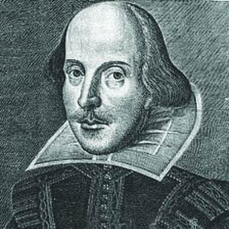

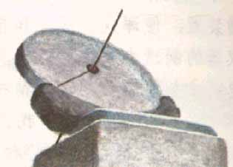


Context Features of a Document
Weblog Article
communities
Author
source
Time
Location
Author’s Occupation
Notes:
Compared with other kinds of data, Weblogs have some interesting special characteristics, which make it interesting to exploit for text mining.

Slide 19
A General View of Context
papers written in 1998
1998
1999
……
……
Partition of documents
Any combination of context features (metadata) can define a context
2005
2006
papers written by Bruce Croft
WWW
SIGIR
ACL
KDD
SIGMOD

Slide 20
Empower PLSA with Context [Mei & Zhai 06]
Make topics depend on context variables
Text is generated from a contextualized PLSA model (CPLSA)
Fitting such a model to text enables a wide range of analysis tasks involving topics and context
Qiaozhu Mei, ChengXiang Zhai, A Mixture Model for Contextual Text Mining, Proceedings of the 2006 ACM SIGKDD International Conference on Knowledge Discovery and Data Mining , (KDD'06 ), pages 649-655

Slide 21
Contextual Probabilistic Latent Semantics Analysis
View1
View2
View3
Choose a theme
Themes
Draw a word from θ_{i}
Criticism of government response to the hurricane primarily consisted of criticism of its response to … The total shut-in oil production from the Gulf of Mexico … approximately 24% of the annual production and the shut-in gas production … Over seventy countries pledged monetary donations or other assistance. …
Document
context:
Time = July 2005
Location = Texas
Author = xxx
Occup. = Sociologist
Age Group = 45+
…
government 0.3
response 0.2..
government
government
response
donate 0.1
relief 0.05
help 0.02 ..
donate
donation
help
aid
city 0.2
new 0.1
orleans 0.05 ..
New Orleans
Orleans
new
Texas
July 2005
sociologist
Choose a view
Theme coverages:
……
Choose a
Coverage
Texas
July 2005
document

Slide 22
Comparing News Articles
Iraq War (30 articles) vs. Afghan War (26 articles)
The common theme indicates that “United Nations” is involved in both wars
 | Cluster 1 | Cluster 2 | Cluster 3
Common Theme | united 0.042 nations 0.04 … | killed 0.035 month 0.032 deaths 0.023 … | …
Iraq Theme | n 0.03 Weapons 0.024 Inspections 0.023 … | troops 0.016 hoon 0.015 sanches 0.012 … | …
Afghan Theme | Northern 0.04 alliance 0.04 kabul 0.03 taleban 0.025 aid 0.02 … | taleban 0.026 rumsfeld 0.02 hotel 0.012 front 0.011 … | …
Collection-specific themes indicate different roles of “United Nations” in the two wars

Slide 23
Spatiotemporal Patterns in Blog Articles
Query= “Hurricane Katrina”
Topics in the results:
Spatiotemporal patterns

Slide 24
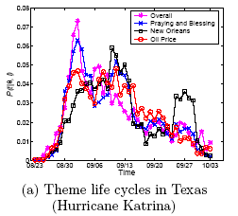
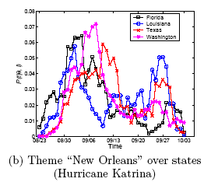
Theme Life Cycles (“Hurricane Katrina”)
Oil Price
price 0.0772
oil 0.0643
gas 0.0454
increase 0.0210
product 0.0203
fuel 0.0188
company 0.0182
…
New Orleans
city 0.0634
orleans 0.0541
new 0.0342
louisiana 0.0235
flood 0.0227
evacuate 0.0211
storm 0.0177
…
Notes:
The upper figure is the life cycles for different themes in Texas. The red line refers to a theme with the top probability words such as price, oil, gas, increase, etc, from which we know that it is talking about “oil price”. The blue one, on the other hand, talks about events that happened in the city “new orleans”. In the upper figure, we can see that both themes were getting hot during the first two weeks, and became weaker around the mid September. The theme New Orleans got strong again around the last week of September while the other theme dropped monotonically.
In the bottom figure, which is the life cycles for the same theme “New Orleans” in different states. We observe that this theme reaches
the highest probability first in Florida and Louisiana, followed by Washington and Texas, consecutively. During early September, this theme drops significantly in Louisiana while still strong in other states. We suppose this is because of the evacuation in Louisiana. Surprisingly, around late September, a re-arising pattern can be observed in most states, which is most significant in Louisiana. Since this is the time period in which Hurricane Rita arrived, we guess that Hurricane Rita has an impact on the discussion of Hurricane Katrina. This is reasonable since people
are likely to mention the two hurricanes together or make comparisons. We can find more clues to this hypothesis from Hurricane Rita data set.

Slide 25
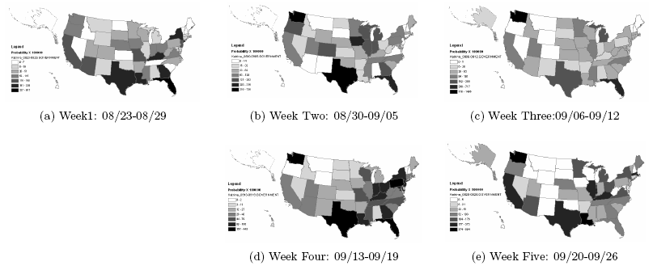
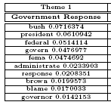
Theme Snapshots (“Hurricane Katrina”)
Week2: The discussion moves towards the north and west
Week1: The theme is the strongest along the Gulf of Mexico
Week3: The theme distributes more uniformly over the states
Week4: The theme is again strong along the east coast and the Gulf of Mexico
Week5: The theme fades out in most states
Notes:
This slide shows the snapshot for theme ``Government Response'' over the first five weeks of Hurricane Katrina. The darker the color is, the hotter the discussion about this theme is. we observe that at the first week of Hurricane Katrina, the theme ``Government Response'‘ is the strongest in the southeast states, especially those along the Gulf of Mexico. In week 2, we can see the pattern that the theme is spreading towards the north and western states because the northern states are getting darker. In week 3, the theme is distributed even more uniformly, which means that it is spreading all over the states. However, in week 4, we observe that the theme converges to east states and southeast coast again. Interestingly, this week happens to overlap with the first week of Hurricane Rita, which may raise the public concern about government response again in those areas. In week 5, the theme becomes weak in most inland states and most of the remaining discussions are along the coasts.
Another interesting observation is that this theme is originally very strong in Louisiana (the one to the right of Texas, ), but dramatically weakened in Louisiana during week 2 and 3, and becomes strong again from the fourth week. Interestingly, Week 2 and 3 are consistent with the time of evacuation in Louisiana.

Slide 26
Theme Life Cycles (KDD Papers)
gene 0.0173
expressions 0.0096
probability 0.0081
microarray 0.0038
…
marketing 0.0087
customer 0.0086
model 0.0079
business 0.0048
…
rules 0.0142
association 0.0064
support 0.0053
…

Slide 27
Theme Evolution Graph: KDD
1999
2000
2001
2002
2003
2004
T
web 0.009
classifica –tion 0.007
features0.006
topic 0.005
…
SVM 0.007
criteria 0.007
classifica – tion 0.006
linear 0.005
…
mixture 0.005
random 0.006
cluster 0.006
clustering 0.005
variables 0.005
…
topic 0.010
mixture 0.008
LDA 0.006
semantic
0.005
…
decision 0.006
tree 0.006
classifier 0.005
class 0.005
Bayes 0.005
…
…
Classifica
- tion 0.015
text 0.013
unlabeled 0.012
document 0.008
labeled 0.008
learning 0.007
…
Informa
- tion 0.012
web 0.010
social 0.008
retrieval 0.007
distance 0.005
networks 0.004
…
…
…
…

Slide 28
Multi-Faceted Sentiment Summary
(query=“Da Vinci Code”)
 | Neutral | Positive | Negative
Facet 1: Movie | ... Ron Howards selection of Tom Hanks to play Robert Langdon. | Tom Hanks stars in the movie,who can be mad at that? | But the movie might get delayed, and even killed off if he loses.
 | Directed by: Ron Howard Writing credits: Akiva Goldsman ... | Tom Hanks, who is my favorite movie star act the leading role. | protesting ... will lose your faith by ... watching the movie.
 | After watching the movie I went online and some research on ... | Anybody is interested in it? | ... so sick of people making such a big deal about a FICTION book and movie.
Facet 2: Book | I remembered when i first read the book, I finished the book in two days. | Awesome book. | ... so sick of people making such a big deal about a FICTION book and movie.
 | I’m reading “Da Vinci Code” now. … | So still a good book to past time. | This controversy book cause lots conflict in west society.

Slide 29
Separate Theme Sentiment Dynamics
“book”
“religious beliefs”

Slide 30
Event Impact Analysis: IR Research
xml 0.0678
email 0.0197
model 0.0191
collect 0.0187
judgment 0.0102
rank 0.0097
subtopic 0.0079
…
vector 0.0514
concept 0.0298
extend 0.0297
model 0.0291
space 0.0236
boolean 0.0151
function 0.0123
feedback 0.0077
…
Theme: retrieval models
SIGIR papers
term 0.1599
relevance 0.0752
weight 0.0660
feedback 0.0372
independence 0.0311
model 0.0310
frequent 0.0233
probabilistic 0.0188
document 0.0173
…
Publication of the paper “A language modeling approach to information retrieval”
1992
year
1998
Starting of the TREC conferences
model 0.1687
language 0.0753
estimate 0.0520
parameter 0.0281
distribution 0.0268
probable 0.0205
smooth 0.0198
markov 0.0137
likelihood 0.0059
…
probabilist 0.0778
model 0.0432
logic 0.0404
ir 0.0338
boolean 0.0281
algebra 0.0200
estimate 0.0119
weight 0.0111
…

Slide 31
Many Other Variations
Latent Dirichlet Allocation (LDA) [Blei et al. 03]
  Impose priors on topic choices and word distributions
  Make PLSA a generative model
Many variants of LDA!
In practice, LDA and PLSA variants tend to work equally well for text analysis [Lu et al. 11]
[Blei et al. 02] D. Blei, A. Ng, and M. Jordan. Latent dirichlet allocation. In T G Dietterich, S. Becker, and Z. Ghahramani, editors, Advances in Neural Information Processing Systems 14, Cambridge, MA, 2002. MIT Press.
Yue Lu, Qiaozhu Mei, ChengXiang Zhai. Investigating Task Performance of Probabilistic Topic Models - An Empirical Study of PLSA and LDA, Information Retrieval, vol. 14, no. 2, April, 2011.

Slide 32
Other Uses of Topic Models for Text Analysis
Topic analysis on social networks [Mei et al. 08]
Opinion Integration [Lu & Zhai 08]
Latent Aspect Rating Analysis [Wang et al. 10]
Qiaozhu Mei, Deng Cai, Duo Zhang, ChengXiang Zhai. Topic Modeling with Network Regularization, Proceedings of the World Wide Conference 2008 ( WWW'08), pages 101-110.
Yue Lu, ChengXiang Zhai. Opinion Integration Through Semi-supervised Topic Modeling, Proceedings of the World Wide Conference 2008 ( WWW'08), pages 121-130.
Hongning Wang, Yue Lu, ChengXiang Zhai. Latent Aspect Rating Analysis on Review Text Data: A Rating Regression Approach, Proceedings of the 17th ACM SIGKDD International Conference on Knowledge Discovery and Data Mining (KDD'10), pages 115-124, 2010.

Slide 33
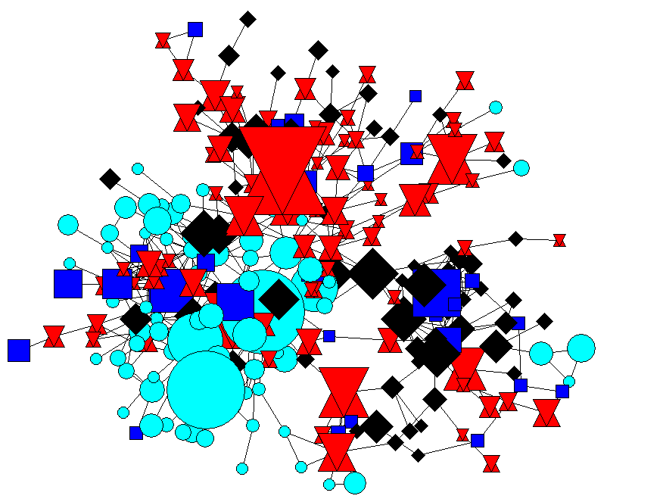
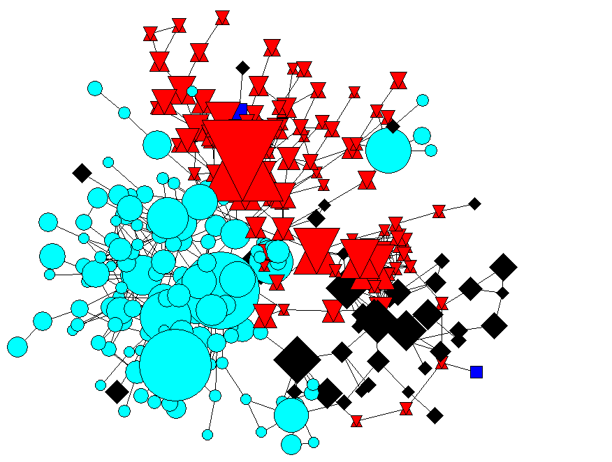
Topic Modeling + Social Networks: who work together on what?
  Authors writing about the same topic form a community
Separation of 3 research communities: IR, ML, Web
Topic Model Only
Topic Model + Social Network

Slide 34
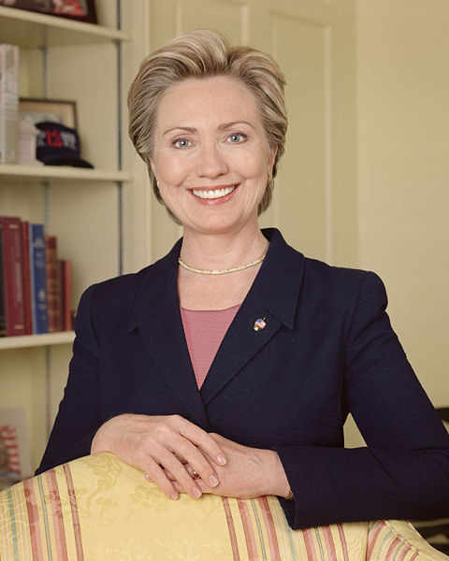
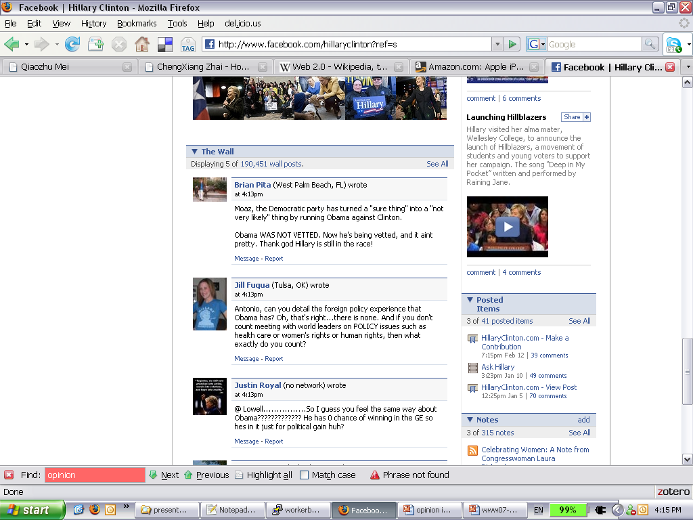
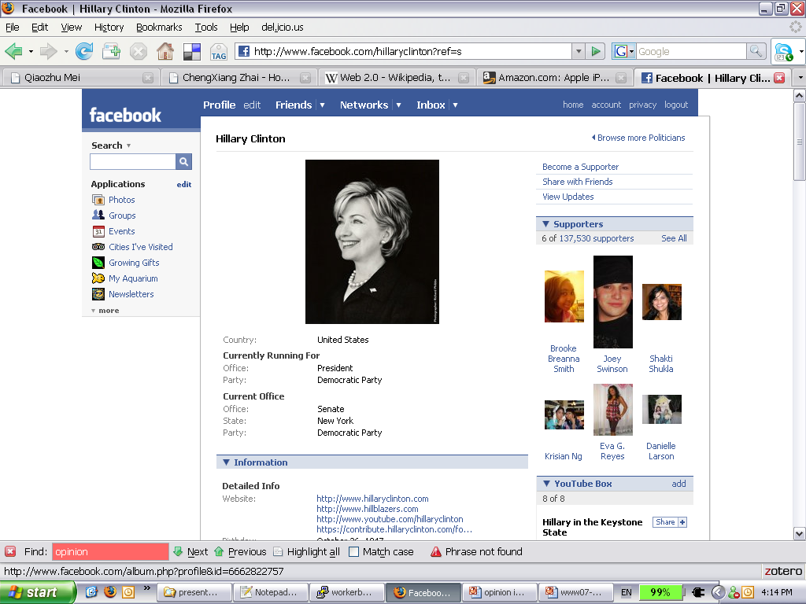
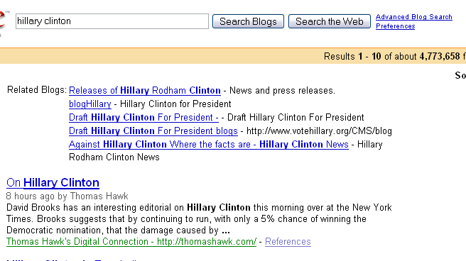

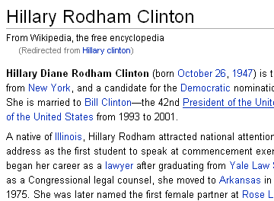

Topic Model for Opinion Integration
How to digest all?
190,451 posts
4,773,658 results
Notes:
Why do we need to integrate opinions?
Web 2.0 technology has enabled more and more people to freely express their opinions on the Web in various ways such as customer reviews, internet forums, discussion groups, and Weblogs. Web has become an extremely valuable source which covers a wide range of topics and a huge amount of opinions.
For instance, given a topic about a presidential candidate hillary clinton, there is a quite comprehensive article in the wikipedia; there are nearly 200,000 posts in facebook and we get over 4 million results from blog search and many many others.
But with such a large scale of information source, how could a user to digest all the opinions from different sources

Slide 35
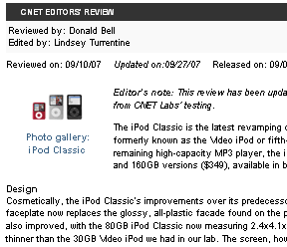

Two Kinds of Opinions
190,451 posts
4,773,658 results
How to benefit from both?
Expert opinions
CNET editor’s review Wikipedia article
Well-structured Easy to access
Maybe biased Outdated soon
Ordinary opinions
Forum discussions Blog articles
Represent the majority Up to date
Hard to access fragmental
Notes:
Generally, there are two kinds of opinion sources. One kind called expert opinions is opinions expressed in some well-structured relatively complete review typically written by some expert, such as wiki articles and cnet product reviews. The other is ordinary opinions which are fragmental opinions scattering around in blog articles and forums.
These two kinds of opinions both have adv and disadv. Apparently expert opinions are very useful since they are well written and easy to access through those service websites. However, they may be biased and could become outdated soon. On contrary, ordinary opinions tend to represent the general opinions of large number of people and get refreshed quickly. But they are fragmental and hard to digest.
How can we benefit from both kinds of opinions?

Slide 36
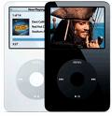
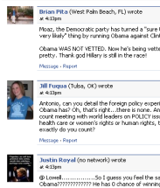
Generate an Integrative Summary
Output
Input
Similar
opinions
Supplementary
opinions
Topic: iPod
Review Aspects
Design
Battery
Price
cute… tiny… | ..thicker..
last many hrs | die out soon
could afford it | still expensive
DesignBatteryPrice..
Expert review with aspects
Extra Aspects
Text collection of ordinary opinions, e.g. Weblogs
iTunes | … easy to use…
warranty | …better to extend..
Integrated Summary
Notes:
We take the input of a topic, could be a product, a person or an event; an expert review which contains expert opinions on different aspects of the topic; and a text collection of ordinary opinions, which could be weblogs or forums data.
In the output, we hope to remain the well written expert review, and we also extract useful info from the collection ordinary opinions. Some of the ordinary opinions are aligned with the aspects in expert reviews; we also want to discover opinions on some extra aspects. We further separate ordinary opinions that are similar to expert opinions from those that supplementary.
we are essentially to use the expert review as a “template" to mine text data for ordinary opinions and generate a integrated summary to help user best digest the opinions.
Note that we taka a broad definition of opinion in this paper. We do not consider the subjectivity or polarity. Theoretically we could apply any sentiment analysis technique after such summary is generated.

Slide 37
Methods
Semi-Supervised Probabilistic Latent Semantic Analysis (PLSA)
  The aspects extracted from expert reviews serve as clues to define a conjugate prior on topics
  Maximum a Posteriori (MAP) estimation
  Repeated applications of PLSA to integrate and align opinions in blog articles to expert review

Slide 38
Results: Product (iPhone)
Opinion Integration with review aspects
Review article | Similar opinions | Supplementary opinions
You can make emergency calls, but you can't use any other functions… | N/A | … methods for unlocking the iPhone have emerged on the Internet in the past few weeks, although they involve tinkering with the iPhone hardware…
rated battery life of 8 hours talk time, 24 hours of music playback, 7 hours of video playback, and 6 hours on Internet use. | iPhone will Feature Up to 8 Hours of Talk Time, 6 Hours of Internet Use, 7 Hours of Video Playback or 24 Hours of Audio Playback | Playing relatively high bitrate VGA H.264 videos, our iPhone lasted almost exactly 9 freaking hours of continuous playback with cell and WiFi on (but Bluetooth off).
Unlock/hack iPhone
Confirm the opinions from the review
Activation
Additional info under real usage
Battery
Notes:
Firstly, we show the opin integration with review aspects. The three columns are review, similar, supp. The rows are different aspects. The first aspect shown is about activation of iphone, it talks about the result if you do not activate it. Our method discovered some supp opinoins about unclock or hack iphone. This kind of info is not mentioned at all in the expert review but would be interesting to know.
The next aspect is about battery life. We found similar opinions saying iphone could support xxx, it confirms the opinions from review. In addition, we also extracted opinions on battery life under real usage. This is quite useful for a potential buyer.

Slide 39
Results: Product (iPhone)
Opinions on extra aspects
support | Supplementary opinions on extra aspects
15 | You may have heard of iASign … an iPhone Dev Wiki tool that allows you to activate your phone without going through the iTunes rigamarole.
13 | Cisco has owned the trademark on the name "iPhone" since 2000, when it acquired InfoGear Technology Corp., which originally registered the name.
13 | With the imminent availability of Apple's uber cool iPhone, a look at 10 things current smartphones like the Nokia N95 have been able to do for a while and that the iPhone can't currently match...
Another way to activate iPhone
iPhone trademark originally owned by Cisco
A better choice for smart phones?
Notes:
We also display a few most supported opinions on extra aspects. The first points out another way to activate iphone; the second provides some related info that “”; the third recommends nokia n95 saying it is a better choice of smart phones.
These opinions on extra aspects are useful for potential buyers, current customers, or just people who want to know more about the hot product.

Slide 40
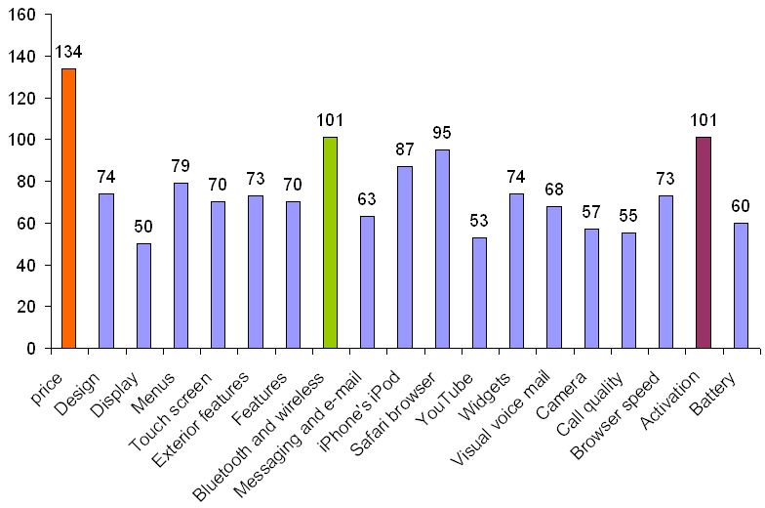
Results: Product (iPhone)
Support statistics for review aspects
People care about price
Controversy: activation requires contract with AT&T
People comment a lot about the unique wi-fi feature
Notes:
If we sum up the support of representative opinions, we could plot the support stat for review aspects. The colored ones are the three most supported review aspects. Appraently people care a lot about the price. The unique wi-fi feature of iphone received lots of comments. And there are lots of controversy that activation of iphone requires a two-year contract with AT&T.
This kind of information could help the product company get to know a high level feedback of their product and potentially support better business decisions.

Slide 41




Latent Aspect Rating Analysis
How to infer aspect ratings?
How to infer aspect weights?
Value Location Service …..
Value Location Service …..

Slide 42
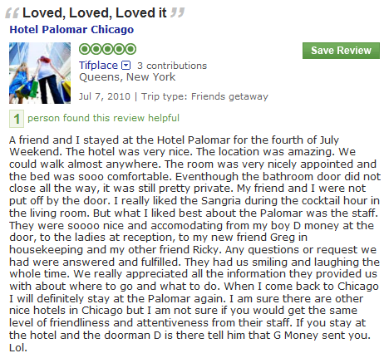
Solution: Latent Rating Regression Model
Aspect Segmentation
+
Latent Rating Regression
Reviews + overall ratings
Aspect segments
Term weights
Aspect Rating
Aspect Weight
location:1
amazing:1
walk:1
anywhere:1
0.0
0.9
0.1
0.3
1.3
0.2
room:1
nicely:1
appointed:1
comfortable:1
0.1
0.7
0.1
0.9
1.8
0.2
nice:1
accommodating:1
smile:1
friendliness:1
attentiveness:1
0.6
0.8
0.7
0.8
0.9
3.8
0.6
Topic model for aspect discovery

Slide 43
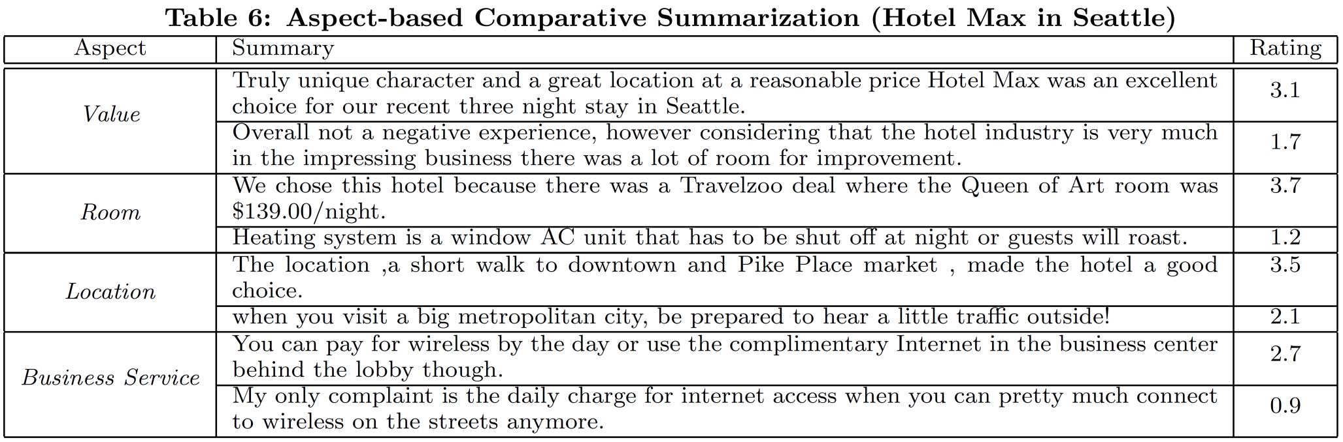
Aspect-Based Opinion Summarization

Slide 44
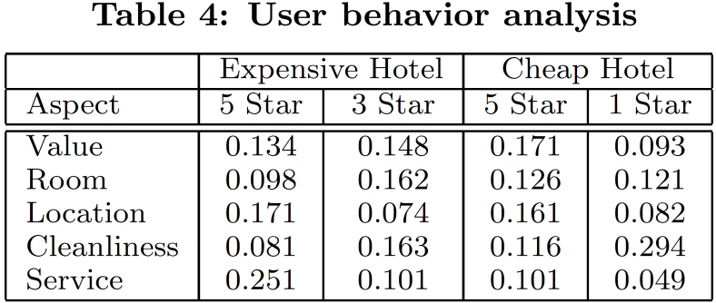
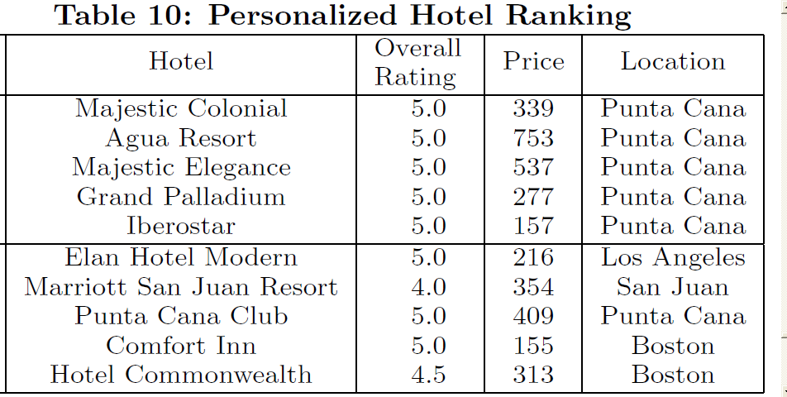
Reviewer Behavior Analysis & Personalized Ranking of Entities
People like cheap
hotels because of
good value
People like
expensive hotels
because of
good service
Query: 0.9 value
0.1 others
Non-Personalized
Personalized

Slide 45
How can we extend a search engine to leverage topic models for text analysis?
How should we extend a search engine to support text analysis in general?

Slide 46
Analysis Engine based on Topic Models
Search + Analysis Interface
Query
Results
Information Synthesis
Comparison
Summarization
Categorization …
Workspace
Search
Engine
Topic
Models

Slide 47
Beyond Search:
Toward a General Analysis Engine
Task Completion
Search
Information Synthesis & Analysis
Search 1
Search 2
…
Decision Making
Learning
…
Analysis Engine

Slide 48
Challenges in Building a General Analysis Engine
What is a “task” and how can we formally model a task? (task vs. intent vs. information needs)
How to design a task specification language?
How do we design a set of general analysis operators to accommodate many different tasks?
What does ranking mean in an analysis engine (ranking terms, documents, topics, operators)?
What should the user interface look like?
How can we seamlessly integrate search and analysis?
How should we evaluate an analysis engine?
…

Slide 49
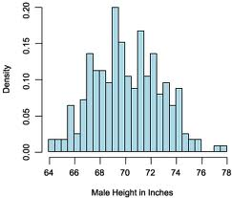

Analysis Operators
Intersect
Select
Split
…
Union
Topic
Ranking
Interpret
Compare
Common | C1 | C2

Slide 50
Examples of Specific Operators
C={D1, …, Dn}; S, S1, S2, …, Sk subset of C
Select Operator
  Querying(Q): C→ S
  Browsing: C→S
Split
  Categorization (supervised): C→ S1, S2, …, Sk
  Clustering (unsupervised): C→ S1, S2, …, Sk
Interpret
  C x θ →S
Ranking
  θ x Si → ordered Si

Slide 51
Compound Analysis Operator:
Comparison of K Topics
Select
Topic 1
…
Compare
Common | S1 | S2
Select
Topic k
Interpret
Interpret
Interpret
Interpret(Compare(Select(T1,C), Select(T2,C),…Select(Tk,C)),C)

Slide 52
Compound Analysis Operator: Split and Compare
Split
…
Compare
Common | S1 | S2
Interpret
Interpret
Interpret
Interpret(Compare(Split(S,k)),C)

Slide 53
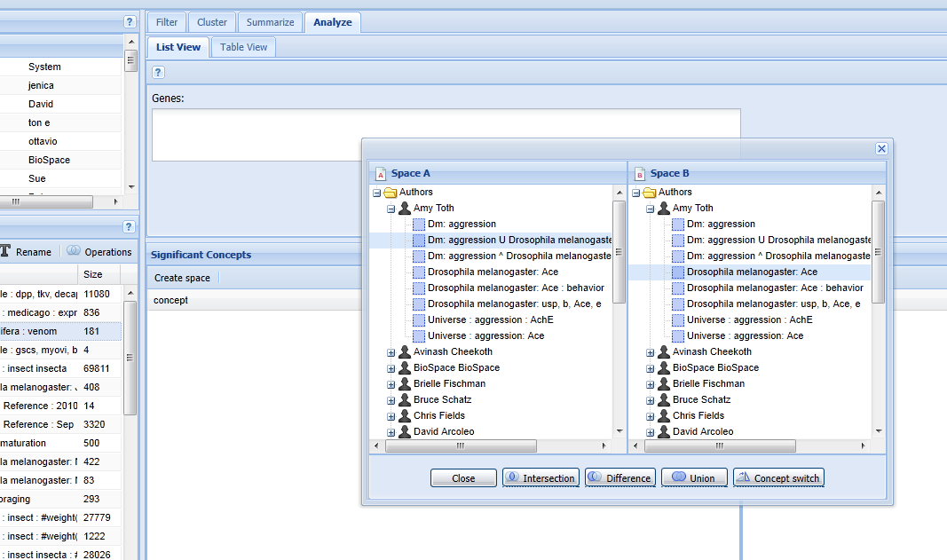
BeeSpace System
Sarma, M.S., et al. (2011) BeeSpace Navigator: exploratory analysis of gene function using semantic indexing of biological literature. Nucleic Acids Research, 2011, 1-8, doi:10.1093/nar/gkr285.
A biological analysis engine
Filter, Cluster, Summarize, Analyze
Persistent Workspace
Intersection, Difference, Union, …

Slide 54
Automation-Confidence (AC) Tradeoff
Automation of task
Goal
Deliver Actionable
Knowledge
Multi-Resolution
Information Delivery
Return Raw Search Results
Confidence in service

Slide 55
Automation-Generality (AG) Tradeoff
Automation of task
Goal
Complete support for
special tasks
Operator-Based
Analysis Engine
Search
Engine
Scalability/Generality

Slide 56
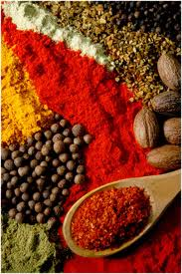
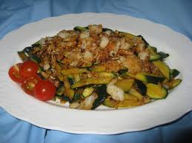
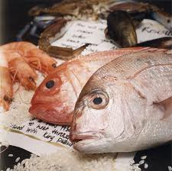

Automation-Confidence Tradeoff: Dining Analogy
Serve Raw-Food
Need further processing,
but flexible for making different dishes
Serve Cooked Dishes
Directly useful for a task,
But would be worse if it’s not the right dish
?

Slide 57
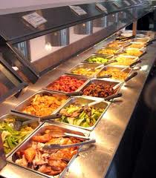
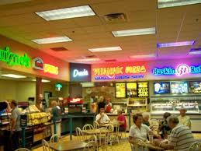
Automation-Generality Tradeoff: Dining Analogy
What’s the right paradigm? Need both paradigms?
Buffet Paradigm
Basic Components + Infinite Combination
Food Court Paradigm
Finite Choices of Complete Packages

Slide 58
Summary
Statistical topic models are promising general tools for supporting text analysis
Next-generation search engines should go beyond search to seamlessly support text analysis and better help users complete their tasks
Many challenges to be solved:
  Task modeling
  Task specification language
  New analysis operators
  New ranking models
  New interface issues
  New evaluation challenges
  Automation-Generality (AG) tradeoff & Automation-Confidence (AC) tradeoff
  …

Slide 59
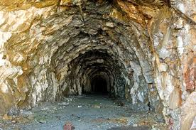
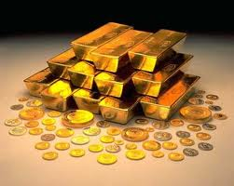
Looking Ahead…
Text Analysis/Mining
Databases & Data Mining
Visualization
Natural Language
Processing
Information Retrieval

Slide 60









Acknowledgments
Collaborators: Qiaozhu Mei, Yue Lu, Hongning Wang, Jiawei Han, Bruce Schatz, and many others
Funding

Slide 61
Thank You!
Questions/Comments?

