Slide 1
Maximum Personalization:
User-Centered
Adaptive Information Retrieval
ChengXiang (“Cheng”) Zhai
Department of Computer Science
Graduate School of Library & Information Science
Department of Statistics
Institute for Genomic Biology
University of Illinois at Urbana-Champaign

Slide 2
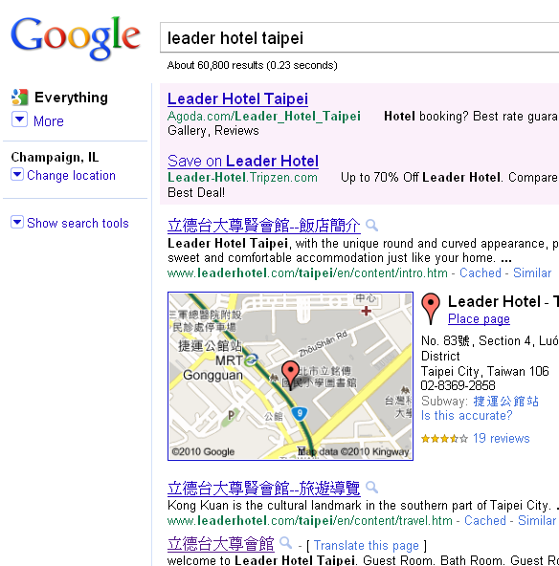

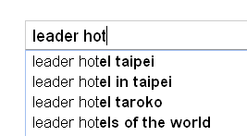
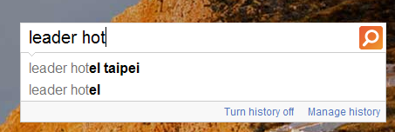
Happy Users

Slide 3
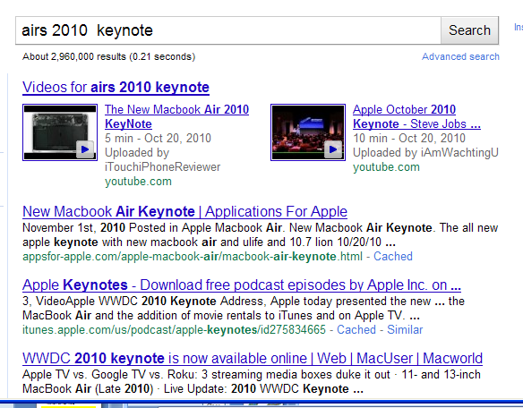


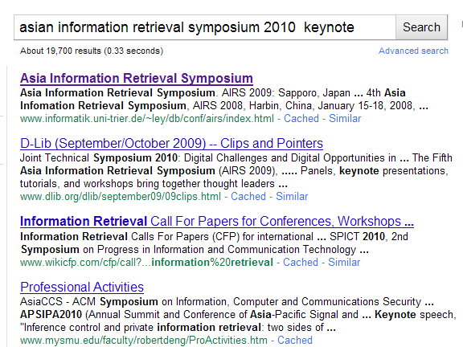
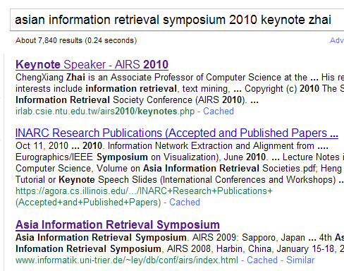
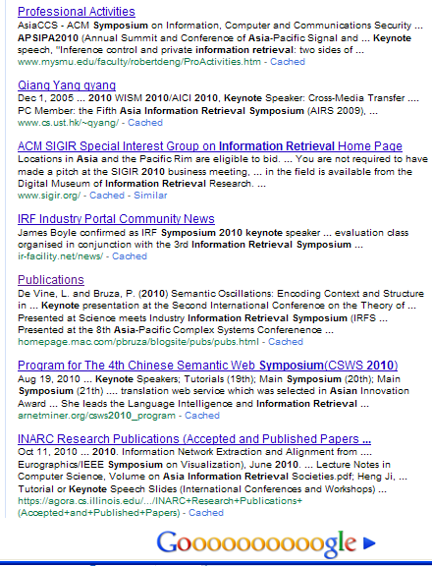
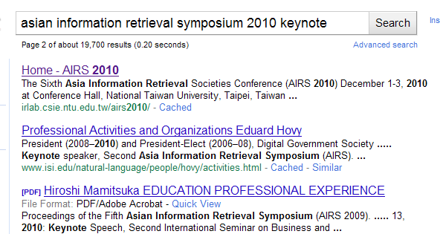
Sad Users
How can search engines better help these users?
They’ve got to know the users better!
I work on information retrieval; I searched for similar pages
last week; I clicked on AIRS-related pages (including keynote); …

Slide 4


Current Search Engines are
Document-Centered
...
“airs”
Search
Engine
“airs”
Documents
It’s hard for a search engine to know everyone well!

Slide 5
To maximize personalization, we must put a user in the center!
A search agent knows about
a particular user very well
WEB
...
Email
Viewed
Web pages
Query
History
Search
Engine
Search
Engine
Personalized
search agent
Search
Engine
“airs”
Personalized
search agent
Desktop
Files
“airs”

Slide 6
User-Centered Adaptive IR (UCAIR)
A novel retrieval strategy emphasizing
  user modeling (“user-centered”)
  search context modeling (“adaptive”)
  interactive retrieval
Implemented as a personalized search agent that
  sits on the client-side (owned by the user)
  integrates information around a user (1 user vs. N sources as opposed to 1 source vs. N users)
  collaborates with each other
  goes beyond search toward task support

Slide 7
Much work has been done on personalization
Personalized data collection: Haystack [Adar & Karger 99], MyLifeBit [Gemmell et al. 02], Stuff I’ve Seen [Dumais et al. 03] , Total Recall [Cheng et al. 04], Google desktop search, Microsoft desktop search
Server-side personalization: My Yahoo! [Manber et al. 00], Personalized Google Search
Capturing user information & search context: SearchPad [Bharat 00], Watson [Budzik & Hammond 00], Intellizap [Finkelstein et al. 01], Understanding clickthrough data [Joachmis et al. 05]
Implicit feedback: SVM [Joachims 02] , BM25 [Teevan et al. 05] , Language models [Shen et al. 05]
However, we are far from
unleashing the full power of personalization

Slide 8
UCAIR is unique in emphasizing maximum exploitation of client-side personalization
Benefit of client-side personalization
  More information about the user, thus more accurate user modeling
    Can exploit the complete interaction history (e.g., can easily capture all click-through information and navigation activities)
    Can exploit user’s other activities (e.g., searching immediately after reading an email)
  Naturally scalable
  Alleviate the problem of privacy
Can potentially maximize benefit of personalization

Slide 9
Maximum Personalization
= Maximum User Information ×
Maximum Exploitation of User Info.
Client-Side Agent ×
(Frequent + Optimal) Adaptation

Slide 10
Examples of Useful User Information
Textual information
  Current query
  Previous queries in the same search session
  Past queries in the entire search history
Clicking activities
  Skipped documents
  Viewed/clicked documents
  Navigation traces on non-search results
  Dwelling time
  Scrolling
Search context
  Time, location, task, …

Slide 11
Examples of Adaptation
Query formulation
  Query completion: provide assistance while a user enters a query
  Query suggestion: suggest useful related queries
  Automatic generation of queries: proactive recommendation
Dynamic re-ranking of unseen documents
  As a user clicks on the “back” button
  As a user scrolls down on a result list
  As a user clicks on the “next” button to view more results
Adaptive presentation/summarization of search results
Adaptive display of a document: display the most relevant part of a document

Slide 12
Challenges for UCAIR
General: how to obtain maximum personalization without requiring extra user effort?
Specific challenges
  What’s an appropriate retrieval framework for UCAIR?
  How do we optimize retrieval performance in interactive retrieval?
  How can we capture and manage all user information?
  How can we develop robust and accurate retrieval models to maximally exploit user information and search context?
  How do we evaluate UCAIR methods?
  …

Slide 13
The Rest of the Talk
Part I: A decision-theoretic framework for UCAIR
Part II: Algorithms for personalized search
  Optimize initial document ranking
  Dynamic re-ranking of search results
  Personalize search result presentation
Part III: Summary and open challenges

Slide 14
Part I
A Decision-Theoretic
Framework for UCAIR

Slide 15
IR as Sequential Decision Making
(Information Need)
(Model of Information Need)
User
System
A₁ : Enter a query
Which documents to present?
How to present them?
Which documents
to view?
R_{i}: results (i=1, 2, 3, …)
A₂ : View document
Which part of the document
to show? How?
View more?
R’: Document content
A₃ : Click on “Back” button

Slide 16
Retrieval Decisions
Given U, C, A_{t} , and H, choose
the best R_{t} from all possible
responses to A_{t}
History H={(A_{i},R_{i})}
i=1, …, t-1
Query=“Jaguar”
User U: A₁ A₂ … … A_{t-1} A_{t}
System: R₁ R₂ … … R_{t-1}
Click on “Next” button
The best ranking for the query
R_{t} =?
The best ranking of unseen docs
R_{t} ∈ r(A_{t})
C
All possible rankings of C
Document
Collection
All possible rankings of unseen docs

Slide 17
A Risk Minimization Framework
Observed
User: U
Interaction history: H
Current user action: A_{t}
Document collection: C
User Model
Seen docs
M=(S, θ_{U},… )
Information need
All possible responses:
r(A_{t})={r₁, …, r_{n}}
L(r_{i},A_{t},M)
Loss Function
Optimal response: r* (minimum loss)
Bayes risk
Inferred
Observed

Slide 18
A Simplified Two-Step
Decision-Making Procedure
Approximate the Bayes risk by the loss at the mode of the posterior distribution
Two-step procedure
  Step 1: Compute an updated user model M* based on the currently available information
  Step 2: Given M*, choose a response to minimize the loss function

Slide 19
Optimal Interactive Retrieval
User
U
C
Collection
A₁
M*₁
P(M₁|U,H,A₁,C)
Many possible actions:
type in a query character
scroll down a page
click on any button
…
Many possible responses:
query completion
display relevant passage
recommendation
clarification
…
L(r,A₁,M*₁)
R₁
A₂
M*₂
P(M₂|U,H,A₂,C)
L(r,A₂,M*₂)
R₂
A₃
IR system
…

Slide 20
Refinement of Risk Minimization
r(A_{t}): decision space (A_{t} dependent)
  r(A_{t}) = all possible rankings of docs in C
  r(A_{t}) = all possible rankings of unseen docs
  r(A_{t}) = all possible summarization strategies
  r(A_{t}) = all possible ways to diversify top-ranked documents
M: user model
  Essential component: θ_{U} = user information need
  S = seen documents
  n = “Topic is new to the user”; r=“reading level of user”
L(R_{t} ,A_{t},M): loss function
  Generally measures the utility of R_{t} for a user modeled as M
  Often encodes retrieval criteria, but may also capture other preferences
P(M|U, H, A_{t}, C): user model inference
  Often involves estimating the unigram language model θ_{U}
  May involve inference of other variables also (e.g., readability, tolerance of redundancy)

Slide 21
Case 1: Context-Insensitive IR
  A_{t}=“enter a query Q”
  r(A_{t}) = all possible rankings of docs in C
  M= θ_{U}, unigram language model (word distribution)
  p(M|U,H,At,C)=p(θ_{U} |Q)

Slide 22
Case 2: Implicit Feedback
  A_{t}=“enter a query Q”
  r(A_{t}) = all possible rankings of docs in C
  M= θ_{U}, unigram language model (word distribution)
  H={previous queries} + {viewed snippets}
  p(M|U,H,At,C)=p(θ_{U} |Q,H)

Slide 23
Case 3: General Implicit Feedback
  A_{t}=“enter a query Q” or “Back” button, “Next” button
  r(A_{t}) = all possible rankings of unseen docs in C
  M= (θ_{U}, S), S= seen documents
  H={previous queries} + {viewed snippets}
  p(M|U,H,At,C)=p(θ_{U} |Q,H)

Slide 24
Case 4: User-Specific Result Summary
  A_{t}=“enter a query Q”
  r(A_{t}) = {(D,π)}, D⊂C, |D|=k, π∈{“snippet”,”overview”}
  M= (θ_{U}, n), n∈{0,1} “topic is new to the user”
  p(M|U,H,At,C)=p(θ_{U}, n|Q,H), M*=(θ*, n*)
 | n*=1 | n*=0
π_{i}=snippet | 1 | 0
π_{i}=overview | 0 | 1
If a new topic (n*=1),
give an overview summary;
otherwise, a regular snippet summary
Choose k most relevant docs

Slide 25
Part II. Algorithms for personalized search
- Optimize initial document ranking
- Dynamic re-ranking of search results - Personalize search result presentation

Slide 26
Scenario 1: After a user types in a query, how to exploit long-term search history to optimize initial results?

Slide 27
Case 2: Implicit Feedback
  A_{t}=“enter a query Q”
  r(A_{t}) = all possible rankings of docs in C
  M= θ_{U}, unigram language model (word distribution)
  H={previous queries} + {viewed snippets}
  p(M|U,H,At,C)=p(θ_{U} |Q,H)

Slide 28
Long-term Implicit Feedback from Personal Search Log
query champaign map
......
query jaguar
query champaign jaguar
click champaign.il.auto.com
query jaguar quotes
click newcars.com
......
query yahoo mail
......
query jaguar quotes
click newcars.com
Search interests:
user interested in X
(champaign, luxury car)
consistent & distinct
Most useful for
ambiguous queries
session
noise
Search preferences:
For Y, user prefers X
quotes → newcars.com
Most useful for
recurring queries
recurring
query
avg 80 queries / mo

Slide 29

Estimate Query Language Model using the Entire Search History
S₁
S₂
S_{t-1}
S_{t}
q₁D₁C₁
q₂D₂C₂
...
q_{t-1}D_{t-1}C_{t-1}
q_{t}D_{t}
θ_{S1}
θ_{S2}
λ₂?
θ_{St-1}
λ₁?
λ_{t-1}?
θq
θ_{H}
1-λ_{q}
λ_{q}?
How can we optimize λ_{k}and λ_{q}?
Need to distinguish informative/noisy past searches
Need to distinguish queries with strong vs. weak support from history
θ_{q,H}

Slide 30
Adaptive Weighting with
Mixture Model [Tan et al. 06]
D_{t}
θ_{S1}
θ_{S2}
...
θ_{St-1}
<d1>
jaguar car official site
racing
<d2>
jaguar is a big cat...
<d3>
local jaguar dealer
in champaign...
λ₂
λ₁
λ_{t-1}
θ_{q}
θ_{H}
1-λ_{q}
λ_{q}
θ_{B}
λ_{B}
1-λ_{B}
θ_{q,H}
θ_{mix}
query
past jaguar searches
past champaign searches
background
select {λ} to maximize P(D_{t} | θ_{mix})
EM algorithm

Slide 31
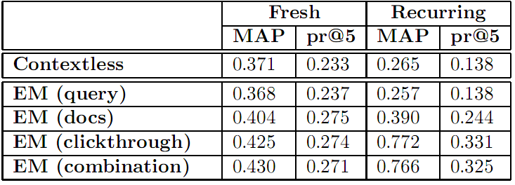
Sample Results: improving initial ranking with long-term implicit feedback
recurring ≫ fresh
combination ≈ clickthrough > docs > query, contextless

Slide 32
Scenario 2: The user is examining search results, how can we further dynamically optimize search results based on clickthroughs?

Slide 33
Case 3: General Implicit Feedback
  A_{t}=“enter a query Q” or “Back” button, “Next” button
  r(A_{t}) = all possible rankings of unseen docs in C
  M= (θ_{U}, S), S= seen documents
  H={previous queries} + {viewed snippets}
  p(M|U,H,At,C)=p(θ_{U} |Q,H)

Slide 34
Estimate a Context-Sensitive LM
Q₁
User Query
e.g., Apple software
C₁={C_{1,1} , C_{1,2} ,C_{1,3 ,}…}
User Clickthrough
e.g., Apple - Mac OS X
The Apple Mac OS X product page. Describes features in the current version of Mac OS X, …
Q₂
C₂={C_{2,1} , C_{2,2} ,C_{2,3 ,}… }
…
Q_{k}
e.g., Jaguar
User Model:
Query History
Clickthrough

Slide 35
Method1: Fixed Coeff. Interpolation (FixInt)
C₁
…
C_{k-1}
Linearly interpolate history models
Average user query history and clickthrough
Q₁
…
Q_{k-1}
Linearly interpolate current query
and history model
Q_{k}

Slide 36
Method 2: Bayesian Interpolation
(BayesInt)
C₁
Intuition: trust the current
query Q_{k} more if it’s longer
…
C_{k-1}
Average user query and
clickthrough history
Dirichlet Prior
Q₁
…
Q_{k-1}
Q_{k}

Slide 37
Method 3: Online Bayesian Updating (OnlineUp)
Intuition: incremental updating of the language model
Q₁
C₁
Q₂
C₂
Q_{k}

Slide 38
Method 4: Batch Bayesian Update
(BatchUp)
Intuition: all clickthrough data are equally useful
Q₁
Q₂
Q_{k}
C₁
C₂
…
C_{k-1}

Slide 39
Overall Effect of Search Context [Shen et al. 05b]
Query | FixInt (α=0.1,β=1.0) |  | BayesInt (μ=0.2,ν=5.0) |  | OnlineUp (μ=5.0,ν=15.0) |  | BatchUp (μ=2.0,ν=15.0)
 | MAP | pr@20 | MAP | pr@20 | MAP | pr@20 | MAP | pr@20
Q₃ | 0.0421 | 0.1483 | 0.0421 | 0.1483 | 0.0421 | 0.1483 | 0.0421 | 0.1483
Q₃+H_{Q}+H_{C} | 0.0726 | 0.1967 | 0.0816 | 0.2067 | 0.0706 | 0.1783 | 0.0810 | 0.2067
Improve | 72.4% | 32.6% | 93.8% | 39.4% | 67.7% | 20.2% | 92.4% | 39.4%
Q₄ | 0.0536 | 0.1933 | 0.0536 | 0.1933 | 0.0536 | 0.1933 | 0.0536 | 0.1933
Q₄+H_{Q}+H_{C} | 0.0891 | 0.2233 | 0.0955 | 0.2317 | 0.0792 | 0.2067 | 0.0950 | 0.2250
Improve | 66.2% | 15.5% | 78.2% | 19.9% | 47.8% | 6.9% | 77.2% | 16.4%
Short-term context helps system improve retrieval accuracy
BayesInt better than FixInt; BatchUp better than OnlineUp

Slide 40
Using Clickthrough Data Only
Clickthrough is the
major contributor
Query
MAP
pr@20
Q₃
0.0331
0.125
Performance
on
unseen docs
Query | MAP | pr@20
Q₃ | 0.0421 | 0.1483
Q₃+H_{C} | 0.0766 | 0.2033
Improve | 81.9% | 37.1%
Q₄ | 0.0536 | 0.1930
Q₄+H_{C} | 0.0925 | 0.2283
Improve | 72.6% | 18.1%
Q₃+H_{C}
0.0661
0.178
Improve
99.7%
42.4%
Q₄
0.0442
0.165
Q₄+H_{C}
0.0739
0.188
Improve
67.2%
13.9%
Query
MAP
pr@20
Q₃
0.0421
0.1483
BayesInt (μ=0.0,ν=5.0)
Q₃+H_{C}
0.0521
0.1820
Snippets for non-relevant docs are still useful!
Improve
23.8%
23.0%
Q₄
0.0536
0.1930
Q₄+H_{C}
0.0620
0.1850
Improve
15.7%
-4.1%

Slide 41
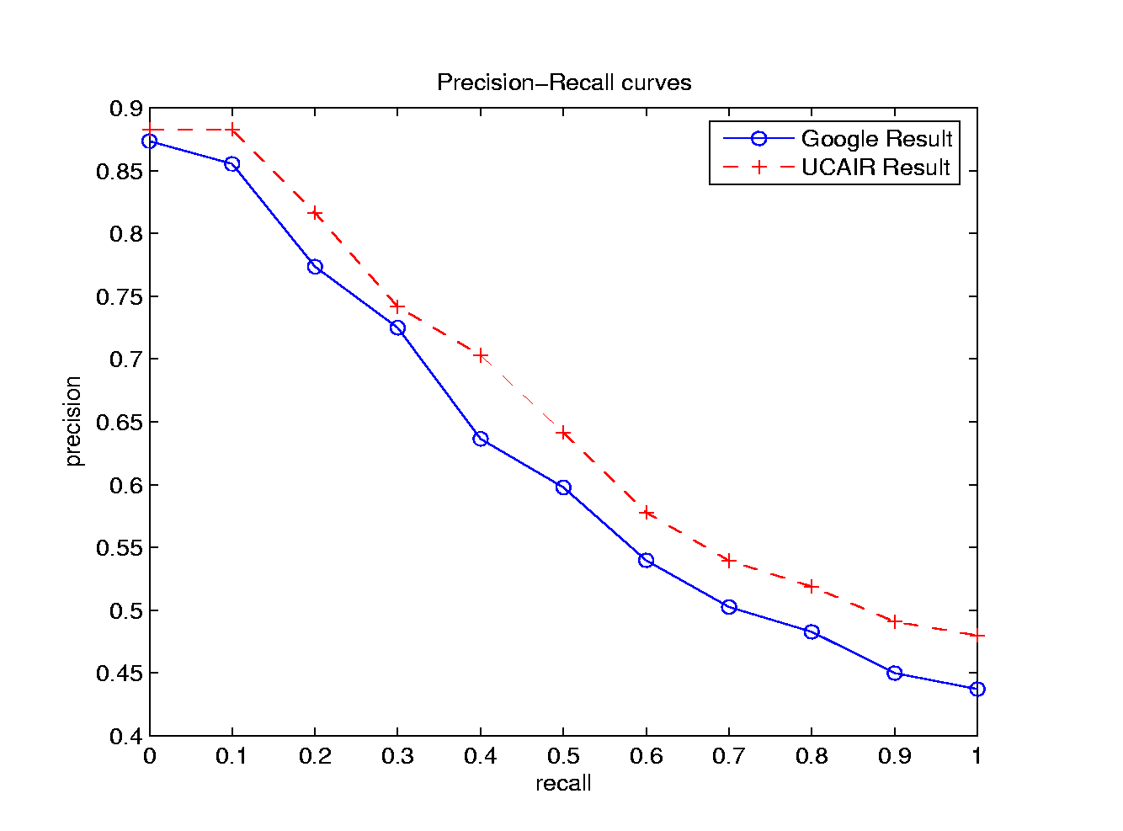
UCAIR Outperforms Google:
PR Curve

Slide 42
Scenario 3: The user has not viewed any document on the first result page and is now clicking on “Next” to view more: how can we optimize the search results on the next page?

Slide 43
Problem Formulation
Query: Q
Results
Seen, Negative
L₁
L₂
…
L_{f}
1st page
Search
Engine
N
2nd page
L_{f+1}
L_{f+2}
…
L_{f+r}
Unseen, To be Reranked
U
…
101st page
Collection C
How to rerank these unseen docs?

Slide 44
Strategy I: Query Modification
Q_{new}
Q
D₁₁
D₁₂
D₁₃
D₁₄
D₁₅
…
D₁₀₁₀
D’₁₁
D’₁₂
D’₁₃
D’₁₄
D’₁₅
…
D’₁₀₁₀
N = {L₁, …, L₁₀}
Q
Q_{new}
parameter

Slide 45
Strategy II: Score Combination
D₁₁ 0.05
D₁₂ 0.04
D₁₃ 0.04
D₁₄ 0.03
D₁₅ 0.03
…
D₁₀₁₀ 0.01
Q_{neg}
Q
parameter
D’₁₁ 0.04
D’₁₂ 0.03
D’₁₃ 0.03
D’₁₄ 0.01
D’₁₅ 0.01
…
D’₁₀₁₀ 0.01
D₁₁ 0.03
D₁₂ 0.05
D₁₃ 0.02
D₁₄ 0.01
D₁₅ 0.01
…
D₁₀₁₀ 0.01

Slide 46
Multiple Negative Models
Negative feedback examples may be quite diverse
  They may distract in totally different ways
  A single negative model is not optimal
Multiple negative models
  Learn multiple models from N
  Score function for negative query
Q¹_{neg}
Q²_{neg}
Q
Q³_{neg}
Q⁴_{neg}
Q⁶_{neg}
Q⁵_{neg}
F: aggregation function

Slide 47
Effectiveness of Negative Feedback
[Wang et al. 08]
 | MAP | GMAP | MAP | GMAP
 | ROBUST+LM |  | ROBUST+VSM
OriginalRank | 0.0293 | 0.0137 | 0.0223 | 0.0097
SingleQuery | 0.0325 | 0.0141 | 0.0222 | 0.0097
SingleNeg1 | 0.0325 | 0.0147 | 0.0225 | 0.0097
SingleNeg2 | 0.0330 | 0.0149 | 0.0226 | 0.0097
MultiNeg1 | 0.0346 | 0.0150 | 0.0226 | 0.0099
MultiNeg2 | 0.0363 | 0.0148 | 0.0233 | 0.0100
 | GOV+LM |  | GOV+VSM
OriginalRank | 0.0257 | 0.0054 | 0.0290 | 0.0035
SingleQuery | 0.0297 | 0.0056 | 0.0301 | 0.0038
SingleNeg1 | 0.0300 | 0.0056 | 0.0331 | 0.0038
SingleNeg2 | 0.0289 | 0.0055 | 0.0298 | 0.0036
MultiNeg1 | 0.0331 | 0.0058 | 0.0294 | 0.0036
MultiNeg2 | 0.0311 | 0.0057 | 0.0290 | 0.0036

Slide 48
Scenario 4:Can we leverage user interaction history to personalize result presentation?

Slide 49
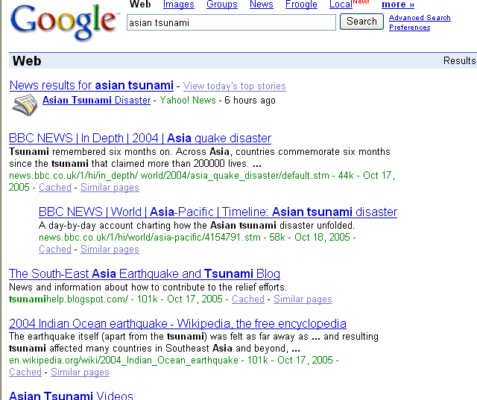
Need for User-Specific Summaries
Query = “Asian tsunami”
Such a snippet summary may be fine for
a user who knows about the topic
But for a user who hasn’t been tracking
the news, a theme-based
overview summary may be more useful

Slide 50
A Theme Overview Summary
(Asia Tsunami)
Time
Theme evolution thread
Statistics of Death
and loss
Immediate Reports
Statistics of further
impact
Personal Experience
of Survivors
Donations from
countries
Aid from Local Areas
Aid from the world
…
Doc1
Doc3
Doc ..
Specific Events of Aid
…
Lessons from Tsunami
Research inspired
Theme
Evolutionary transitions
Notes:
Explain the Plots. Temporal theme analysis separate to make the fonts bigger… more explanations.
Title: sample ETP: theme evolutionary graph

Slide 51
Risk Minimization for User-Specific Summary
  A_{t}=“enter a query Q”
  r(A_{t}) = {(D,π)}, D⊂C, |D|=k, π∈{“snippet”, “overview”}
  M= (θ_{U}, n), n∈{0,1} “topic is new to the user”
  p(M|U,H,At,C)=p(θ_{U},n|Q,H), M*=(θ*, n*)
 | n*=1 | n*=0
π_{i}=snippet | 1 | 0
π_{i}=overview | 0 | 1
Task 1 = Estimating n*: p(n=1)≈p(Q|H)
Task 2 = Generating an overview summary

Slide 52
Temporal Theme Mining for
Generating Overview News Summaries
General problem definition:
Given a text collection with time stamps
Extract a theme evolution graph
Model the life cycles of the most salient themes
Time
T₁
T₂
…
T_{n}
…
Theme1.1
Theme2.1
Theme3.1
…
…
…
Theme evolution graph
Theme1.2
Theme2.2
Theme3.2
Theme A
Theme B
Theme life cycles
T₁ T₂ … T_{n}

Slide 53
A Topic Modeling Approach [Mei & Zhai 06]
Theme Evolution Graph
Theme Life cycles
t
s
Computing Theme Strength
θ₁₁
θ₃₁
θ₂₁
θ₁₂
…
t
θ₂₂
θ₁₃
θ_{3k}
…
…
…
…
Model theme transitions
(KL div)
Decoding Collection
t
θ₁
θ₂
(HMM)
B
θ₃
Theme extraction
(mixture models)
Partitioning
Extracting global salient themes
(mixture model)
Collection with time stamps
t1 t2 t3, …, t
Notes:
Stay long enough

Slide 54
Task I: Theme Extraction
There are k themes in the collection (or a time span), each document is a sample of words generated by multiple themes
Infer the best theme language models that fit our data
Document d
warning 0.3 system 0.2..
Theme θ₁
π_{d,1}
?
θ₁
“Generating” word w
in doc d in the collection
Aid 0.1
donation 0.05
support 0.02 ..
θ₂
Theme θ₂
?
π_{d,2}
1 - λ_{B}
?
π_{d, k}
W
…
θ_{k}
statistics 0.2
loss 0.1
dead 0.05 ..
?
λ_{B}
Theme θ_{k}
?
?
B
Is 0.05
the 0.04
a 0.03 ..
Background B
Parameters:
λ_{B}=noise-level (manually set)
θ’s and π’s are estimated with Maximum Likelihood

Slide 55
Task II: Transition Modeling
Theme spans in an earlier time interval could evolve into theme spans in a later time interval
t1
…
t2
T
microarray 0.2
gene 0.1
protein 0.05
?
B
Information 0.2
topic 0.1 classification 0.1
text 0.05
A
?
web 0.3
classification 0.1
topic 0.1
C
Evolutionary Transition
=
Theme
similarity
Similarity between two theme spans is modeled with KL Divergence between two distributions
Notes:
“Transition = Theme similarity” pictures?

Slide 56
Task III: Theme Segmentation
View the whole collection as a sequence ordered by time, Model the theme shifts in documents with a Hidden Markov Model
w
w
w
w
w
w
w
w
w
w
w
w
w
w
w
w
w
w
w
…
…
Background
Decoding Collection
Theme θ₁
θ₁
θ₂
Theme θ₂
B
θ₃
Train transition probabilities
Theme θ₃
The Collection
output probability
=
P (w|θ)
Notes:
A bit more time to explain what is an HMM
A word with a larger probability to be generated by theme1 would be…

Slide 57
Theme Evolution Graph: Tsunami
12/28/04
01/05/05
01/15/05
…
T
system 0.0104
Bush 0.008
warning 0.007
conference 0.005
US 0.005
…
aid 0.020
relief 0.016
U.S. 0.013
military 0.011
U.N. 0.011
…
…
…
Bush 0.016
U.S. 0.015
$ 0.009
relief 0.008
million 0.008
…
Indonesian 0.01
military 0.01
islands 0.008
foreign 0.008
aid 0.007
…
system 0.008
China 0.007
warning 0.005
Chinese 0.005
…
warning 0.012
system 0.012
Islands 0.009
Japan 0.005
quake 0.003
…
…
…
…
…
…

Slide 58
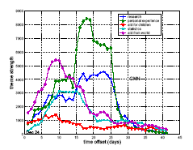
Theme Life Cycles: Tsunami
$ 0.0173
million 0.0135
relief 0.0134
aid 0.0099
U.N. 0.0066
…
Aid from the world
Personal experiences
I 0.0322
wave 0.0061
beach 0.0051
saw 0.0046
sea 0.0046
…
CNN, Absolute Strength

Slide 59
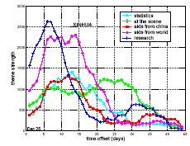
Theme Life Cycles: Tsunami
Aid from the world
dollars 0.0226
million 0.0204
aid 0.0118
U.N. 0.0102
reconstruction
0.0062 …
Scene and Experiences
Research
Aid from China
statistics
China 0.0391
yuan 0.0180
Beijing 0.0089
$ 0.0058
donation 0.0052
…
XINHUA News, Absolute Strength

Slide 60
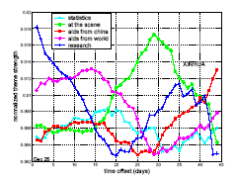
Theme Life Cycles: Tsunami
Aid from the world
$ 0.0173
million 0.0135
relief 0.0134
aid 0.0099
U.N. 0.0066
…
Scene and Experiences
Research
Aid from China
statistics
China 0.0391
yuan 0.0180
Beijing 0.0089
$ 0.0058
donation 0.0052
…
XINHUA News , Normalized Strength

Slide 61
Theme Evolution Graph: KDD
1999
2000
2001
2002
2003
2004
T
web 0.009
classifica –tion 0.007
features0.006
topic 0.005
…
SVM 0.007
criteria 0.007
classifica – tion 0.006
linear 0.005
…
mixture 0.005
random 0.006
cluster 0.006
clustering 0.005
variables 0.005
…
topic 0.010
mixture 0.008
LDA 0.006
semantic
0.005
…
decision 0.006
tree 0.006
classifier 0.005
class 0.005
Bayes 0.005
…
…
Classifica
- tion 0.015
text 0.013
unlabeled 0.012
document 0.008
labeled 0.008
learning 0.007
…
Informa
- tion 0.012
web 0.010
social 0.008
retrieval 0.007
distance 0.005
networks 0.004
…
…
…
…

Slide 62
Theme Life Cycles: KDD
gene 0.0173
expressions 0.0096
probability 0.0081
microarray 0.0038
…
marketing 0.0087
customer 0.0086
model 0.0079
business 0.0048
…
rules 0.0142
association 0.0064
support 0.0053
…
Global Themes life cycles of KDD Abstracts

Slide 63
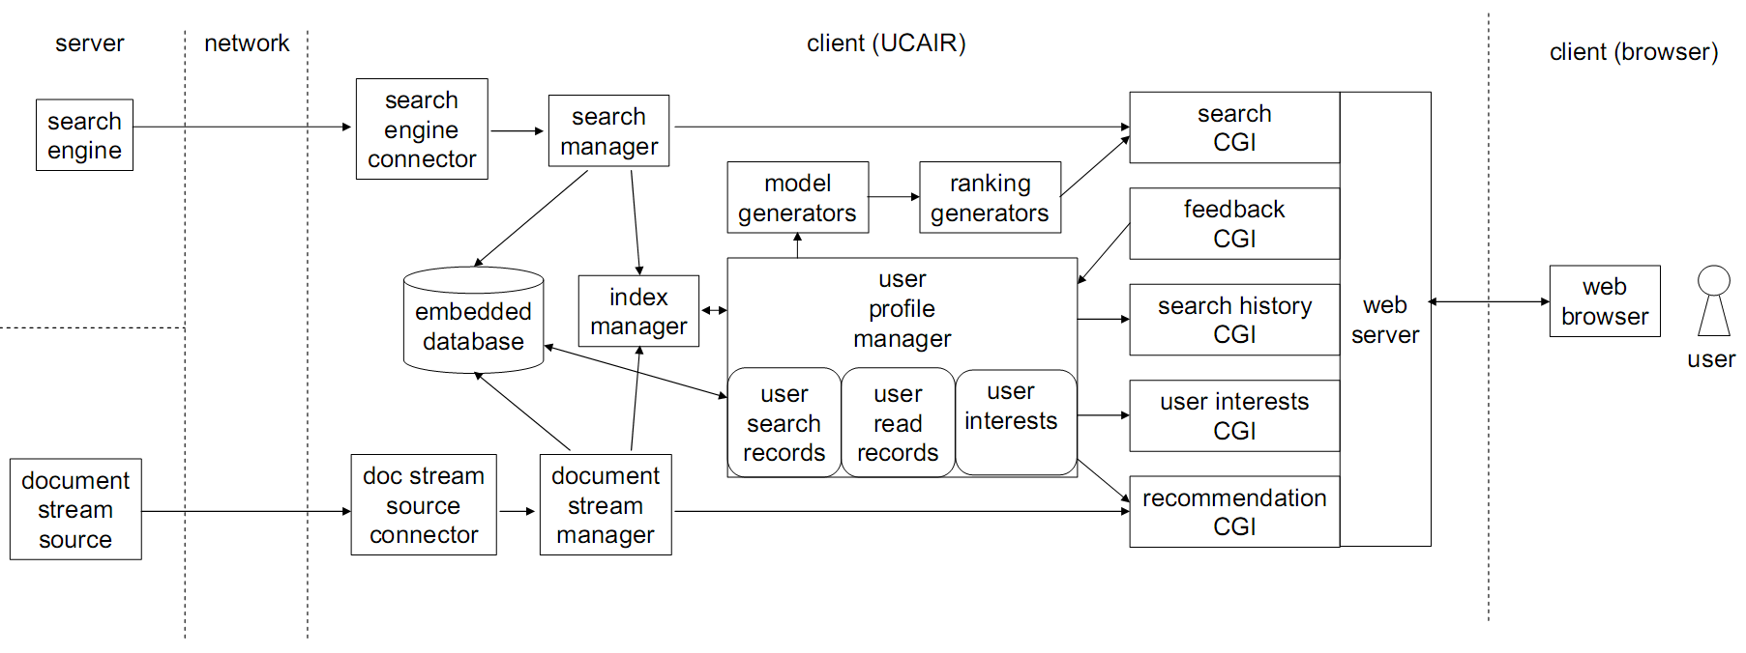
The UCAIR Prototype System
A client-side search agent
Talks to any browser (both Firefox and IE)
http://timan.cs.uiuc.edu/proj/ucair

Slide 64
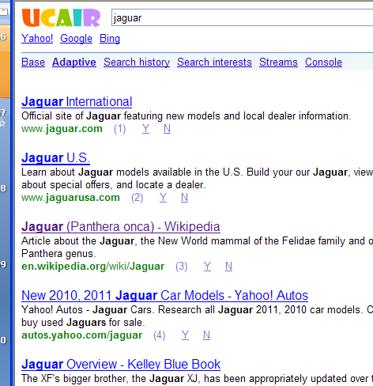
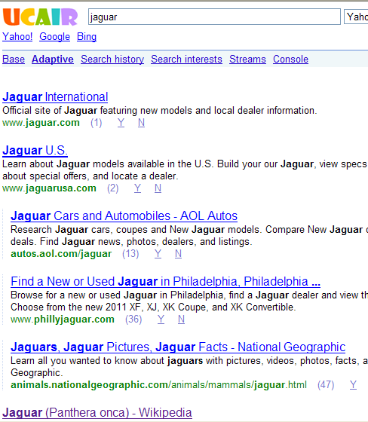
UCAIR Screen Shots:
Immediate Implicit Feedback
Standard mode
Adaptive mode

Slide 65
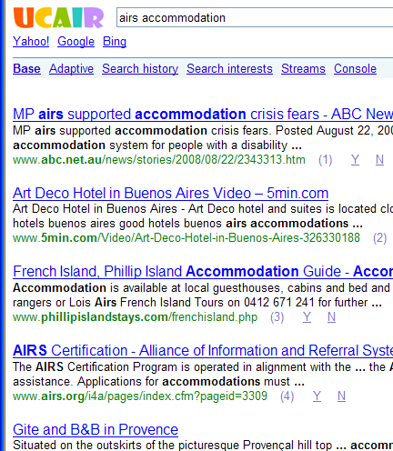
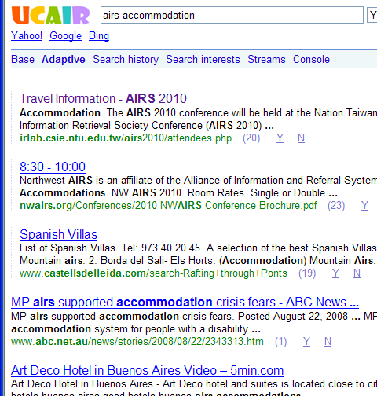
Screen Shots of UCAIR System: query =“airs accommodation”
Standard mode
Adaptive mode

Slide 66
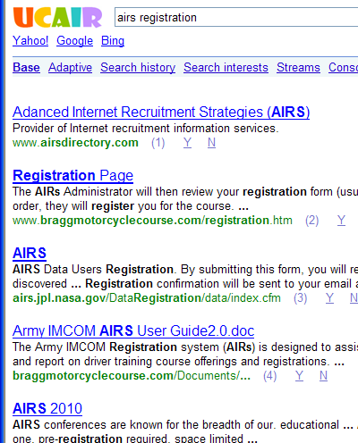
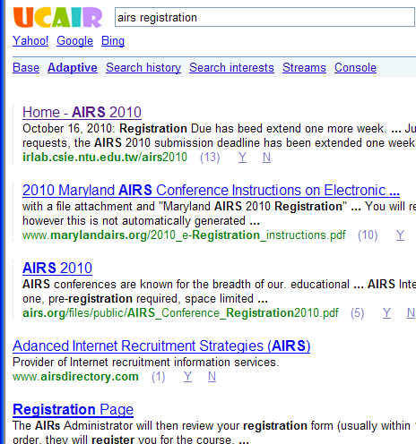
Screen Shots of UCAIR:
“airs regisgtration”
Standard mode
Adaptive mode

Slide 67
Part III. Summary and Open Challenges

Slide 68
Summary
One doesn’t fit all; each user needs his/her own search agent (especially important for long-tail search)
User-centered adaptive IR (UCAIR) emphasizes
  Collecting maximum amount of user information and search context
  Formal models of user information needs and other user status variables
  Information integration
  Optimizing every response in interactive IR, thus potentially maximizing the effectiveness
Preliminary results show that
  Implicit user modeling can improve search accuracy in many different ways

Slide 69
Open Challenges
Formal user models
  More in-depth analysis of user behavior (e.g., why did the user drop a query word and add it again later?)
  Exploit more implicit feedback clues (e.g., dwelling time-based language model)
  Collaborative user modeling (e.g., smoothing of user model)
Context-sensitive retrieval models based on appropriate loss functions
  Optimize long-term utility in interactive retrieval (e.g., active feedback, exploration-exploitation tradeoff, incorporation of Fuhr’s interactive retrieval model)
  Robust and non-intrusive adaptation (e.g., considering confidence of adaptation)
UCAIR system extension
  Right architecture: client+server? P2P?
  Design of novel interface to facilitate acquisition of user info
  Beyond search to support querying+browsing+recommendation

Slide 70
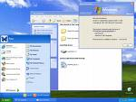




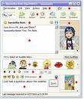

Final Goal:
A unified personal intelligent information agent
WWW
Desktop
Email
Intranet
User Profile
Proactive Info Service
E-COM
IM
…
Task
Support
Security
Handler
Blog
Intelligent Adaptation
Sports
Frequently Accessed Info
…
Literature

Slide 71









Acknowledgments
Collaborators: Xuehua Shen, Bin Tan, Maryam Karimzadehgan, Qiaozhu Mei, Xuanhui Wang, Hui Fang, and other TIMAN group members
Funding

Slide 72
References
Xuehua Shen, Bin Tan, and ChengXiang Zhai, Implicit User Modeling for Personalized Search , In Proceedings of the 14th ACM International Conference on Information and Knowledge Management ( CIKM'05), pages 824-831.
Xuehua Shen, Bin Tan, ChengXiang Zhai, Context-Sensitive Information Retrieval with Implicit Feedback, Proceedings of the 28th Annual International ACM SIGIR Conference on Research and Development in Information Retrieval ( SIGIR'05), 43-50, 2005.
Bin Tan, Xuehua Shen, ChengXiang Zhai, Mining long-term search history to improve search accuracy , Proceedings of the 2006 ACM SIGKDD International Conference on Knowledge Discovery and Data Mining , (KDD'06 ), pages 718-723.
Xuanhui Wang, Hui Fang, ChengXiang Zhai. A study of methods for negative relevance feedback , Proceedings of the 31st Annual International ACM SIGIR Conference on Research and Development in Information Retrieval ( SIGIR'08 ), pages 219-226.
Qiaozhu Mei, ChengXiang Zhai, Discovering Evolutionary Theme Patterns from Text -- An Exploration of Temporal Text Mining, Proceedings of the 2005 ACM SIGKDD International Conference on Knowledge Discovery and Data Mining , (KDD'05 ), pages 198-207, 2005.
Maryam Karimzadehgan, ChengXiang Zhai: Exploration-exploitation tradeoff in interactive relevance feedback. In Proceedings of the 19th ACM International Conference on Information and Knowledge Management ( CIKM‘10), pages1397-1400.
Norbert Fuhr: A probability ranking principle for interactive information retrieval. Information Retrieval 11(3): 251-265 (2008)

