Slide 1
TextScope: Enhance Human Perception via Text Mining
ChengXiang (“Cheng”) Zhai
Department of Computer Science
(Carl R. Woese Institute for Genomic Biology
School of Information Sciences
Department of Statistics)
University of Illinois at Urbana-Champaign
czhai@illinois.edu
http://czhai.cs.illinois.edu/
Keynote at IEEE BigData 2017, Boston, Dec. 12, 2017

Slide 2
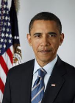
Text data cover all kinds of topics
Topics:
People
Events
Products
Services, …
…
Sources:
Blogs
Microblogs
Forums
Reviews ,…
45M reviews
53M blogs
1307M posts
65M msgs/day
115M users 10M groups
…

Slide 3
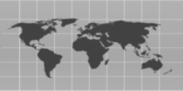
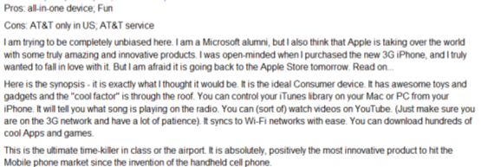
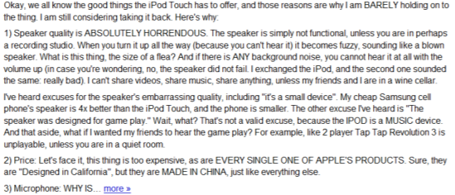
Humans as Subjective & Intelligent “Sensors”
Real World
Sense
Sensor
Report
Data
Weather
Thermometer
3°C , 15°F, …
Locations
Geo Sensor
41°N and 120°W ….
Network Sensor
01000100011100
Networks
Perceive
Express
“Human Sensor”

Slide 4
Unique Value of Text Data
Useful to all big data applications
Especially useful for mining knowledge about people’s behavior, attitude, and opinions
Directly express knowledge about our world: Small text data are also useful!
Data ➔ Information ➔ Knowledge
Text Data

Slide 5
Opportunities of Text Mining Applications
+ Non-Text Data
4. Infer other real-world variables
(predictive analytics)
2. Mining content of text data
Real World
Observed World
Text Data
+ Context
Perceive
Express
(Perspective)
(English)
3. Mining knowledge
about the observer
1. Mining knowledge
about language

Slide 6
However, NLP is difficult!
“A man saw a boy with a telescope.” (who had the telescope?)
“He has quit smoking” ➔ he smoked before.
How can we leverage imperfect NLP to
build a perfect general application?
Answer: Having humans in the loop!

Slide 7
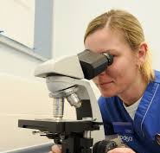
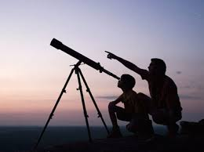
TextScope to enhance human perception
TextScope
Microscope
Telescope
Intelligent Interactive Retrieval & Text Analysis
for Task Support and Decision Making

Slide 8
TextScope in Action: intelligent interactive decision support
TextScope
Predicted Values
of Real World Variables
Predictive
Model
Multiple
Predictors
(Features)
Learning to interact
Domain Knowledge
…
Optimal Decision Making
Prediction
…
Text + Non-Text
Sensor 1
Joint Mining of Non-Text
and Text
Real World
Non-Text
Data
Interactive
text analysis
Sensor k
…
Text
Data
Interactive information retrieval
Natural language processing

Slide 9
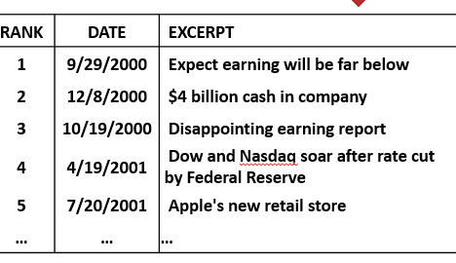
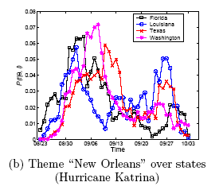
TextScope = Intelligent & Interactive Information Retrieval + Text Mining
Task Panel
TextScope
…
Topic Analyzer
Opinion
Prediction
Event Radar
Search Box
Microsoft (MSFT,) Google, IBM (IBM) and other cloud-computing rivals of Amazon Web Services are bracing for an AWS "partnership" announcement with VMware expected to be announced Thursday. …
MyFilter1
MyFilter2
…
Select Time
Select Region
My WorkSpace
Project 1
Alert A
Alert B ...

Slide 10
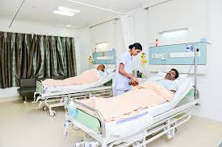
Application Example 1: Medical & Health
Predicted Values
of Real World Variables
Predictive
Model
Multiple
Predictors
(Features)
Diagnosis, optimal treatment
Side effects of drugs, …
…
Optimal Decision Making
Doctors, Nurses, Patients…
…
Sensor 1
Joint Mining of Non-Text
and Text
Real World
Non-Text
Data
Medical & Health
Sensor k
…
Text
Data

Slide 11
1. Extraction of Adverse Drug Reactions from Forums
Green: Disease symptoms
Blue: Side effect symptoms
Red: Drug
TextScope
Drug: Cefalexin
ADR:
panic attack
faint
….

Slide 12
A Probabilistic Model for ADR Extraction [Wang et al. 14]
Challenge: how do we separate treated symptoms from side-effect symptoms?
Solution: leverage knowledge about known symptoms of diseases treated by a drug
Probabilistic model
Assume forum posts are generated from a mixture language model
Most words are generated using a background language model
Treated (disease) symptoms and side-effect symptoms are generated from separate models, enabled by the use of external knowledge about known disease symptoms
Fitting the model to the forum data allows us to learn the side-effect symptom distributions
Sheng Wang et al. 2014. SideEffectPTM: an unsupervised topic model to mine adverse drug reactions from health forums. In ACM BCB 2014.

Slide 13
Sample ADRs Discovered [Wang et al. 14]
Drug(Freq) | Drug Use | Symptoms in Descending Order
Zoloft (84) | antidepressant | weigh gain, weight, depression, side effects, mgs, gain weight, anxiety, nausea, head, brain, pregnancy, pregnant, headaches, depressed, tired
Ativan (33) | anxiety disorders | Ativan, sleep, Seroquel, doc prescribed seroqual, raising blood sugar levels, anti-psychotic drug, diabetic, constipation, diabetes, 10mg, benzo, addicted
Topamax (20) | anticonvulsant | Topmax, liver, side effects, migraines, headaches, weight, Topamax, pdoc, neurologist, supplement, sleep, fatigue, seizures, liver problems, kidney stones
Ephedrine (2) | stimulant | dizziness, stomach, Benadryl, dizzy, tired, lethargic, tapering, tremors, panic attach, head
Unreported to FDA
Sheng Wang et al. 2014. SideEffectPTM: an unsupervised topic model to mine adverse drug reactions from health forums. In ACM BCB 2014.

Slide 14
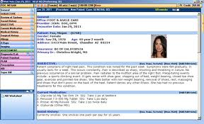
2. Analysis of Electronic Medical Records (EMRs)
Disease Profile
EMRs (Patient Records)
TextScope
Typical symptoms: P(Symptom|Disease)
Typical treatments: P(Treatment|Disease)
Effectiveness of treatment
Subcategories of disease
… …

Slide 15
The Conditional Symptom-Treatment Model [Wang et al. 16]
Typical symptoms
of disease d
Typical treatments
of disease d
Likelihood of
patient t having disease d
Symptom
Disease
All diseases
of patient t
Treatment
Observed Patient Record
S. Wang, E. Huang, R. Zhang, X. Zhang, B. Liu. X. Zhou, C. Zhai, A Conditional Probabilistic Model for Joint Analysis of Symptoms, Diseases, and Herbs in Traditional Chinese Medicine Patient Records, IEEE BIBM 2016.
Notes:
We show the probability of patient t having symptom s and being prescribed herb h with disease diagnoses Dt.
Here Pr(s,h|t) is the probability of of patient t having symptom s and being prescribed herb h.
Dt is the set of diseases this patient have, which is also observed in the record.
Pr(d|t) is the likelihood of patient t having disease d.
Pr(s|d) is the typical symptoms of disease d.
Pr(h|d) is the typical herbs of disease d.
The goal of optimization is to find optimial Pr(s|d), Pr(h|d) and Pr(d|t) so that the probability of all the observed {Pr(s,h|t)} would be maximzied.
We use EM algorithm to optimize this loss function. The optimization is fast and can be scaled to thousands of medical record.
More details about the models are in the paper.

Slide 16
Evaluation: Traditional Chinese Medicine(TCM) EMRs
10,907 patients TCM records in digestive system treatment
3,000 symptoms, 97 diseases and 652 herbs
Most frequently occurring disease: chronic gastritis
Most frequently occurring symptoms: abdominal pain and chills
Ground truth: 27,285 manually curated herb-symptom relationship.
Notes:
While we envision that our method would be used to mine a large number of patient records from multiple physicians, direct experimentation with such a mixed dataset would make it difficult to choose the most suitable physician to assess the data mining results. This is because different
physicians tend to have varying opinions due to the differences in their training and experiences.
Thus, we decided to evaluate the proposed model using patient records from a single physician. This way, the physician can judge to what extent
the mined results match the his reasoning and experience.
Specifically, we used 10,907 anonymous electronic medical records provided by a TCM physician whose specialization is in digestive system treatments. We normalized the symptom and herb terms to obtain 9,530 records with 3,000 symptoms, 97 diseases, and 652 herbs.
The most frequently occurring disease is “chronic gastritis” and the most frequently occurring symptom is “abdominal pain and chills.”
To quantitatively evaluate our model, we collected a set of herb-symptom relationship annotations, manually curated by TCM experts. These nnotations contain 27,285 herb-symptom relationships. The symptoms and herbs of 1,624 of these relationships appear in our dataset. Consequently, we evaluate how our method can accurately identify this subset of 1,624 relationships.

Slide 17
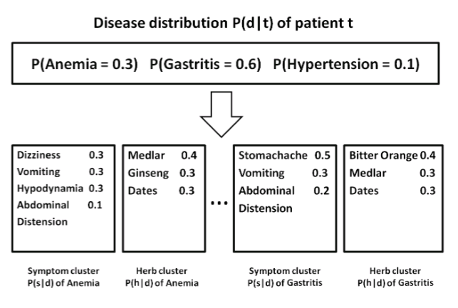
Output of the model
Notes:
As we have introduced before, our model will generate a disease distribution for each record, a symptom profile for each disease and a herb profile for each disease. Here is an example of the output.
Here, a patient with three disease Anemia, Gastritis and Hypertension will get a distribution. Gastritis will have a probability of 0.6. It means that most of the symptoms of this patient is caused by Gastritis.
Then we also get a herb and symptom distribution for all these diseases.
For example, anemia will have 0.3 probability of dizziness, 0.3 probability of vomiting and 0.3 probability of hypodynamia. These probability shows the common symptoms of anemia.
On the other side, anemia will have 0.4 probability of Medlar and 0.3 probability of Ginseng.

Slide 18
“Typical Symptoms” of 3 Diseases: p(s|d)
Notes:
We show three sample conditional symptom distributions with the highest entropy values among all 100 disease profiles learned with our model. The entropy of a distribution measures its information content. Thus, the higher the entropy, the more informative the distribution.
Here we show the top five symptoms, sorted by decreasing probability, for three different diseases. The physician judged these symptoms to be typical symptoms for the corresponding disease. Indeed, the relevance of these symptoms to the disease is often obvious. For example, “difficult
bowel movements,” “abdominal distension,” and “dry, hard stools” are common symptoms for “constipation.” The fact that our model was able to learn these associations automatically from the dataset clearly demonstrates the effectiveness of the model for mining medical knowledge. Our model can also differentiate between similar diseases, such as “reflux esophagitis” and “chronic gastritis,” which share symptoms such as “acid reflux” and “heartburn.” We discover “paresthesia pharynges” and “discomfort in upper respiratory tract” for “reflux esophagitis,” while these symptoms do not appear for “chronic gastritis.”
Remarkably, many of these symptoms are unique TCM symptoms and are not well-studied in western medicine. For example, the model discovered that “dark, purplish tongue” is associated with “coronary heart disease.” Our physician verified these unique TCM symptoms for their corresponding diseases. This result further shows the effectiveness of using our model in revealing TCM knowledge from medical records. Our model can provide useful TCM symptoms to facilitate differential diagnosis and precision herb prescription.

Slide 19
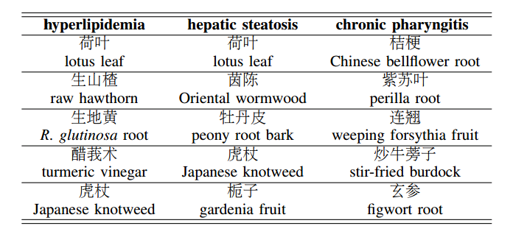
“Typical Herbs” Prescribed for 3 Diseases: p(h|d)
Notes:
We show the top five herbs of selected herb distributions for three different diseases. These herbs are unique to TCM and are unused by western medicine. There is evidence showing the empirical effectiveness of these herbs, of which a deeper understanding can improve our overall medicinal knowledge. We can see that our model successfully discovered many herbs with known relations to these different diseases
. For example, our model asserts that “lotus leaves” and “fresh hawthorn” can be used to treat “hyperlipidemia,” which can be verified by existing TCM knowledge and recent studies.
In addition to supporting existing knowledge, our model can also find novel herb prescription knowledge. For instance, our model determines that “turmeric root” can be used to treat “hypertension.” A recent work showed that curcumin, an active ingredient of turmeric root, can be used to treat idiopathic pulmonary arterial hypertension, a type of genetic hypertension. With further analysis on multiple visits of a given patient, we can assess the effectiveness of specific herbs prescribed for a disease. This is an important future direction we wish to pursue.

Slide 20
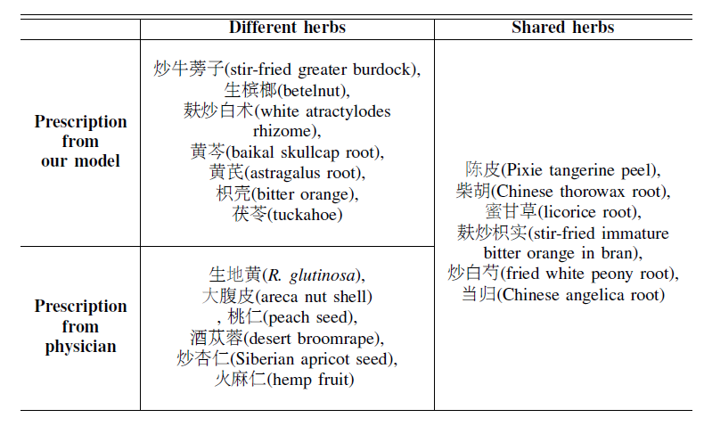
Algorithm-Recommended Herbs vs. Physician-Prescribed Herbs
Model
Shared
Difference
Physician

Slide 21
Application Example 2: Business intelligence
Predicted Values
of Real World Variables
Predictive
Model
Multiple
Predictors
(Features)
Business intelligence
Consumer trends…
…
Optimal Decision Making
Business analysts, Market researcher…
…
Sensor 1
Products
Joint Mining of Non-Text
and Text
Real World
Non-Text
Data
Sensor k
…
Text
Data

Slide 22
Latent Aspect Rating Analysis (LARA) [Wang et al. 10]
TextScope
How to infer aspect ratings?
How to infer aspect weights?
Value Location Service …
Value Location Service …
Hongning Wang, Yue Lu, ChengXiang Zhai. Latent Aspect Rating Analysis on Review Text Data: A Rating Regression Approach, Proceedings of the 17th ACM SIGKDD International Conference on Knowledge Discovery and Data Mining (KDD'10), pages 115-124, 2010.

Slide 23
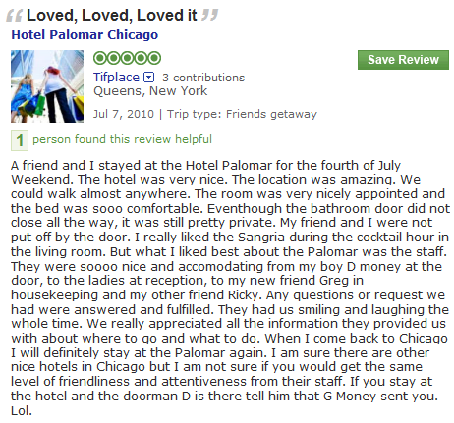
Solving LARA in two stages: Aspect Segmentation + Rating Regression
Aspect Segmentation
+
Latent Rating Regression
Reviews + overall ratings
Aspect segments
Term Weights
Aspect Rating
Aspect Weight
location:1
amazing:1
walk:1
anywhere:1
0.0
2.9
0.1
0.9
3.9
0.2
room:1
nicely:1
appointed:1
comfortable:1
0.1
1.7
0.1
3.9
4.8
0.2
nice:1
accommodating:1
smile:1
friendliness:1
attentiveness:1
2.1
1.2
1.7
2.2
0.6
5.8
0.6
Observed
Latent!

Slide 24
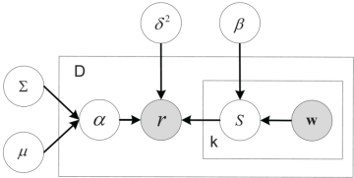
Latent Rating Regression
Aspect segments
Term Weights
Aspect Rating
Aspect Weight
location:1
amazing:1
walk:1
anywhere:1
0.0
0.9
0.1
0.3
1.3
0.2
room:1
nicely:1
appointed:1
comfortable:1
0.1
0.7
0.1
0.9
1.8
0.2
nice:1
accommodating:1
smile:1
friendliness:1
attentiveness:1
0.6
0.8
0.7
0.8
0.9
3.8
0.6
Conditional likelihood

Slide 25
A Unified Generative Model for LARA
Entity
Review
Aspect Rating
Aspect Weight
Location
location
amazing
walk
anywhere
Excellent location in walking distance to Tiananmen Square and shopping streets. That’s the best part of this hotel! The rooms are getting really old. Bathroom was nasty. The fixtures were falling off, lots of cracks and everything looked dirty. I don’t think it worth the price. Service was the most disappointing part, especially the door men. this is not how you treat guests, this is not hospitality.
0.86
Room
room
dirty
appointed
smelly
Aspects
0.04
Service
terrible
front-desk
smile
unhelpful
0.10
Hongning Wang, Yue Lu, ChengXiang Zhai, Latent Aspect Rating Analysis without Aspect Keyword Supervision, Proceedings of KDD 2011, pages 618-626.

Slide 26
Sample Result 1: Rating Decomposition
Hotels with the same overall rating but different aspect ratings
Reveal detailed opinions at the aspect level
(All 5 Stars hotels, ground-truth in parenthesis.)
Hotel | Value | Room | Location | Cleanliness
Grand Mirage Resort | 4.2(4.7) | 3.8(3.1) | 4.0(4.2) | 4.1(4.2)
Gold Coast Hotel | 4.3(4.0) | 3.9(3.3) | 3.7(3.1) | 4.2(4.7)
Eurostars Grand Marina Hotel | 3.7(3.8) | 4.4(3.8) | 4.1(4.9) | 4.5(4.8)

Slide 27
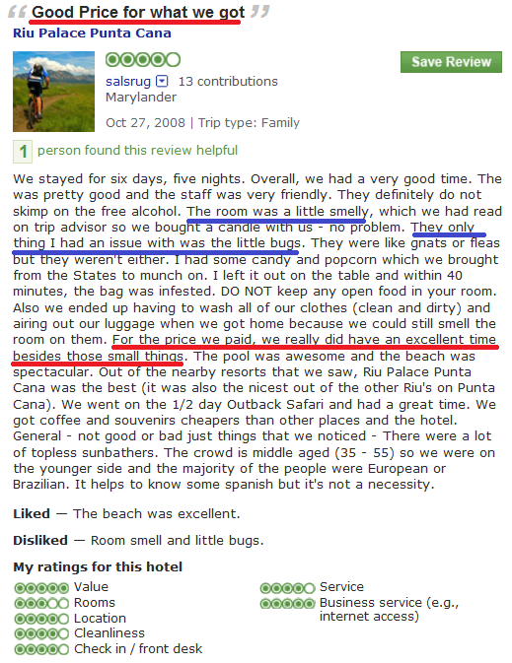
Sample Result 2: Comparison of reviewers
Reviewer-level Hotel Analysis
Different reviewers’ ratings on the same hotel
Reveal differences in opinions of different reviewers
Reviewer | Value | Room | Location | Cleanliness
Mr.Saturday | 3.7(4.0) | 3.5(4.0) | 3.7(4.0) | 5.8(5.0)
Salsrug | 5.0(5.0) | 3.0(3.0) | 5.0(4.0) | 3.5(4.0)
(Hotel Riu Palace Punta Cana)

Slide 28
Sample Result 3:Aspect-Specific Sentiment Lexicon
Uncover sentimental information directly from the data
Value | Rooms | Location | Cleanliness
resort 22.80 | view 28.05 | restaurant 24.47 | clean 55.35
value 19.64 | comfortable 23.15 | walk 18.89 | smell 14.38
excellent 19.54 | modern 15.82 | bus 14.32 | linen 14.25
worth 19.20 | quiet 15.37 | beach 14.11 | maintain 13.51
bad -24.09 | carpet -9.88 | wall -11.70 | smelly -0.53
money -11.02 | smell -8.83 | bad -5.40 | urine -0.43
terrible -10.01 | dirty -7.85 | road -2.90 | filthy -0.42
overprice -9.06 | stain -5.85 | website -1.67 | dingy -0.38

Slide 29
Sample Result 4: User Rating Behavior Analysis
 | Expensive Hotel |  | Cheap Hotel
 | 5 Stars | 3 Stars | 5 Stars | 1 Star
Value | 0.134 | 0.148 | 0.171 | 0.093
Room | 0.098 | 0.162 | 0.126 | 0.121
Location | 0.171 | 0.074 | 0.161 | 0.082
Cleanliness | 0.081 | 0.163 | 0.116 | 0.294
Service | 0.251 | 0.101 | 0.101 | 0.049
People like expensive hotels
because of good service
People like cheap hotels because of good value

Slide 30
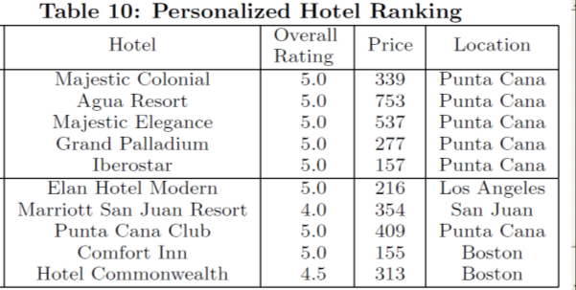
Sample Result 5: Personalized Recommendation of Entities
Query: 0.9 value
0.1 others
Non-Personalized
Personalized

Slide 31
Application Example 3: Prediction of Stock Market
Predicted Values
of Real World Variables
Multiple
Predictors
(Features)
Market volatility
Stock trends, …
Predictive
Model
…
Optimal Decision Making
Stock traders
…
Sensor 1
Joint Mining of Non-Text
and Text
Real World
Non-Text
Data
Events in Real World
Sensor k
…
Text
Data

Slide 32
Text Mining for Understanding Time Series [Kim et al. CIKM’13]
What might have caused the stock market crash?
Sept 11 attack!
TextScope
Dow Jones Industrial Average [Source: Yahoo Finance]
…
Time
…
Time
Any clues in the companion news stream?
H. Kim, M. Castellanos, M. Hsu, C. Zhai, T. A. Rietz, D. Diermeier. Mining causal topics in text data: iterative topic modeling with time series feedback, Proceedings of ACM CIKM 2013, pp. 885-890, 2013.
Notes:
If we consider external factor, there are additional challenges.
For example, this is Dow Jones Industrial Average, average stock price.
Near September, stock price crash. Actually, this is 2001, and September 11 terrorist attack happened at that time.
Like this, these days, need for analyzing text data jointly with external temporal factor is increasing.
If we can understand why this happen, automatically find reasons, it would be very useful.

Slide 33
A General Framework for Causal Topic Modeling [Kim et al. CIKM’13]
Text Stream
Topic Modeling
Causal Topics
Topic 1
Topic 2
Topic 1
Topic 2
Sep 2001
Oct … 2001
Topic 3
Topic 4
Topic 3
Topic 4
Non-text Time Series
Zoom into
Word Level
Feedback
as Prior
Split Words
Topic 1
W1 +
W2 --
W3 +
W4 --
W5
…
Topic 1-1
W1 +
W3 +
Causal Words
Topic 1-2
W2 --
W4 --
H. Kim, M. Castellanos, M. Hsu, C. Zhai, T. A. Rietz, D. Diermeier. Mining causal topics in text data: iterative topic modeling with time series feedback, Proceedings of ACM CIKM 2013, pp. 885-890, 2013.

Slide 34
Heuristic Optimization of Causality + Coherence

Slide 35
Stock-Correlated Topics in New York Times: June 2000 ~ Dec. 2011
AAMRQ (American Airlines) | AAPL (Apple)
russia russian putin europe european germany bush gore presidential police court judge airlines airport air united trade terrorism food foods cheese nets scott basketball tennis williams open awards gay boy moss minnesota chechnya | paid notice st russia russian europe olympic games olympics she her ms oil ford prices black fashion blacks computer technology software internet com web football giants jets japan japanese plane …
Topics are biased toward each time series
Hyun Duk Kim, Malu Castellanos, Meichun Hsu, ChengXiang Zhai, Thomas A. Rietz, Daniel Diermeier. Mining causal topics in text data: iterative topic modeling with time series feedback, Proceedings of the 22nd ACM international conference on Information
and knowledge management (CIKM ’13), pp. 885-890, 2013.

Slide 36
“Causal Topics” in 2000 Presidential Election
Top Three Words in Significant Topics from NY Times
tax cut 1 screen pataki guiliani enthusiasm door symbolic oil energy prices news w top pres al vice love tucker presented partial abortion privatization court supreme abortion gun control nra
Text: NY Times (May 2000 - Oct. 2000)
Time Series: Iowa Electronic Market
http://tippie.uiowa.edu/iem/
Issues known to be
important in the
2000 presidential election

Slide 37
Retrieval with Time Series Query [Kim et al. ICTIR’13]
News
2000
2001 …
RANK | DATE | EXCERPT
1 | 9/29/2000 | Expect earning will be far below
2 | 12/8/2000 | $4 billion cash in company
3 | 10/19/2000 | Disappointing earning report
4 | 4/19/2001 | Dow and Nasdaq soar after rate cut by Federal Reserve
5 | 7/20/2001 | Apple's new retail store
… | … | …
Hyun Duk Kim, Danila Nikitin, ChengXiang Zhai, Malu Castellanos, and Meichun Hsu. 2013. Information Retrieval with Time Series Query. In Proceedings of the 2013 Conference on the Theory of Information Retrieval (ICTIR '13).

Slide 38
A general TextScope to support many different applications?
TextScope
Predicted Values
of Real World Variables
Predictive
Model
Multiple
Predictors
(Features)
Learning to interact
Domain Knowledge
…
Optimal Decision Making
Prediction
…
Text + Non-Text
Medical & Health
E-Commerce
Stocks & Financial
Education
Security
… …
Sensor 1
Joint Mining of Non-Text
and Text
Real World
Non-Text
Data
Interactive
text analysis
Sensor k
…
Text
Data
Interactive information retrieval
Natural language processing

Slide 39
Major Challenges in Building a General TextScope
Different applications have different requirements ➔ Need abstraction
What are the common analysis operators shared by multiple text analysis tasks?
How can we design a general text analysis language covering many applications?
Retrieval and analysis need to be integrated ➔ A unified operator-based framework
How can we formalize retrieval and analysis functions as multiple compatible general operators?
How can we manage workflow?
How can we optimize human-computer collaboration?
How can TextScope adapt to a user’s need dynamically and support personalization?
How can humans train/teach TextScope with minimum effort?
How can we perform joint analysis of text and non-text data?
Implementation Challenges: Architecture of a general TextScope? Real-time response?

Slide 40
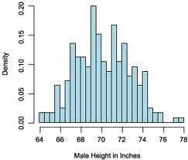
Some Possible Analysis Operators
Intersect
Select
Split
…
Union
Topic
Ranking
Interpret
Compare
Common | C1 | C2

Slide 41
Formalization of Operators
C={D1, …, Dn}; S, S1, S2, …, Sk subset of C
Select Operator
Querying(Q): C→ S
Browsing: C→S
Split
Categorization (supervised): C→ S1, S2, …, Sk
Clustering (unsupervised): C→ S1, S2, …, Sk
Interpret
C x θ →S
Ranking
θ x Si → ordered Si

Slide 42
Compound Analysis Operator: Comparison of K Topics
Select
Topic 1
…
Compare
Common | S1 | S2
Select
Topic k
Interpret
Interpret
Interpret
Interpret(Compare(Select(T1,C), Select(T2,C),…Select(Tk,C)),C)

Slide 43
Compound Analysis Operator: Split and Compare
Split
…
Compare
Common | S1 | S2
Interpret
Interpret
Interpret
Interpret(Compare(Split(S,k)),C)

Slide 44
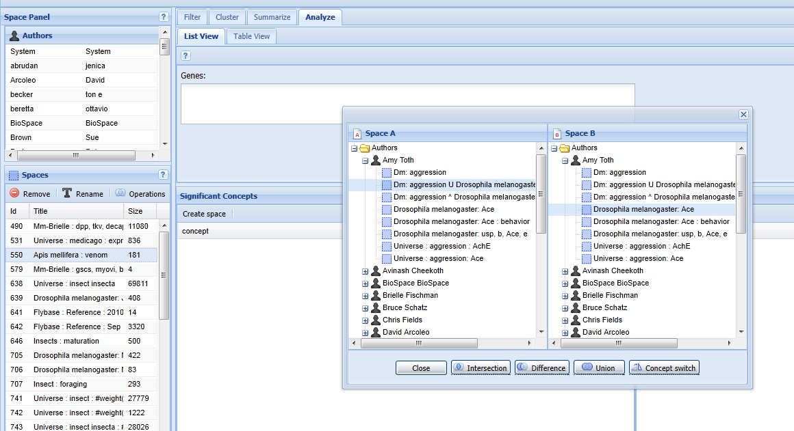
BeeSpace: Analysis Engine for Biologists [Sarma et al. 11]
Sarma, M.S., et al. (2011) BeeSpace Navigator: exploratory analysis of gene function using semantic indexing of biological literature. Nucleic Acids Research, 2011, 1-8, doi:10.1093/nar/gkr285.
Filter, Cluster, Summarize, Analyze
Persistent Workspace
Intersection, Difference, Union, …

Slide 45
Summary
Human as Subject Intelligent Sensor ➔ Special value of text for mining
Applicable to all “big data” applications
Especially useful for mining human behavior, preferences, and opinions
Directly express knowledge (small text data are useful as well)
Difficulty in NLP ➔ Must optimize the collaboration of humans and machines, maximization of combined intelligence of humans and computers
Let computers do what they are good at (statistical analysis and learning)
Turn imperfect techniques into perfect applications
Vision of TextScope: many applications & many new challenges
Integration of intelligent retrieval and text analysis
Joint analysis of text and non-textual (context) data
How to optimize the collaboration (combined intelligence) of computer and humans?

Slide 46
Beyond TextScope: Intelligent Task Agent, DataScope
DataScope
...
TextScope
Intelligent
Task Agents
…
…
Predicted Values
of Real World Variables
Predictive
Model
Multiple
Predictors
(Features)
Learning to interact
Domain Knowledge
…
Learning to explore
Optimal Decision Making
Prediction
Learning to collaborate
…
Text + Non-Text
Sensor 1
Joint Mining of Non-Text
and Text
Real World
Non-Text
Data
Analysis of
non-text data
Interactive
text analysis
Sensor k
…
Text
Data
Interactive information retrieval
Natural language processing

Slide 47
General Open Research Challenges
Grand Challenge: How to maximize the combined intelligence of humans and machines instead of intelligence of machines alone
How to optimize the “cooperative game” of human-computer collaboration?
Machine learning is just one way of human-computer collaboration
What are other forms of collaboration? How to optimally divide the task between humans and machines?
How to minimize the total effort of a user in finishing a task?
How to go beyond component evaluation to measure task-level performance?
How to optimize sequential decision making (reinforcement learning)?
How to model/predict user behavior?
How to minimize user effort in labeling data (active learning)?
How to explain system operations to users?
How to minimize the total system operation cost?
How to model and predict system operation cost (computing resources, energy consumption, etc)?
How to optimize the tradeoff between operation cost and system intelligence?
Robustness Challenge: How to manage/mitigate risk of system errors? Security problems?

Slide 48
Acknowledgments
Collaborators: Many former and current TIMAN group members, UIUC colleagues, and many external collaborators
Funding

Slide 49
References
Sheng Wang et al. 2014. SideEffectPTM: an unsupervised topic model to mine adverse drug reactions from health forums. In ACM BCB 2014.
S. Wang, E. Huang, R. Zhang, X. Zhang, B. Liu. X. Zhou, C. Zhai, A Conditional Probabilistic Model for Joint Analysis of Symptoms, Diseases, and Herbs in Traditional Chinese Medicine Patient Records, IEEE BIBM 2016.
Hongning Wang, Yue Lu, ChengXiang Zhai. Latent Aspect Rating Analysis on Review Text Data: A Rating Regression Approach, Proceedings of the 17th ACM SIGKDD International Conference on Knowledge Discovery and Data Mining (KDD'10), pages 115-124, 2010.
Hongning Wang, Yue Lu, ChengXiang Zhai, Latent Aspect Rating Analysis without Aspect Keyword Supervision, Proceedings of KDD 2011, pages 618-626.
H. Kim, M. Castellanos, M. Hsu, C. Zhai, T. A. Rietz, D. Diermeier. Mining causal topics in text data: iterative topic modeling with time series feedback, Proceedings of ACM CIKM 2013, pp. 885-890, 2013.
Hyun Duk Kim, Danila Nikitin, ChengXiang Zhai, Malu Castellanos, and Meichun Hsu. 2013. Information Retrieval with Time Series Query. In Proceedings of the 2013 Conference on the Theory of Information Retrieval (ICTIR '13).
Sarma, M.S., et al. (2011) BeeSpace Navigator: exploratory analysis of gene function using semantic indexing of biological literature. Nucleic Acids Research, 2011, 1-8, doi:10.1093/nar/gkr285.
ChengXiang Zhai, Towards a game-theoretic framework for text data retrieval. IEEE Data Eng. Bull. 39(3): 51-62 (2016)

Slide 50
Thank You!
Questions/Comments?

