Slide 1
Integration of Big Data and Education: Towards a Cloud-based Open Lab for Data Science
ChengXiang (“Cheng”) Zhai
Department of Computer Science
University of Illinois at Urbana-Champaign
USA
Microsoft Research Asia Faculty Summit, Nov. 4, 2016, Seoul, Korea

Slide 2

Integration of Big Data and Education
Educate
Intelligent
MOOC Platform
?
Scalability
& Quality
Improve
Research
& Develop
Applied to
MOOC Log
Education Big Data
Big Data Technology

Slide 3
A Cloud-based Open Lab for Data Science (CLaDS)
…
Leaderboard
Log
Data
App Data 1
App Data N
Leaderboard
#1 Team1 0.81
#2 Team 2 0.75
…
#1 Team1 0.5
#2 Team 2 0.3
…
…
Big Data Tool 1
Big Data Tool 2
Big Data Tool 1
Big Data Education System
Log
…

Slide 4
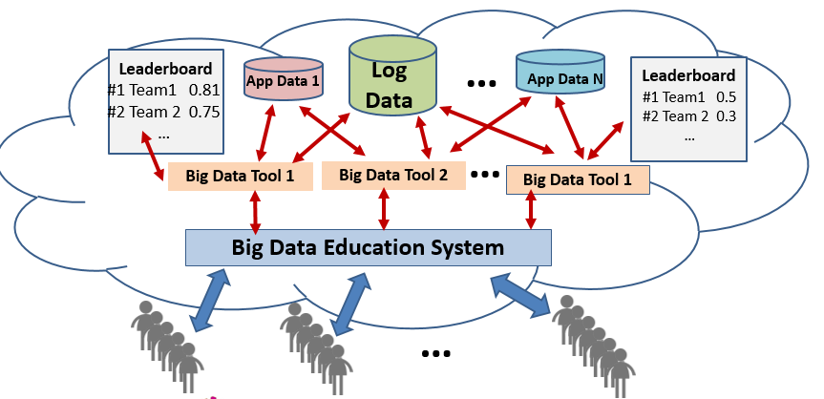
Unification of education, research, and applications!
4. Industry data sets not released to students & researchers
➔ Privacy-preserving Big Data education & research
3. Well-archived interaction history
➔ Reproducibility of research
2. Continuous creation of new data sets for open exploration and research
➔ Remove gap between education & research
1. Students working on industry data sets/problems and contributing applications
➔ Remove gap between education & applications

Slide 5
Self-Sustaining Data Set Annotations & Open Challenge
Annotations
Auto
Grader
Annotations
...
Open Challenge
Competition
Assignment
Annotation
Assignment
...
Raw Data Set
...
Leaderboard
#1 Team1 0.81
#2 Team 2 0.75
…
Annotations
Test Collection

Slide 6

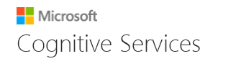

Preliminary Work: Search Engine Competition (Fall 2016)
Microsoft Academic Search Data Sets
MeTA
search engine
Academic
Search Leaderboard
Competition
Task
Grader
#1 Team1 0.5
#2 Team 2 0.3
…
…
https://competitions.codalab.org/competitions/14411?secret_key=c395eae0-ae7c-42d7-bed3-83d603c83ad3

Slide 7
Education ➔ Research
A top-performing student’s assignment/research notes
1.BM25, start with default and by adjusting value. Manually tuning is really inefficient. 2.Programmatic tune, wrote a function to programmatic adjusting k1, b, k3 ….
3.Testing other ranking methods [in MeTA], all of them produce a lower MAP score than BM25. 4.With tuned value of BM25, Start to implement query expansion function. ….
5.Implementation of MPtf2ln ranking function ….
6. Pseudo feed back, since we have the best ranking for BM25 and MPtf2ln, Can we combine the ranking output of these two functions?
7. New Ranking merge this two ranking function’s output, ….
8. With above methods, I received MAP 0.6962 on the Phase 1 Validation Leaderboard, by far the highest score on the leader board.

Slide 8
Next Step: Compete with Microsoft Academic Search Engine!
Build an Experimental Academic Search Engine for A/B Test
Results of student systems: MeTA-based
Results of Microsoft Academic Search Engine: Academic Search API
Students = Users of experimental search engine application
IF (Student system > Microsoft Academic Search) ➔ Immediate Improvement of Microsoft Academic Search!

Slide 9
Summary
Vision: Cloud-based Open Lab for Data Science (CLaDS)
Essential for data science education & research
Integration of education, research, and applications
Sustainable open infrastructure beneficial to everyone
Industry shares cost for highly relevant data set annotations, on target workforce training, and directly useful technology
Students receive free/low-cost training
Researchers benefit from improving productivity and reproducible results
Preliminary results encouraging, but more can be done!
Fully exploit resources such as big scholarly data sets (Open Academic Society)
More investment/work on general infrastructure

Slide 10
Education Automation & Revolution?
Big Data and IT enable education automation and revolution toward more affordable high-quality education
IT enables one teacher to teach many more students than before (efficiency)
Big Data technology would enable “automated” TA/instructor (scalability)
Intelligent MOOC would improve quality of education at low cost
Implications: Many traditional boundaries will likely disappear!
No strict distinction between a teacher and a student (everyone learns from each other)
No strict distinction between grade levels or age groups (learn at your own pace)
No inherent boundaries between different courses (due to high modularization)
No boundaries of subject areas (due to high modularization)
No boundaries of institutions (MOOCs unify all institutions!)

Slide 11
Acknowledgments
Grants
Intel Big Data Education pilot grant (John Somoza)
Microsoft Azure for Education grant (Randy Guthrie, David Giard)
Infrastructure
Microsoft Azure, CodaLab (Evelyne Viegas), and Academic Search API (Kuansan Wang)
UIUC MeTA toolkit (Chase Geigle, Sean Massung), and CS410 assignment (Ismini Lourentzou)
Coursera
Collaboration
Univ. of Delaware (Hui Fang)
Chinese Academy of Sciences (Xueqi Cheng)

Slide 12
Thank You!
Questions/Comments?

