Slide 1
Towards ITDataScope:
Augmenting Human Intelligence for Optimizing IT Operations via Big Data Analytics
ChengXiang (“Cheng”) Zhai
Department of Computer Science
(Carl R. Woese Institute for Genomic Biology
School of Information Sciences
Department of Statistics)
University of Illinois at Urbana-Champaign
czhai@illinois.edu
http://czhai.cs.illinois.edu/
AIOps 2023 Academic Saloon , May 24, 2023, Berlin, Germany

Slide 2
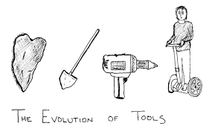
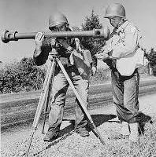




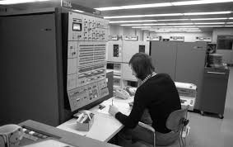

Humans have invented many tools to augment human capabilities
Augment human intelligence?
Make more intelligent decisions?
Particularly for AIOps?

Slide 3
Outline
Big Data to Intelligence: Autonomous AI vs. Assistive AI
ITDataScope: Augmenting Human Intelligence in AIOps
Relevant Techniques and Results
Roadmap for Future Directions

Slide 4
Big Data-Enabled Intelligent Systems (IS)
Autonomous AI: Intelligent systems to replace humans
Training Data
(Supervised) Machine Learning
Big Data
Observations of World
Human
(Unsupervised) Machine Learning
Data Mining
Intelligence
Assistive AI: Intelligent systems to assist humans

Slide 5
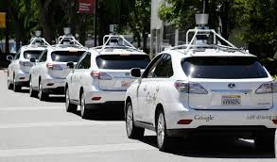

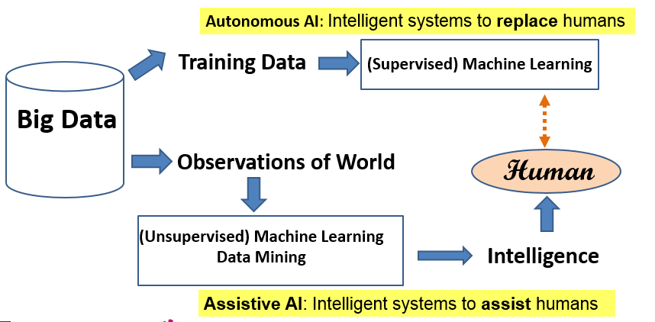


Autonomous IS vs. Assistive IS
Autonomous IS
Simple tasks, Big training data available, Limited domain
Intelligence(Machine) ≤ Intelligence (Human) [Upper Bound]
Mimic Human Intelligence
Any domain, All kinds of data
Augment Human Intelligence
“Data Scope” to enhance human perception, Complex tasks
Intelligence (Machine + Human) > Intelligence(Human) [Lower Bound]
Human in the Loop
Assistive IS
Tasks that humans can’t (easily) do

Slide 6


DataScope in Action: intelligent interactive decision support
DataScope
Prediction of
Decision Factors
(Current & Future)
Visualization
Multiple
Predictors
(Features)
Predictive
Model
Learning to interact
Domain Knowledge
…
Optimal Decision Making
Prediction
Hypothesis
exploration
…
Sensor 1
Joint Mining of Non-Text
and Text
Real World
Non-Text
Data
Data Integration
Sensor k
Interactive
data analysis
Data
Understanding
(NLP, Vision, …)
…
Text
Data
Interactive
retrieval

Slide 7
Outline
Big Data to Intelligence: Autonomous AI vs. Assistive AI
ITDataScope: Augmenting Human Intelligence in AIOps
Relevant Techniques and Results
Roadmap for Future Directions

Slide 8
IT Big Data Enables AIOps
Autonomous AI: Intelligent systems to automate tasks
IT Big Data
Training Data
(Supervised) Machine Learning
logs, metrics, tickets, documentations, source codes, info & knowledge on Web, …
Observations of
IT systems &
applications
…
Reliability
Engineers
Developers
(Unsupervised) Machine Learning
Data Mining
Intelligence
Assistive AI: Intelligent systems to assist human decision makers

Slide 9

ITDataScope as a Special DataScope for AIOps
Anomalies, performance issues,
security concerns, …
ITDataScope
Prediction of
Decision Factors
(Current & Future)
Visualization
Multiple
Predictors
(Features)
Predictive
Model
Learning to interact
Domain Knowledge
…
Reliability engineers,
users, software developers …
Optimal Decision Making
Prediction
Hypothesis
exploration
…
Sensor 1
Joint Mining of Non-Text
and Text
Real World
Non-Text
Data
IT Systems
Data Integration
Sensor k
Interactive
data analysis
Data
Understanding
(NLP, Vision, …)
…
Text
Data
Interactive
retrieval

Slide 10
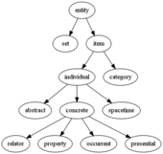
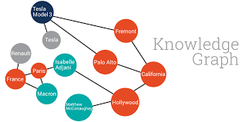

Architecture of ITDataScope
Reliability engineers,
users, software developers …
Personalized System Healthcare Advising Agent & Workbench
User Model
Task Model
Interaction Log Data
Reactive Healthcare Support
Proactive Healthcare Management
AIOps Knowledge Network
Optimal
Decision Making
AIOps Ontology
Real World
IT Systems
Data Understanding and
Actionable Knowledge Extraction
System Health Records
Ticket Data, Logs, Metrics ….
Public Information & Knowledge
StackOverflow , GitHub, …

Slide 11
Design Principles & Benefits
Knowledge-based AIOps:
  Enable explainable AI (XAI) and robust lifelong machine learning
  Naturally involve human in loop for optimization of combined intelligence
Integration and joint analysis of all kinds of data:
  Exploit “big data” maximally (humans as subjective intelligent sensors)
  Enable (early) discovery of weak signals (addressing data sparseness)
Operator-based workbench:
  Enable support of infinitely many different workflows using a finite number of compatible data analysis operators
  Enable personalized trainable intelligent operators
Natural progression from assistive to autonomous AI
  Enable lifelong and continuous machine learning from interactions with users

Slide 12
Major Challenges
Knowledge-based AIOps:
  How can we design a general knowledge representation language for AIOps?
  How can we extract such knowledge with no/minimum human effort?
Integration and joint analysis of all kinds of data:
  How can we develop models and algorithms to enable computers to understand and make sense of all scattered data?
  How can we apply natural language processing (NLP) to AIOps?
  How can we perform joint analysis of text and non-text data?
Operator-based workbench:
  How can we design and implement a set of basic and compatible analysis operators?
  How can we design an operator-based programming language for AIOps?
  How can we naturally integrate all kinds of machine learning methods (i.e., unsupervised, semi-supervised, self-supervised, active, and reinforcement learning) to support personalized trainable intelligent operators?
Natural progression from assistive to autonomous AI
  How can we leverage recent progress in generative AI to develop a general AIOps Chatbot?

Slide 13
Outline
Big Data to Intelligence: Autonomous AI vs. Assistive AI
ITDataScope: Augmenting Human Intelligence in AIOps
Relevant Techniques and Results
Roadmap for Future Directions

Slide 14
Relevant Applications of Text Analysis (TextScope)
1. Aviation Safety (interactive analysis of text + non-text)
2. Medical and Healthcare (probabilistic generative models)
3. IT tickets (topic discovery and mapping)
4. Taxonomy construction (leveraging pre-trained neural language models)

Slide 15
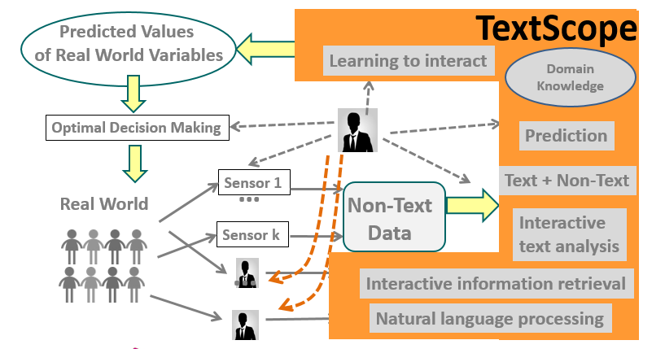

TextScope Application 1: Aviation Safety
Anomalous events &
causes
Aviation Administrator
Aviation Safety

Slide 16

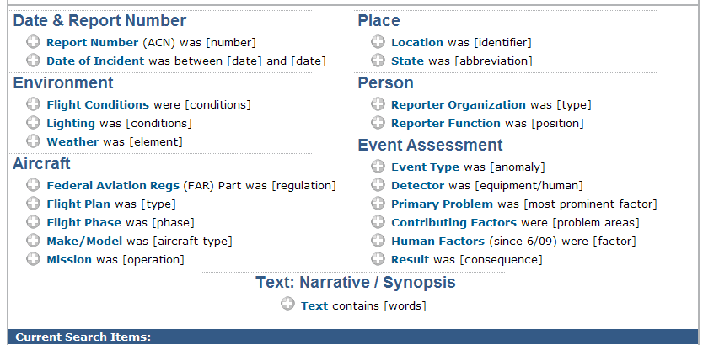
Abundance of text data in the aviation domain
Collecting reports since 1976
>860,000 reports as of Dec. 2009

Slide 17
Lots of useful knowledge buried in text
ASRS Report ACN: 928983 (Date: 201101, Time: 1801-2400. …)
We were delayed inbound for about 2 hours and 20 minutes. On the approach there was ice that accumulated on the aircraft. … The Captain wrote up … The flight crew [who picked up the plane] the following morning notified us of an incorrect remark section write up. I believe a few years ago, there was a different procedure for writing up aborted takeoffs. I think there was some confusion as to what the proper write-up for the aborted takeoff was. A contributing factor for this incorrect entry into the log may have been fatigue. I had personally been awake for about 14 hours and still had another leg to do. …Also a contributing factor is that this event does not happen regularly…. A more thorough review and adherence to the operations manual section regarding aircraft status would have prevented this, [as well as], a better recognition of the onset of fatigue. The manual is sometimes so large that finding pertinent data is difficult. Even after it was determined that the event had occurred, it took me 15 to 20 minutes to find the section regarding aborted takeoffs.

Slide 18
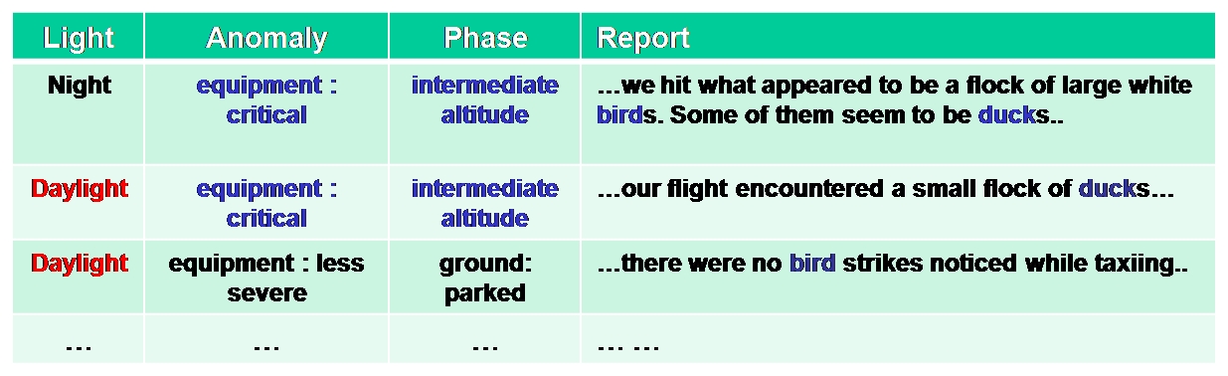
Interactive Analysis of Multidimensional Text Databases [Yu et al. 2009]
Analyst
…
Analysis Support
Multidimensional OLAP, Ranking, Comparison, Cause Analysis, …
Topic
Topic
turbulence
Topic Cube
Representation
birds
Encounter
undershoot
Deviation
overshoot
1998
98.02
98.01
1999
99.02
LAX
SJC
MIA
AUS
99.01
Time
CA
FL
TX
Time
Location
Location
drill-down
roll-up
Multidimensional
Text Database
Yintao Yu, Cindy X. Lin, Yizhou Sun, Chen Chen, Jiawei Han, Binbin Liao, Tianyi Wu, ChengXiang Zhai, Duo Zhang, and Bo Zhao, “iNextCube: Information Network-Enhanced Text Cube", Proc. 2009 Int. Conf. on Very Large Data Bases (VLDB'09) (system demo), 2009
Notes:
18

Slide 19
Topic Cube Construction [Zhang et al. 2010]
ALL
Anomaly Altitude Deviation
Anomaly Maintenance Problem
Anomaly Inflight Encounter
……
……
Undershoot
……
Overshoot
Improper Documentation
……
Improper Maintenance
Birds
……
Turbulence
Time | Loc | Env | … | Narrative
98.01 | TX | Daylight | …
98.01 | LA | Daylight | …
98.01 | LA | Night | …
99.02 | FL | Night | …
Altitude 0.03
Ft 0.02
Climb 0.01
… ….
Topics in daylight
Descent 0.06
Cloud 0.03
Ft 0.01
… ….
Altitude 0.04
Ft 0.03
Instruct 0.01
… ….
Topics in night
Descent 0.05
System 0.02
View 0.01
… ….
Duo Zhang, ChengXiang Zhai, Jiawei Han, Ashok Srivastava, Nikunj Oza. Topic Modeling for OLAP on Multidimensional Text Databases: Topic Cube and its Applications, Statistical Analysis and Data Mining, Vol. 2, pp.378-395, 2010.

Slide 20

Comparison of distributions of anomalies in FL, TX, and CA
Improper Documentation
(Florida)
Turbulence
(Texas)
Notes:
20

Slide 21
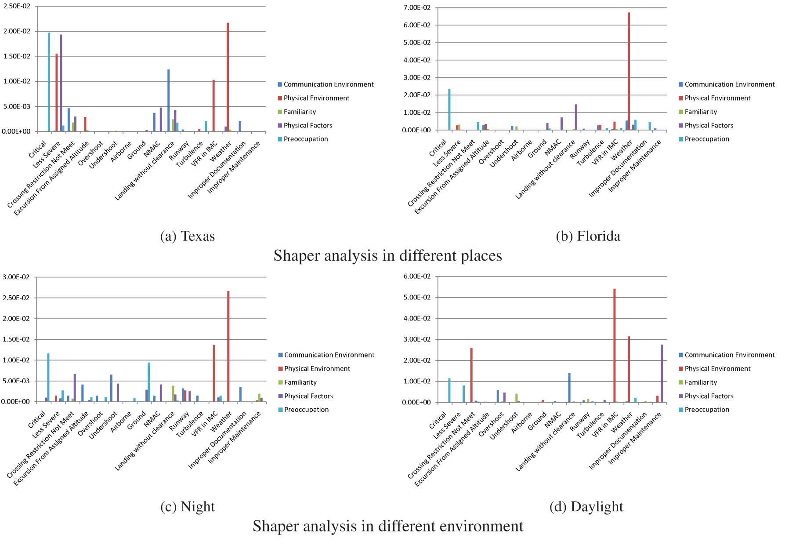
Comparative Analysis of Shaping Factors: Texas vs. Florida
Texas
Florida
Improper Documentation
Turbulence
Notes:
“Physical Environment” is the main cause for anomalous events “Weather” and “VFR in IMC”
“Physical Factors” causes more anomaly during night rather than daylight
“Communication environment”causes “Landing without clearance” more in Texas than in Florida
21

Slide 22
Future: Similar interactive analysis of multidimensional text data for AIOps?
Analyst
…
Analysis Support
Multidimensional OLAP, Ranking, Comparison, Cause Analysis, …
Topic
Topic
turbulence
Topic Cube
Representation
birds
Encounter
undershoot
Deviation
overshoot
1998
98.02
98.01
1999
99.02
LAX
SJC
MIA
AUS
99.01
Time
CA
FL
TX
Time
Location
Location
drill-down
roll-up
Multidimensional
Text Database
Yintao Yu, Cindy X. Lin, Yizhou Sun, Chen Chen, Jiawei Han, Binbin Liao, Tianyi Wu, ChengXiang Zhai, Duo Zhang, and Bo Zhao, “iNextCube: Information Network-Enhanced Text Cube", Proc. 2009 Int. Conf. on Very Large Data Bases (VLDB'09) (system demo), 2009
Notes:
22

Slide 23
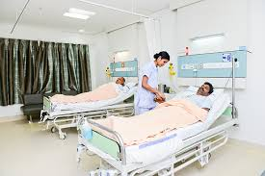
TextScope Application 2: Medical & Health
Diagnosis, optimal treatment
Side effects of drugs, …
Physicians, Patients, Researchers…
Medical & Health

Slide 24
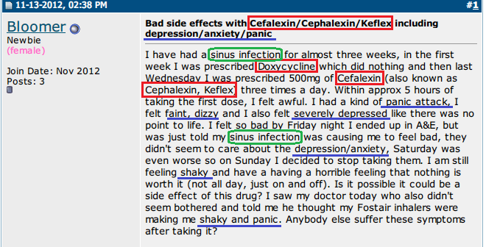

2.1 Extraction of Adverse Drug Reactions from Forums
Green: Disease symptoms
Blue: Side effect symptoms
Red: Drug
TextScope
Drug: Cefalexin
ADR:
panic attack
faint
….

Slide 25
A Probabilistic Model for ADR Extraction [Wang et al. 14]
Challenge: how do we separate treated symptoms from side-effect symptoms?
Solution: leverage knowledge about known symptoms of diseases treated by a drug
Probabilistic model
  Assume forum posts are generated from a mixture language model
  Most words are generated using a background language model
  Treated (disease) symptoms and side-effect symptoms are generated from separate models, enabled by the use of external knowledge about known disease symptoms
  Fitting the model to the forum data allows us to learn the side-effect symptom distributions
Sheng Wang et al. 2014. SideEffectPTM: an unsupervised topic model to mine adverse drug reactions from health forums. In ACM BCB 2014.

Slide 26
Sample ADRs Discovered [Wang et al. 14]
Drug(Freq) | Drug Use | Symptoms in Descending Order
Zoloft (84) | antidepressant | weigh gain, weight, depression, side effects, mgs, gain weight, anxiety, nausea, head, brain, pregnancy, pregnant, headaches, depressed, tired
Ativan (33) | anxiety disorders | Ativan, sleep, Seroquel, doc prescribed seroqual, raising blood sugar levels, anti-psychotic drug, diabetic, constipation, diabetes, 10mg, benzo, addicted
Topamax (20) | anticonvulsant | Topmax, liver, side effects, migraines, headaches, weight, Topamax, pdoc, neurologist, supplement, sleep, fatigue, seizures, liver problems, kidney stones
Ephedrine (2) | stimulant | dizziness, stomach, Benadryl, dizzy, tired, lethargic, tapering, tremors, panic attach, head
Unreported to FDA
Sheng Wang et al. 2014. SideEffectPTM: an unsupervised topic model to mine adverse drug reactions from health forums. In ACM BCB 2014.

Slide 27
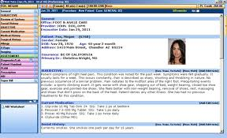
2.2 Analysis of Electronic Medical Records (EMRs)
Disease Profile
EMRs (Patient Records)
TextScope
Typical symptoms: P(Symptom|Disease)
Typical treatments: P(Treatment|Disease)
Effectiveness of treatment
Subcategories of disease
… …

Slide 28

The Conditional Symptom-Treatment Model [Wang et al. 16]
Typical symptoms
of disease d
Typical treatments
of disease d
Likelihood of
patient t having disease d
Symptom
Disease
All diseases
of patient t
Treatment
Observed Patient Record
S. Wang, E. Huang, R. Zhang, X. Zhang, B. Liu. X. Zhou, C. Zhai, A Conditional Probabilistic Model for Joint Analysis of Symptoms, Diseases, and Herbs in Traditional Chinese Medicine Patient Records, IEEE BIBM 2016.
Notes:
We show the probability of patient t having symptom s and being prescribed herb h with disease diagnoses Dt.
Here Pr(s,h|t) is the probability of of patient t having symptom s and being prescribed herb h.
Dt is the set of diseases this patient have, which is also observed in the record.
Pr(d|t) is the likelihood of patient t having disease d.
Pr(s|d) is the typical symptoms of disease d.
Pr(h|d) is the typical herbs of disease d.
The goal of optimization is to find optimial Pr(s|d), Pr(h|d) and Pr(d|t) so that the probability of all the observed {Pr(s,h|t)} would be maximzied.
We use EM algorithm to optimize this loss function. The optimization is fast and can be scaled to thousands of medical record.
More details about the models are in the paper.

Slide 29
Evaluation: Traditional Chinese Medicine(TCM) EMRs
10,907 patients TCM records in digestive system treatment
3,000 symptoms, 97 diseases and 652 herbs
Ground truth: 27,285 manually curated herb-symptom relationship.
Notes:
While we envision that our method would be used to mine a large number of patient records from multiple physicians, direct experimentation with such a mixed dataset would make it difficult to choose the most suitable physician to assess the data mining results. This is because different
physicians tend to have varying opinions due to the differences in their training and experiences.
Thus, we decided to evaluate the proposed model using patient records from a single physician. This way, the physician can judge to what extent
the mined results match the his reasoning and experience.
Specifically, we used 10,907 anonymous electronic medical records provided by a TCM physician whose specialization is in digestive system treatments. We normalized the symptom and herb terms to obtain 9,530 records with 3,000 symptoms, 97 diseases, and 652 herbs.
The most frequently occurring disease is “chronic gastritis” and the most frequently occurring symptom is “abdominal pain and chills.”
To quantitatively evaluate our model, we collected a set of herb-symptom relationship annotations, manually curated by TCM experts. These nnotations contain 27,285 herb-symptom relationships. The symptoms and herbs of 1,624 of these relationships appear in our dataset. Consequently, we evaluate how our method can accurately identify this subset of 1,624 relationships.

Slide 30
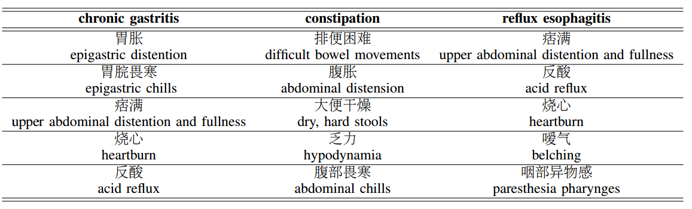
“Typical Symptoms” of 3 Diseases: p(s|d)
Notes:
We show three sample conditional symptom distributions with the highest entropy values among all 100 disease profiles learned with our model. The entropy of a distribution measures its information content. Thus, the higher the entropy, the more informative the distribution.
Here we show the top five symptoms, sorted by decreasing probability, for three different diseases. The physician judged these symptoms to be typical symptoms for the corresponding disease. Indeed, the relevance of these symptoms to the disease is often obvious. For example, “difficult
bowel movements,” “abdominal distension,” and “dry, hard stools” are common symptoms for “constipation.” The fact that our model was able to learn these associations automatically from the dataset clearly demonstrates the effectiveness of the model for mining medical knowledge. Our model can also differentiate between similar diseases, such as “reflux esophagitis” and “chronic gastritis,” which share symptoms such as “acid reflux” and “heartburn.” We discover “paresthesia pharynges” and “discomfort in upper respiratory tract” for “reflux esophagitis,” while these symptoms do not appear for “chronic gastritis.”
Remarkably, many of these symptoms are unique TCM symptoms and are not well-studied in western medicine. For example, the model discovered that “dark, purplish tongue” is associated with “coronary heart disease.” Our physician verified these unique TCM symptoms for their corresponding diseases. This result further shows the effectiveness of using our model in revealing TCM knowledge from medical records. Our model can provide useful TCM symptoms to facilitate differential diagnosis and precision herb prescription.

Slide 31
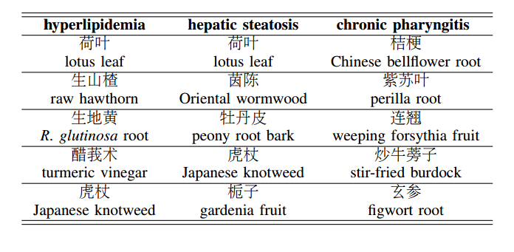
“Typical Herbs” Prescribed for 3 Diseases: p(h|d)
Notes:
We show the top five herbs of selected herb distributions for three different diseases. These herbs are unique to TCM and are unused by western medicine. There is evidence showing the empirical effectiveness of these herbs, of which a deeper understanding can improve our overall medicinal knowledge. We can see that our model successfully discovered many herbs with known relations to these different diseases
. For example, our model asserts that “lotus leaves” and “fresh hawthorn” can be used to treat “hyperlipidemia,” which can be verified by existing TCM knowledge and recent studies.
In addition to supporting existing knowledge, our model can also find novel herb prescription knowledge. For instance, our model determines that “turmeric root” can be used to treat “hypertension.” A recent work showed that curcumin, an active ingredient of turmeric root, can be used to treat idiopathic pulmonary arterial hypertension, a type of genetic hypertension. With further analysis on multiple visits of a given patient, we can assess the effectiveness of specific herbs prescribed for a disease. This is an important future direction we wish to pursue.

Slide 32
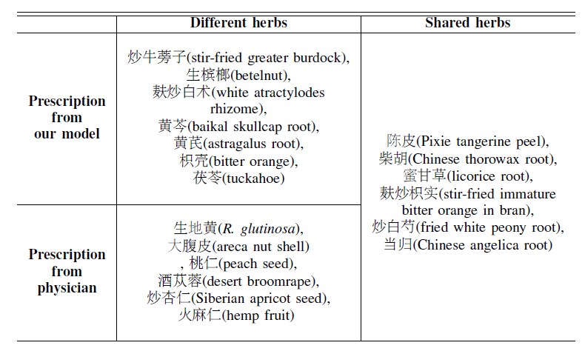
Algorithm-Recommended Herbs vs.
Physician-Prescribed Herbs
Model
Shared
Difference
Physician

Slide 33
Future: AIOps = AI for “system healthcare”?
Electronic Health Records ➔ Electronic System Health Records?
Discovery of adverse drug reactions ➔ Early discovery of potential security concerns from online discussion?
  Enable proactive management of Potential IT problems
Generative models for medical records ➔ Generative models of system health records?
  Enable model-based extraction of knowledge from data
  Enable model-based (knowledge-based) diagnosis and treatment recommendation

Slide 34
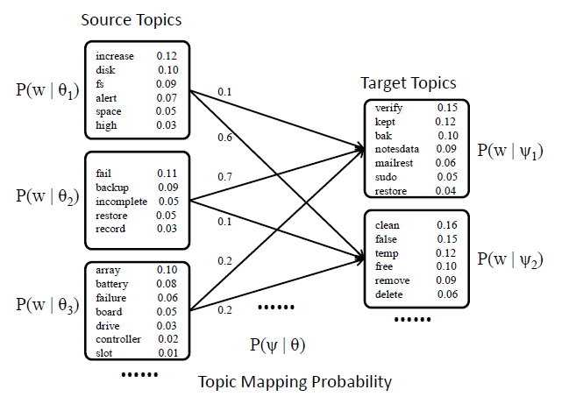
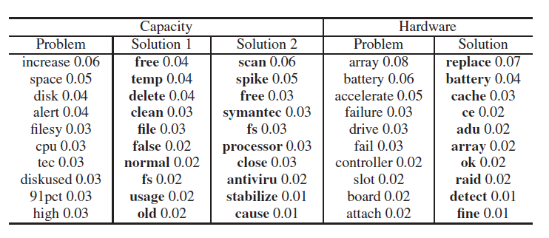
TextScope Application 3: IT Ticket Analysis [Zhang et al. 2010]
IT Ticket Data
Probabilistic Problem-Resolution Topic Map
TextScope
Sample Results
Duo Zhang, Jimeng Sun, ChengXiang Zhai, Abhijit Bose, and Nikos Anerousis. 2010. PTM: probabilistic topic mapping model for mining parallel document collections. In Proceedings of the 19th ACM international conference on Information and knowledge management (CIKM '10). Association for Computing Machinery, New York, NY, USA, 1653–1656. https://doi.org/10.1145/1871437.1871696

Slide 35
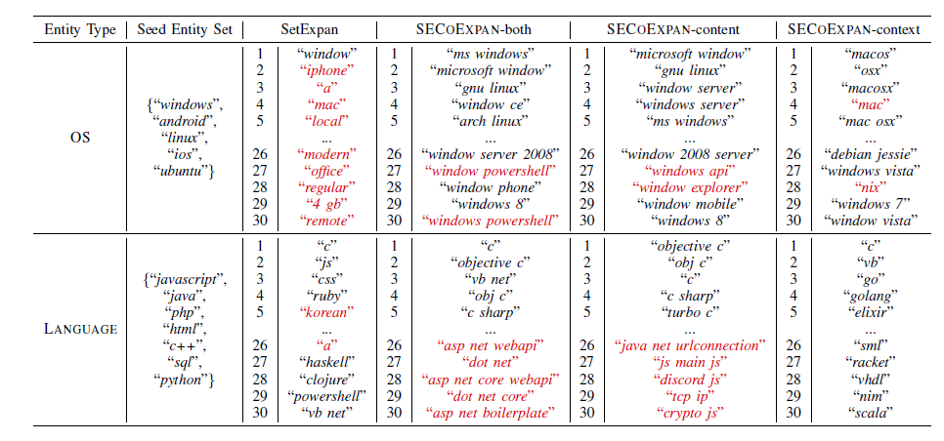
TextScope Application 4: Entity Set Expansion in StackOverflow [Zhang et al. 22]
Content embedding Is more useful for top-ranked entities
Context information Is more useful for low-ranked entities
Yu Zhang, Yunyi Zhang, Yucheng Jiang, Martin Michalski, Yu Deng, Lucian Popa, ChengXiang Zhai, Jiawei Han, "Entity Set Co-Expansion in StackOverflow," in 2022 IEEE International Conference on Big Data (Big Data), Osaka, Japan, 2022 pp. 4792-4795. doi: 10.1109/BigData55660.2022.10020770

Slide 36
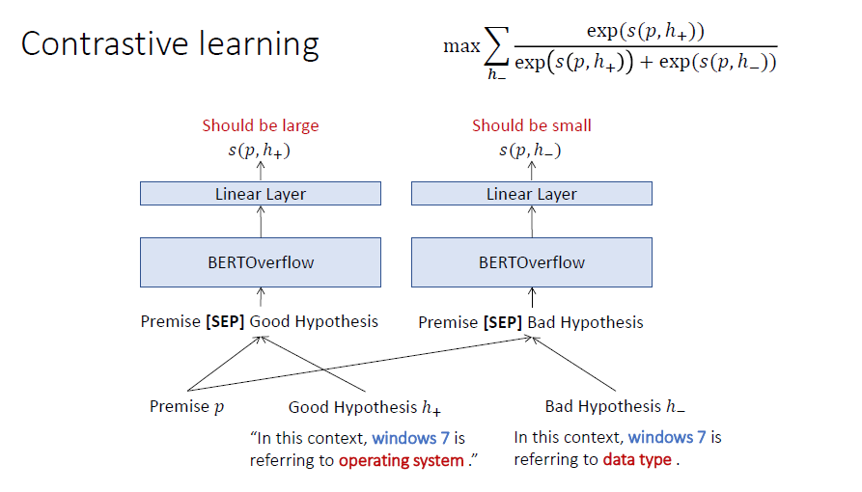
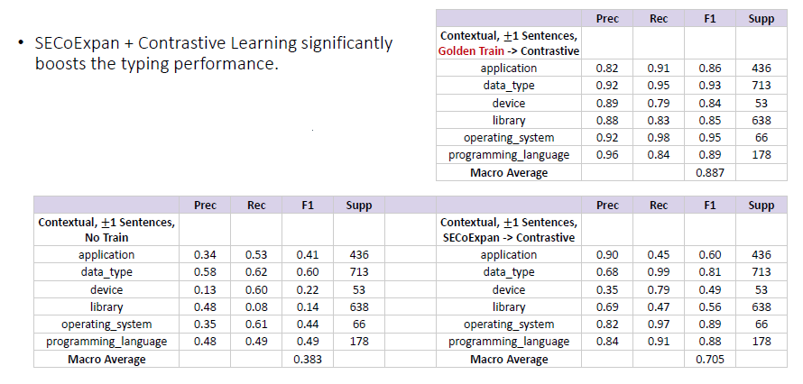
Improvement: More Types, Contrastive Learning (Ongoing Work)

Slide 37
Outline
Big Data to Intelligence: Autonomous AI vs. Assistive AI
ITDataScope: Augmenting Human Intelligence in AIOps
Relevant Techniques and Results
Roadmap for Future Directions

Slide 38
Future Directions: ITDataScope as a roadmap for AIOps
Reliability engineers,
users, Software developers …
7. Conversational Agent and Lifelong Machine Learning
Personalized Healthcare Advising Agent & Workbench
User Model
Task Model
Interaction Log Data
6. User & Task Modeling for Personalization
9. Optimization of
Human-System Collaboration
Reactive Healthcare Support
Proactive Healthcare Management
5. Reactive & Proactive IT System Healthcare
AIOps Knowledge Network
Optimal
Decision Making
AIOps Ontology
4. Interactive Data Analysis Language & Workbench
8. Human-in-Loop Supervision
3. Knowledge Graph (Knowledge Base) Construction
Real World
IT Systems
Data Understanding and
Actionable Knowledge Extraction
2. Public-Private Data Integration
System Health Records
Ticket Data, Logs, Metrics ….
Public Information & Knowledge
StackOverflow , GitHub, …
1. Systematic Data Collection

Slide 39

Industry Partners
…
Big Data 1
Industrial App 1
Industrial App K
Big Data K
…
…
Leaderboard 1
#1 Team1 0.8
#2 Team2 0.7
…
App Data 1
App Data N
Leaderboard N
Open Source Tools
#1 Team1 0.5
#2 Team2 0.3
…
…
Data Project 1
Data Project 2
Data Project N
ITDataScope Lab
=Innovation Ecosystem
Project-Based Education System
Public Edu. Content
…
Continuing Education
Academia Partners
University Course 1
University Course M

Slide 40
Looking forward to opportunities for collaboration!
Thank You!
More information about our work can be found at
http://timan.cs.illinois.edu/
czhai@Illinois.edu

