Slide 1
I3A: An Intelligent Interactive Information Agent Model for Information Retrieval
ChengXiang (“Cheng”) Zhai
Department of Computer Science
(Carl R. Woese Institute for Genomic Biology
School of Information Sciences
Department of Statistics)
University of Illinois at Urbana-Champaign
czhai@illinois.edu
http://czhai.cs.illinois.edu/
Keynote at ACM ICTIR 2022, July 12, 2022

Slide 2
A Broad Interpretation of (Interactive) Information Retrieval
Interaction
Multi-mode
Q2: How can we develop a general system to solve the problem optimally?
Gesture
Q1: How can we mathematically model such a general IR problem?
Natural Language/Speech
Touch Screen
Graphic Interface
Command Line
Question
Answering
Find
Extract
Summarize
Analyze
…
Structured
Text
Retrieval
Non-textual Info
…
Video
Q3: How should we evaluate such a system?
Multimedia
Information
Heterogeneous Information

Slide 3
Importance of Theory of Information Retrieval [Fuhr 12]
“Theories give us a deeper insight into the foundations of our field, thus satisfying the scientific interest.
Theoretic models possess general validity, thus forming the basis for broad ranges of applications — in contrast to experiments where we just don’t know to what extent their results can be generalized.
Only theories allow us to make reliable predictions — which is important from the engineer’s point of view.”
Fuhr, Norbert. "Salton award lecture information retrieval as engineering science." In ACM SIGIR Forum, vol. 46, no. 2, pp. 19-28. New York, NY, USA: ACM, 2012.

Slide 4
Formal/Mathematical Models as the Foundation of IR
Provides precise specification of the IR problem ➔
  Ensures solving the right problem
  Suggests meaningful evaluation metrics
Articulates explicitly all the assumptions made ➔
  Enables examination of optimality
  Generates hypotheses that can be empirically tested
Enables analytical study of the IR problem and solutions ➔
  Ensures generalization of findings (avoid non-interpretable empirical observations)
  Makes predictions (more robust and adaptive application systems)
Enables systematic application of many existing mathematical and statistical tools to solve IR problems

Slide 5
Formal Models of IR: Mostly Single Query & Relevance Only
Probability Ranking Principle
(Robertson 77)
Extension: PRP for IIR (Fuhr 08)
Further Extension: Interface Card Model
(Zhang & Zhai 15)
Relevance constraints
(Fang et al. 04)
Relevance
Div. from Randomness
(Amati & van Rijsbergen 02)
Δ(Rep(q), Rep(d))
Similarity
P(r=1|q,d) r ∈{0,1}
Probability of Relevance
P(d →q) or P(q →d)
Probabilistic inference
…
Regression
Model (Fuhr 89)
Generative
Model
Different
inference system
Different
rep & similarity
Learn. To Rank
(Joachims 02,
Berges et al. 05)
Doc
generation
Query
generation
…
Non-Classical
Logic
(van Rijsbergen 86)
Inference
network
model
(Turtle & Croft, 91)
Prob. concept
space model
(Wong & Yao, 95)
…
Vector space
model
(Salton et al., 75)
Prob. distr.
model
(Wong & Yao, 89)
Classical
prob. Model
(Robertson &
Sparck Jones, 76)
LM
approach
(Ponte & Croft, 98)
(Lafferty & Zhai, 01a)

Slide 6
How can we develop a general formal model for interactive IR?
Answer: I3A: Intelligent Interactive Information Agent Model
Q1: How can we mathematically model the general IIR problem?
Q2: How can we develop a general system/algorithm to solve the general IIR problem optimally?
Q3: How should we evaluate a general IIR system?
➔ IIR = Cooperative Game
➔ IIR Algorithm = Sequential Decision Optimization
➔ IIR Evaluation = Simulated Interaction with Simulated User

Slide 7
Key Idea: Interactive IR = Cooperative Game-Playing
Retrieval process = cooperative game-playing
Players: Player 1= search engine; Player 2= user
Rules of game:
  Player take turns to make “moves”
  First move = “user entering the query” (in search) or “system recommending information” (in recommendation)
  User makes the last move (usually)
  For each move of the user, the system makes a response move (shows an interaction interface), and vice versa
Objective: help the user complete the (information seeking) task with minimum effort & minimum operating cost for search engine
Unification of search and recommendation

Slide 8
Search as cooperative game-playing
(Finish a user task
with minimum effort)
(Help user finish a task
with minimum effort, minimum system cost)
User
System
A₁ : Enter a query
Which information items to present?
How to present them?
Which items
to view?
R₁: results (i=1, 2, 3, …)
Which aspects/parts of the item
to show? How?
Interface Card
A₂ : View item
No
View more?
R₂: Item summary/preview
A₃ : Scroll down or click on
“Back”/”Next” button

Slide 9

The Intelligent Interactive Information Agent (I3A) Model
Intelligent Interactive Information
Agent (I3 Agent)
User U
Action A
Interaction
Controller
Situation
Model
Situation S
M_{S}
Response R
C
User
Model
Task
Model
Content
Model
Collection of Information Items
M_{U}
M_{T}
M_{C}
Interaction History Log
H

Slide 10
Major benefits of IIR as game playing
General
  A formal framework to integrate research in user studies, evaluation, retrieval models, and efficient implementation of IR systems
  A general roadmap for identifying unexplored important research topics in Interactive IR
  Natural generalization of IR to augmentation of human intelligence
Specific
  Naturally optimize performance on an entire session instead of that on a single query (optimizing the chance of winning the entire game)
  Optimize the collaboration of machines and users (maximizing collective intelligence) [Belkin 96]
  Emphasize the two-way communications between a user and a system (e.g., win-win search [Luo et al. 14])
  …

Slide 11
4 Key Elements of the I3A Game Framework (4 C’s)
Collaboration: Optimization of the collaboration (or combined intelligence, combined performance) of a user and a system
  User knows well about what’s useful, but doesn’t know the whole information space
  System “sees” the whole information space, but doesn’t know which is most useful
Communication: Optimization of the two-way communications between a user and a system
  Communication of the shared goal and plan
  Explanation of both user actions and system responses
Cognition: Optimization of cognition for user (user learning) and “cognition” for system (machine learning)
  Modeling of knowledge state and helping users learn during search
  Helping system learn knowledge about tasks and relevance from its users
Cost: Optimization of system operation cost
  Modeling operation cost and providing cost-effective responses

Slide 12
Optimal IR with I3A = Sequential Decision Optimization
Given S, U, C, A_{t} , and H, choose
the best R_{t} from all possible
responses to A_{t}
Situation S
History H={(A_{i},R_{i})}
i=1, …, t-1
Query=“light laptop”
User U: A₁ A₂ … … A_{t-1} A_{t}
System: R₁ R₂ … … R_{t-1}
Click on “Next” button
R_{t} =?
The best ranking for the query
The best ranking of unseen items
C
R_{t} ∈ r(A_{t})
Best interface!
All possible rankings of items in C
Info Item
Collection
All possible rankings of unseen items
All possible interfaces

Slide 13
Bayesian Decision Theory for Optimal IR with I3A [Zhai 16]
Observed
Latent Models
User Model
Situation: S
User: U
Interaction history: H
Current user action: A_{t}
Document collection: C
Content Model
M=(M_{U}, M_{T}, M_{C}, M_{S})
Situation Model
Task Model
All possible responses:
r(A_{t})={r₁, …, r_{n}}
L(r_{i},M)
Loss Function
Optimal response: r* (minimum loss)
$$R_{t}=r^{∗}=argmin_{r∈r(A_{t})}\int_{\text{M} }{L\left(r,M\right)p\left(M | U,H,A_{t},C,S\right)dM}$$
Bayes risk
Inferred
Observed
ChengXiang Zhai. Towards a game-theoretic framework for text data retrieval, IEEE Data Eng. Bull. 39(3): 51-62 (2016).

Slide 14
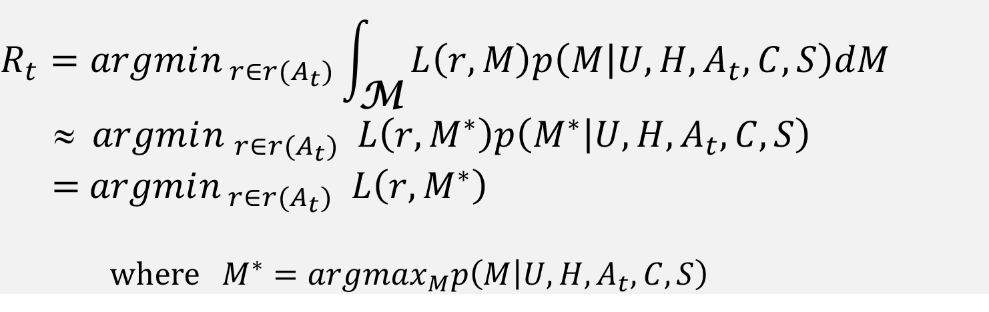
Simplification of Computation
Approximate the Bayes risk using posterior mode
Two-step procedure
  Step 1: Compute an updated user model M* based on all the currently available information
  Step 2: Given M*, choose an optimal response to minimize the loss function
$$R_{t}=argmin_{ r∈r(A_{t})}\int_{\text{M}}{L\left(r,M\right)p\left(M | U,H,A_{t},C,S\right)dM}$$
≈ $argmi{n }_{r∈r(A_{t})} L\left(r,M^{∗}\right)p\left(M^{∗} | U,H,A_{t},C,S\right)$
= $argmin_{ r∈r(A_{t})} L\left(r,M^{∗}\right)$
where $M^{∗}=argmax_{M}p\left(M | U,H,A_{t},C,S\right)$
⬅ Posterior Mode

Slide 15
Optimal Interactive Retrieval
Situation S
User U
IR system
Collection C
S₁
A₁
M*₁
P(M₁|U,H,A₁,C,S₁)
L(r,M*₁)
R₁
S₂
A₂
State = M_{i}
M*₂
P(M₂|U,H,A₂,C,S₂)
L(r,M*₂)
S₃
A₃
R₂
…
System’s decision process can be modeled by a Partially Observable Markov Decision Process (POMDP) with M_{i} as State

Slide 16
Instantiation of I3A Model
Situation S: can include time, location, and other environmental factors that are relevant to a task
Information Item Collection C: naturally available in any application
User U: can include any information we know about a user (or group)
User interaction history H: naturally accumulated over time
User Actions and System Responses R(A): all interfaces (moves of the game)
Loss Function L(R,M): captures the objective of the game
Multi-dimensional Latent Model M=(M_{U}, M_{T}, M_{C}, M_{S}): can include everything that we can infer about a user M_{U}, user’s task M_{T}, the content M_{C}, and situation M_{S} relevant to deciding how to respond to a user’s action
Inference of Model: P(M|U, H, At, C,S): capture system’s belief about the multidimensional latent model M=(M_{U}, M_{T}, M_{C}, M_{S}).
Can go beyond search to support analysis
General framework for developing many novel IIR strategies & algorithms

Slide 17
Instantiation of I3A: Moves of the Game (Interface Design)
User moves: can be modeled at different levels, e.g.,
  Low level: keyboard input, mouse clicking & movement, eye-tracking, gestures
  Intermediate level: query input, result examination, next page button
  High level: each query session as one “move” of a user
System moves: can be enriched via sophisticated interfaces, e.g.,
  User action = “input one character” in the query: System response = query completion
  User action = “scrolling down”: System response = adaptive summary
  User action = “entering a query”: System response = recommending related queries
  User action = “entering a query”: System response = ask a clarification question

Slide 18
Example of new moves (new interface):
Explanatory Feedback
Optimize combined intelligence ➔
  Leverage human intelligence to help search engines
Add new “moves” to allow a user to help a search engine with minimum effort
Explanatory feedback
  I want documents similar to this one except for not matching “X” (user typing in “X”)
  I want documents similar to this one, but also further matching “Y” (user typing in “Y”)
  …

Slide 19
Instantiation of I3A:
Latent Task/User/Content/Situation Models (“TUCS Models”)
The latent Task/User/Content/Situation models (“TUCS Models”) serve as a representation of all the agent’s current knowledge relevant to optimization of interaction decisions: M=(M_{T}, M_{U}, M_{C}, M_{S})
  Task Model M_{T}: knowledge about the user’s task and how such a task is usually done,… (e.g., literature review vs. finding a definition; vacation planning,…)
  User Model M_{U}: knowledge about the user’s information/knowledge need, task status/progress, behavior, preferences, interests, background knowledge, patience level, …
  Content Model M_{C}: knowledge about the content in the collection, pre-trained language models, knowledge graphs, …
  Situation Model M_{S}: knowledge about the user’s task environment and context, common-sense knowledge about our world, current events in the world, …
Focus of existing wrok

Slide 20
Specification of Task/User/Content/Situation Models
The boundaries between component models are vague and unimportant
There are dependencies/correlations between some component models; knowing about one component may help infer another component
The models may be pre-specified based on domain/human knowledge or learned from interactions with users
The models can be interpretable or non-interpretable
  Interpretable models enable humans to improve a model more directly whereas non-interpretable ones can only be learned indirectly from annotations
  However, non-interpretable models may be learned automatically from massive amounts of interaction data and can adapt more flexibly to specific applications

Slide 21
Inference of TUCS Models
P(M|U, H, A_{t}, C, S_{t}) = P(M_{T}, M_{U}, M_{C}, M_{S} |U, H, A_{t}, C, S_{t}): System’s current belief about the TUCS models
  Infer and update all the four component models using all the available information, at any time point t, thus maximization of adaptation/personalization
Potential factorization based on one possibility of conditional independence assumptions to simplify the inference
$${\begin{aligned}{p(M}_{T}, M_{U}, M_{C}, M_{S},U, H,A_{t}, C, S_{t}) \\ =p\left(M_{C}\right)p\left(M_{S}\right)p\left(U\right)p\left(C | M_{C}\right)p\left(S_{t} | M_{S}\right)p\left(M_{T}\right|M_{C},M_{S},U)p\left(M_{U}\right|U,M_{T},M_{S})p\left(H | M_{U}\right)p\left(A_{t} | M_{U}\right)\end{aligned}}_{}$$
C S_{t}
$$M_{S}^{∗}=argma{x_{M}}_{S}p\left(M_{S} | S_{t}\right)=argma{x_{M}}_{S}p\left(M_{S}\right)p\left(S_{t} | M_{S}\right)$$
M_{C} M_{S}
U H A_{t}
Enable plugging in prior knowledge about the world (e.g., major events)
$$M_{C}^{∗}=argma{x_{M}}_{S}p\left(M_{C} | C\right)=argma{x_{M}}_{C}p\left(M_{C}\right)p\left(C | M_{C}\right)$$
M_{T}
M_{U}
Enable plugging in pre-trained neural language models (e.g., BERT, T5)

Slide 22
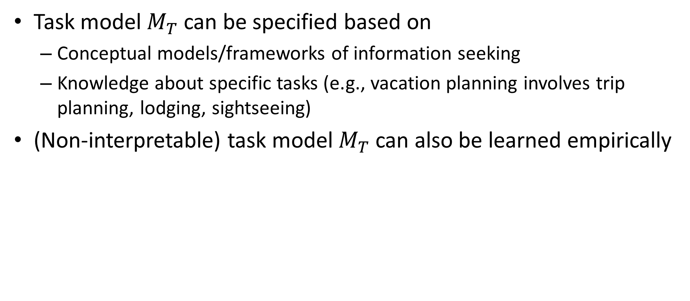
Inference of Task Model $M_{T}^{∗}$
$$M_{T}^{∗}=argma{x_{M}}_{T}p{\left(M_{T}\right|M}_{C}^{∗}, M_{S}^{∗}, U)$$
Task model $M_{T}$ can be specified based on
  Conceptual models/frameworks of information seeking
  Knowledge about specific tasks (e.g., vacation planning involves trip planning, lodging, sightseeing)
(Non-interpretable) task model $M_{T}$ can also be learned empirically

Slide 23
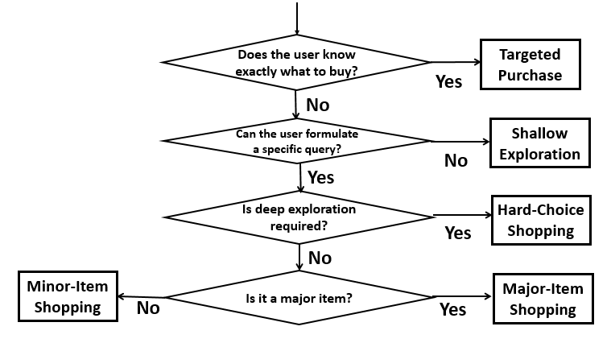
Example of $M_{T}:$ Taxonomy of Web and E-com Search
These taxonomies can be used
as task representation
E-Com Search [Sondhi et al. 18]
Web Search [Broder 02]
Navigational
Informational
Transactional
Andrei Broder. A taxonomy of web search.
SIGIR Forum, 36(2):3–10, 2002.
Parikshit Sondhi, Mohit Sharma, Pranam Kolari, ChengXiang Zhai: A Taxonomy of Queries for E-commerce Search. SIGIR 2018: 1245-1248

Slide 24
Example of $M_{T}:$ Ellis’ Behavioral Model of Information Seeking
Can be used as a process model for a user’s information seeking task
D. Ellis. A behavioural approach to information retrieval system design. Journal of Documentation, 45(3):171–212, 1989.

Slide 25
Example of $M_{T}:$ Meho & Tibbo’s extension of Ellis’ model
Such a dynamic model suggests a
formal user/task model based on
Markov Decision Process
Lokman I. Meho and Helen R. Tibbo. Modeling the information-seeking behavior of social scientists: Ellis’s study
revisited. Journal of the American Society for Information Science and Technology, 54(6): 570–587, 2003.

Slide 26
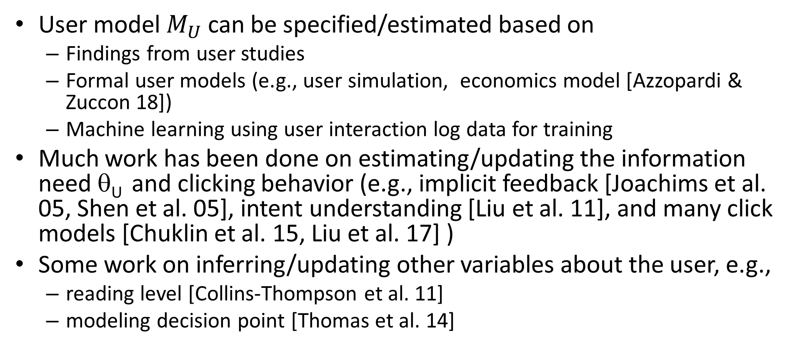
Inference of User Model $M_{U}^{∗}$
$$M_{U}^{∗}=argma{x_{M}}_{U}p\left(M_{U} | {U,H,A_{t}, M}_{S}\right)=argma{x_{M}}_{U}p\left(M_{U}\right|U,M_{T}^{∗},M_{S}^{∗})p\left(H | M_{U}\right)p\left(A_{t} | M_{U}\right)$$
User model $M_{U}$ can be specified/estimated based on
  Findings from user studies
  Formal user models (e.g., user simulation, economics model [Azzopardi & Zuccon 18])
  Machine learning using user interaction log data for training
Much work has been done on estimating/updating the information need θ_{U} and clicking behavior (e.g., implicit feedback [Joachims et al. 05, Shen et al. 05], intent understanding [Liu et al. 11], and many click models [Chuklin et al. 15, Liu et al. 17] )
Some work on inferring/updating other variables about the user, e.g.,
  reading level [Collins-Thompson et al. 11]
  modeling decision point [Thomas et al. 14]

Slide 27
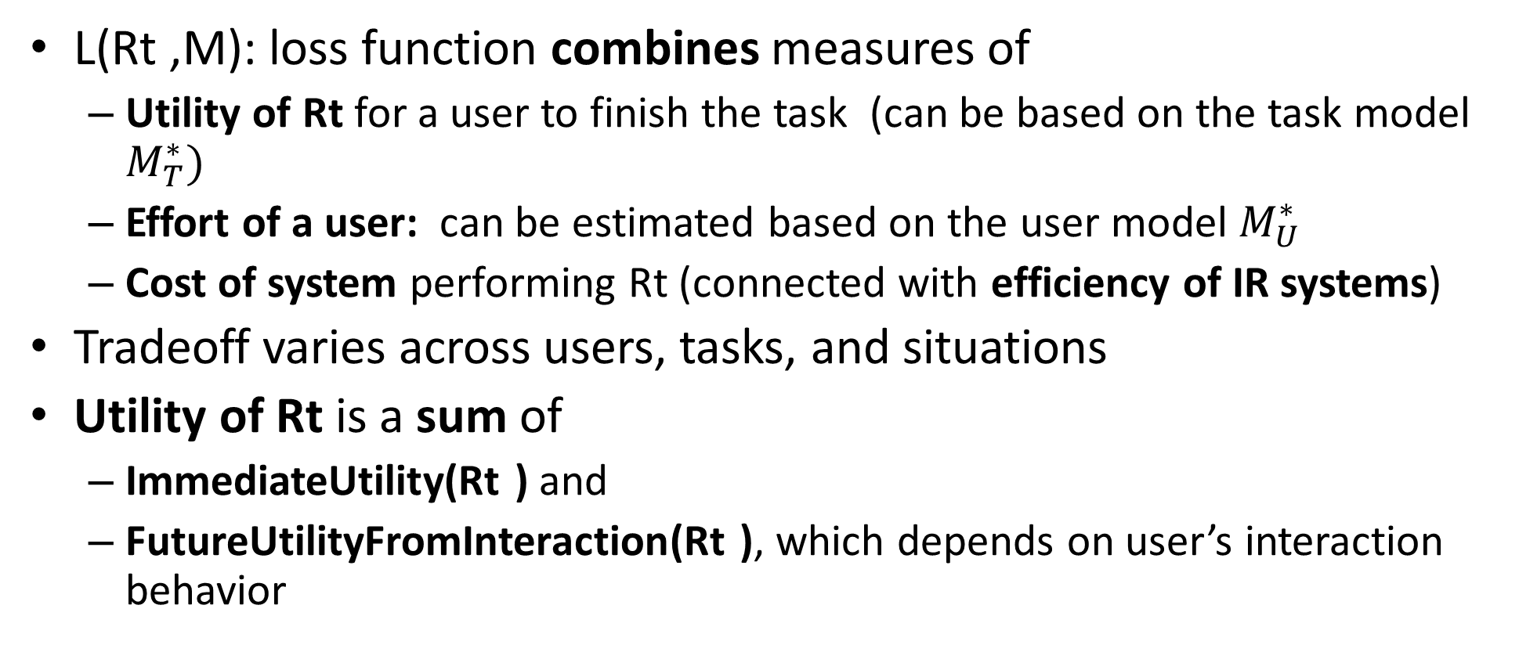
Instantiation of I3A: Loss Function
L(Rt ,M): loss function combines measures of
  Utility of Rt for a user to finish the task (can be based on the task model $M_{T}^{∗})$
  Effort of a user: can be estimated based on the user model $M_{U}^{∗}$
  Cost of system performing Rt (connected with efficiency of IR systems)
Tradeoff varies across users, tasks, and situations
Utility of Rt is a sum of
  ImmediateUtility(Rt ) and
  FutureUtilityFromInteraction(Rt ), which depends on user’s interaction behavior

Slide 28
Instantiation of I3A: Loss Function (cont.)
Formalization of utility depends on research on evaluation, task modeling, and user behavior modeling
Traditional evaluation measures tend to use
  Very simple user behavior model (sequential browsing)
  Straightforward combination of effort and utility
They need to be extended to incorporate more sophisticated user behavior models (e.g., [de Vries et al. 04] , [Smucker & Clarke 12], [Baskaya et al. 13])
Much progress has been made recently on incorporating click models (simple user interaction models) into a loss function for learning to rank or recommend (e.g., online learning to rank [Hofmann et al. 11, Wang et al. 19] , dynamic IR [Yang et al. 06], recommendation [Zhao et al. 08], sequential browsing [Wei et al. 17])

Slide 29
Modeling Diversification with I3A:
Three Different Reasons for Diversification
1. Redundancy reduction ➔ reduce user effort
2. Diverse information needs (e.g., overview, subtopic retrieval) ➔ increase the immediate utility
3. Active relevance feedback ➔ increase future utility

Slide 30
Capturing diversification with different loss functions
1. Redundancy reduction: Loss function includes a redundancy measure
  Special case: list presentation + MMR
2. Diverse information needs: loss function defined on latent topics
  Special case: PLSA/LDA + topic retrieval
3. Active relevance feedback: loss function considers both relevance and benefit for feedback (online learning to rank, dynamic IR)
  Special case: hard queries + feedback only

Slide 31

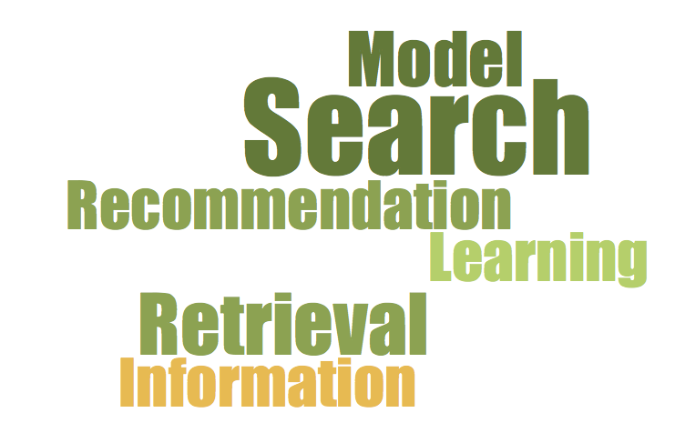


Example of Instantiation:
Interface Card Model (ICM) [Zhang & Zhai 15, Zhang & Zhai 16]
How to optimize the interface design?
… or a combination of some of these?
How to allocate screen space among different blocks?
Yinan Zhang, ChengXiang Zhai, Information Retrieval as Card Playing: A Formal Model for Optimizing Interactive Retrieval Interface, Proceedings of ACM SIGIR 2015.
Yinan Zhang and Chengxiang Zhai. 2016. A Sequential Decision Formulation of the Interface Card Model for Interactive IR. In Proceedings of ACM SIGIR 2016.

Slide 32
Optimal User Interface = Optimal “Card Playing”
In each interaction lap
… facing an (evolving) interaction context
… the system tries to play a card
… that optimizes the user’s expected surplus
… based on the user’s action model and reward / cost estimates
… given all the constraints on card

Slide 33
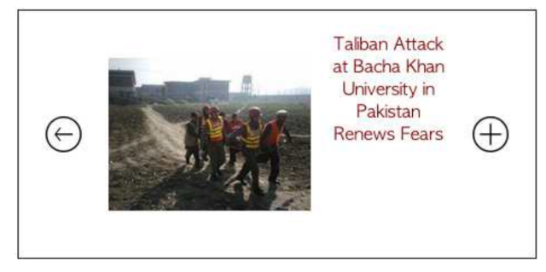
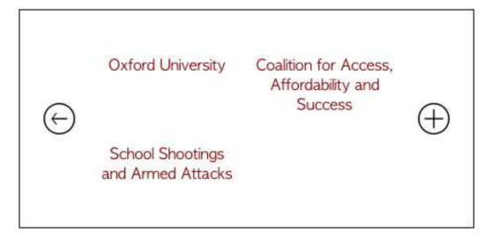
Example of interface optimization
Context c^{t}
After a user clicks on “Colleges & Universities”,
which interface card q^{t} to show?
If user action a^{t+1}= view content
If showing card q^{t}
surplus for a^{t+1} :
u(a^{t+1} |q^{t},c^{t})= gain - cost
A different card
If user action a^{t+1}= “see more”?
If user action a^{t+1}= “navigate”?

Slide 34


Expected surplus of an interface card: E(u^{t}|q^{t},c^{t})
E(u^{t} |q^{t} = ,c^{t} )
=p( a^{t} =“view content” |c^{t} ,q^{t}) × u( | c^{t} ,q^{t})
u( | c^{t} ,q^{t})= Gain ( ) – Cost(Viewing)
Gain ( )=Relevance( )
+ p( a^{t} =“see more”|c^{t} ,q^{t})×u( | c^{t} ,q^{t}) + …
Depends on the next interface card q^{t+1}

Slide 35

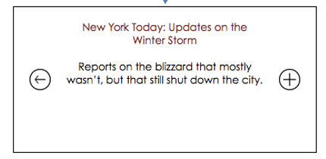
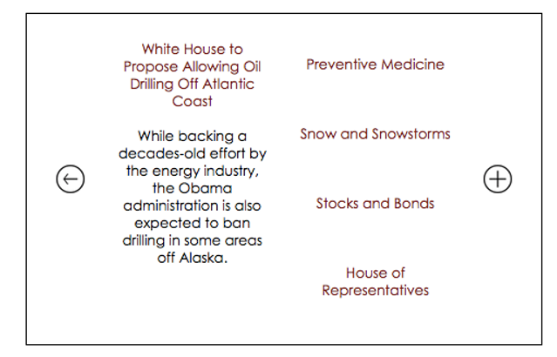


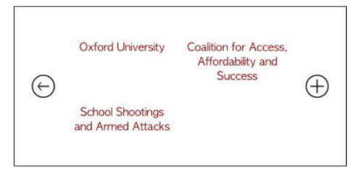
Expected surplus of an interface card: E(u^{t}|q^{t},c^{t})
E(u^{t} |q^{t} = ,c^{t} )
=p( a^{t} =“left-top tag” |c^{t} ,q^{t}) × u( | c^{t} ,q^{t})
+ p( a^{t} =“right-top tag”|c^{t} ,q^{t})×u( | c^{t} ,q^{t})
+ p( a^{t} =“left-bottom tag”|c^{t} ,q^{t})×u( | c^{t} ,q^{t})
+ …

Slide 36
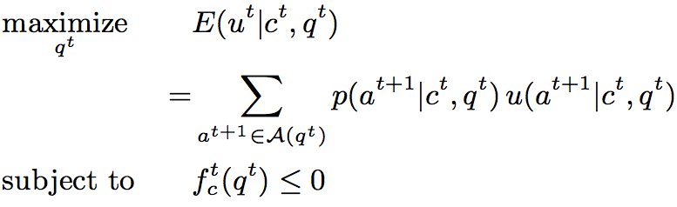
ICM: Formal Definition

Slide 37
R_{t}=Interface card

Slide 38
Situation S =Context

Slide 39
Action set (user’s “moves”)

Slide 40
Action model
(User Model M_{U})

Slide 41

Task Model M_{T} and/or User Model M_{U}
Reward Cost
Action surplus

Slide 42
Expected surplus
(loss function L)

Slide 43
Constraint(s)
(can be captured in
situation S)

Slide 44
Refinements/Instantiations of ICM
ICM (sequential
decision form)
Stop
Action
ICM
ICM-US
MDP
Explicit US
User
State
ICM-US
POMDP
Implicit US

Slide 45
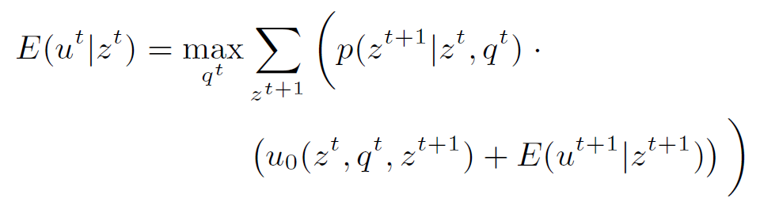
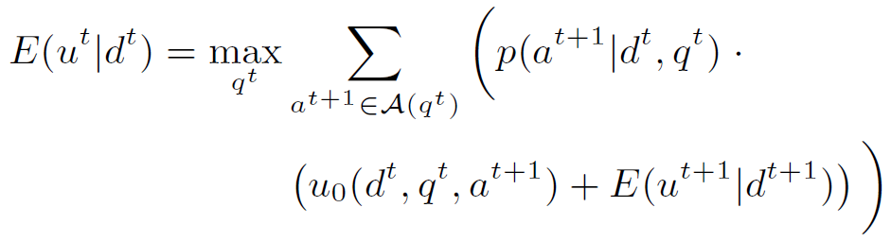
ICM-US model
MDP form:
POMDP form:

Slide 46




Stop action model
An ordinary user action
  Stopping rate:
  Zero expected future surplus:
Constant stopping rate (CSR)

Slide 47
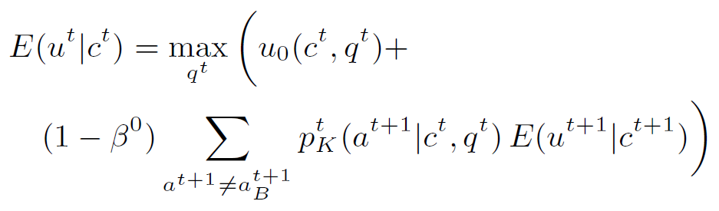
CSR => diminishing reward

Slide 48
ICM for Interactive Retrieval Optimization:
Plain Card
ICM (sequential
decision form)
Stop
Action
ICM
ICM-US
MDP
Explicit US
Plain card
User
State
ICM-US
POMDP
Implicit US

Slide 49
Plain Card (IIR-PRP)

Slide 50
“Backward compatibility”
If we assume sequential interaction reduces to sequential browsing …
q¹
q²
q³
q⁴

Slide 51
Instantiation
Card: a choice in a ranked list
Constraint: none
Action: accept / skip a choice
Context: constant until an accept
Reward (for skip): expected surplus in next lap
Cost: decision cost

Slide 52

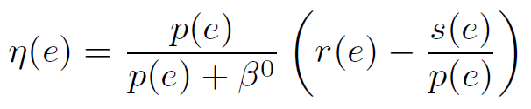
Plain card
Plain user state
Assume CSR
Ranking principle
Further promote
more relevant items
Interactive IR- Prob. Ranking Principle
(IIR-PRP)
Norbert Fuhr. 2008. A probability ranking principle for interactive information retrieval. Inf. Retr. 11, 3 (June 2008), 251-265. DOI=http://dx.doi.org/10.1007/s10791-008-9045-0

Slide 53
ICM for Interactive Retrieval Optimization:
Navigational Card
ICM (sequential
decision form)
Stop
Action
ICM
ICM-US
MDP
Explicit US
Plain card
User
State
ICM-US
POMDP
Navigational
card
Implicit US

Slide 54
Navigational Card

Slide 55
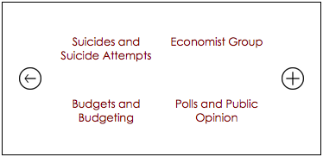
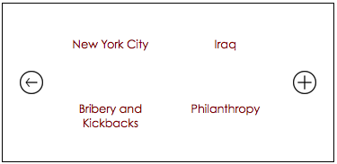
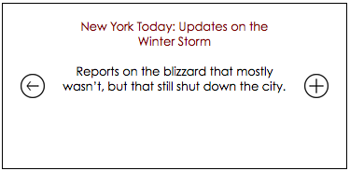
What IIR-PRP cannot do …
If sequential interaction does not reduce to sequential browsing (e.g. on mobile screen) …

Slide 56
Instantiation
Card: a set of item/tag blocks
Constraint: total area does not exceed the card
Action: select block based on item-tag relations
Context: updated based on user actions
Reward: information gain of user interest estimate
Cost: constant for each lap

Slide 57
Analytical Study
Goal
  Derive the optimal mathematical conditions for the blocks on the card
Assumptions
  Uniform initial preference
  Uniform and perfect action model
  Only focus on tags (items would be more trivial)
  “Complete” tag set

Slide 58



One tag per card
What is the optimal number of items the picked tag should cover?
Balanced partition

Slide 59

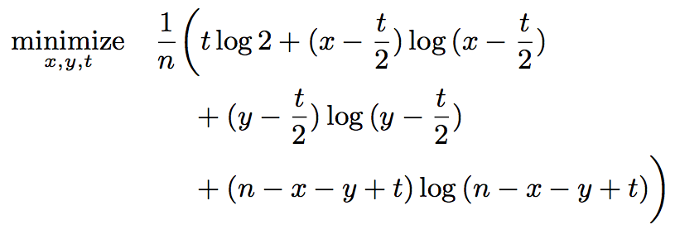


Two tags per card
How many items should each of the two picked tags cover?
How many items should the two tags’ coverage overlap?
Balanced partition
Minimal overlap

Slide 60
User study experiments
Setting
  Prototype interfaces for New York Times
  Articles as items and keywords as tags
  Two sizes: a medium sized one and a small one
Comparison
  # Interaction rounds to reach item of interest
  We automatically optimize the interface layout
  Compare with pre-designed static interfaces

Slide 61
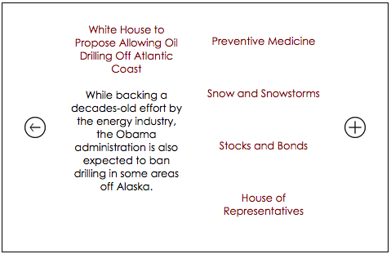
Medium sized screen

Slide 62

Smaller screen

Slide 63
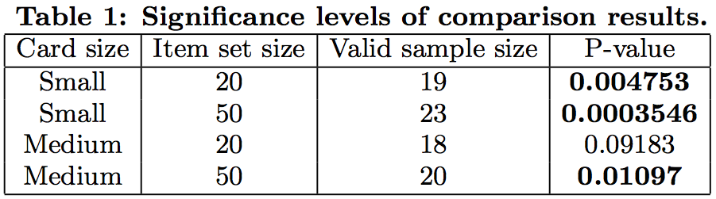
# Interaction round comparison
More beneficial when screen is small and number of items large

Slide 64
Adaptation to user stopping tendency
User stop action: zero expected future surplus
User interest state: the user’s interested item
  Hidden; does not change across laps
Variables to examine in experiments
  Screen size: S = Small; M = Medium
  User patience level: P = Patient; I = Impatient
Simulation experiments
User study experiments

Slide 65
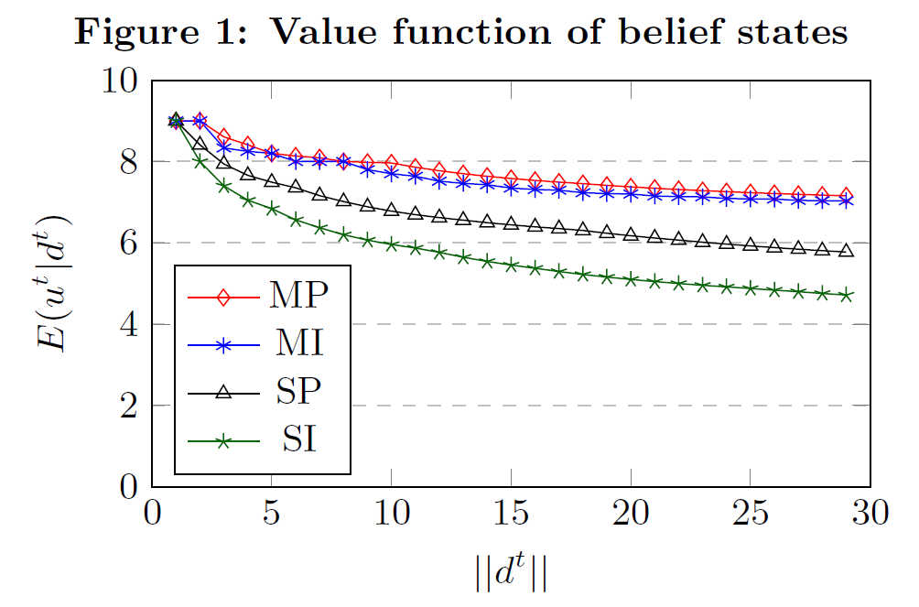
Simulation experiments
Medium Screen > Small Screen; Patient User > Impatient User
More items to explore
➔ Larger State Space
More uncertainty
Lower value

Slide 66
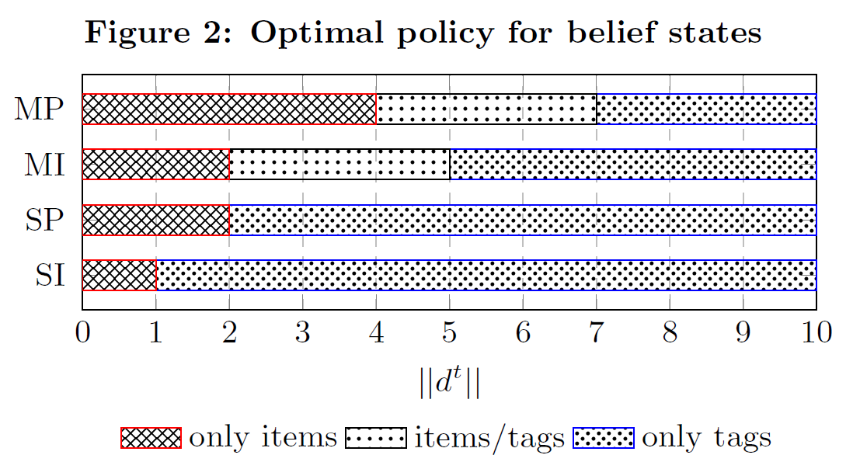
Simulation experiments
Larger screen & more patient user encourage displaying items directly
Smaller screen & less patient user
encourage displaying only tags

Slide 67
Challenge in Evaluating IIR Systems
Problem with using A/B test: Not reusable, not reproducible
Cranfield evaluation methodology has the following benefit, but it cannot be used to evaluate IIR
  Reusable test collection ➔ Can be reused and ensure fairness in comparison
  Facilitate component testing
How can we make a fair comparison of multiple IIR systems using reproducible experiments?
Must control the users ➔ Using user simulators!

Slide 68
A General Simulation-based Evaluation Methodology
A collection of user simulators are constructed to approximate real users
A collection of task simulators are constructed to approximate real tasks
Both user simulators and task simulators can be parameterized to enable modeling of variation in users and tasks
Evaluation of a system
  Have a simulated user perform a simulated task by using (interacting with) the system
  Compute various measures based on the entire interaction history of the whole “task session”

Slide 69
A formal search simulation framework [Zhang et al. 17]
Top level components
  System: S
  User / simulator: U
  Task: T
  Interaction sequence: I
Metrics
  Interaction reward and cost: R(I,T,U,S) and C(I,T,U,S)
  Simulator reward and cost: R(T,U,S) and C(T,U,S)
    Expectation w.r.t. p(I|T,U,S)
Yinan Zhang, Xueqing Liu, and ChengXiang Zhai. "Information retrieval evaluation as search simulation: A general formal framework for ir evaluation." In Proceedings of the ACM SIGIR International Conference on Theory of Information Retrieval, pp. 193-200. 2017

Slide 70
A lap-level decomposition
Lap level components
  Lap, user action and interface card
  User state and user action model
  Interaction sequence (refined)
    A series of (user state, user action, interface card) tuples.
Metrics
  Cumulative reward and cost: R^{t}(I,T,U,S) and C^{t}(I,T,U,S)
  Assume to be the sum of lap-level action reward and cost

Slide 71
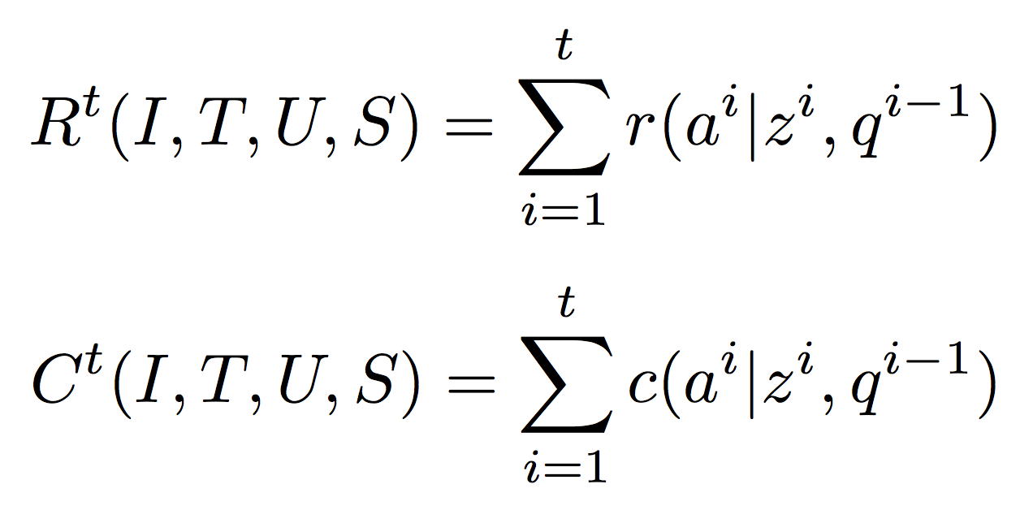
Cumulative reward and cost
Remarks
  How to combine the reward and cost measures is application specific
  The distributions of reward and cost across all interaction sequences are also meaningful

Slide 72
Classical IR simulator
Task: find (all) relevant documents
Interface card: document (snippet)
User action: click / skip (and read next) / stop
  User always clicks a relevant document
  User may skip or stop at a non-relevant document
Lap reward: 1 / 0 for relevant / non-relevant doc
  Cumulative reward: # relevant docs
Lap cost: 1 for each doc
  Cumulative cost: # docs (the simulator scanned through)
User state: cumulative reward and cost

Slide 73
Metrics in Cranfield test
Precision
  R(I,T,U,S) / C(I,T,U,S)
Recall
  R(I,T,U,S) / N, N = maximal possible reward
Remark
  Assumes user stops when the list is exhausted
  Precision@K and Recall@K: K = cost budget
  Precision emphasizes more on cost; Recall emphasizes more on task completion

Slide 74
Mean Average Precision (MAP)
Variable-recall simulator
  Classical IR simulator with task of finding N’ relevant documents (N’ between 1 and N)
  Stops and only stops when the task is finished
Average Precision (AP)
  Average R(I,T,U,S) / C(I,T,U,S) across N variable-recall simulators with N’ ranging from 1 to N respectively
  AP@K: K = cost budget

Slide 75

task = 1
task = 2
task = 3
task = 4
Relevant
Relevant
Relevant
Not retrieved
Relevant

Slide 76
task = 1
task = 2
task = 3
task = 4
Relevant
Relevant
Relevant
Not retrieved
Relevant

Slide 77
task = 1
task = 2
task = 3
task = 4
Relevant
precision =
Relevant
Relevant
precision =
precision =
Not retrieved
precision =
∞
Relevant

Slide 78
task = 1
task = 2
task = 3
task = 4
Relevant
precision =
Relevant
Relevant
precision =
precision =
Not retrieved
precision =
∞
Relevant
AP = Expected Precision across all simulator-task pairs

Slide 79
Evaluation of tag-based search interfaces [Zhang et al. 17]
Example of search interface beyond ranking
  Traditional interface: static layout
    Medium screen: tag list alongside document list
    Small screen: only tag list or document list at a time, and user needs to click “switch” to switch between the two lists
  ICM interface: dynamic layout
Evaluation based on simulators
  Task: find target document(s)
  Simulator never stops until task is complete
  Metrics: interaction cost

Slide 80
Tag-based search interfaces: simulator action model
If a target document is shown, user always clicks it
Otherwise, if a tag related to a target document is shown, user always clicks it
Otherwise:
  On ICM: User always goes to “next page”
  On medium static interface: user scrolls document list with probability τ, and scrolls tag list with probability (1- τ)
  On small static interface:
    If user is on document list, user scrolls list with probability τ1 and switches list with probability (1- τ1)
    If user is on tag list, user scrolls list with probability τ2 and switches list with probability (1- τ2)

Slide 81
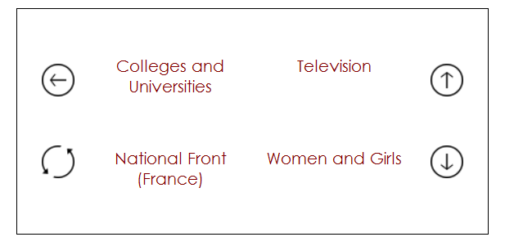

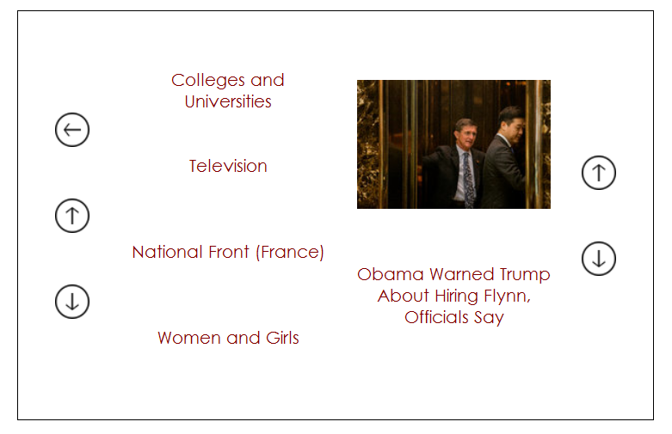
Simulator scrolls list with probability τ₂ and switches list with probability (1- τ₂)
Simulator scrolls list with probability τ₁ and switches list with probability (1- τ₁)
Simulator scrolls document list with probability τ, and scrolls tag list with probability (1- τ)

Slide 82
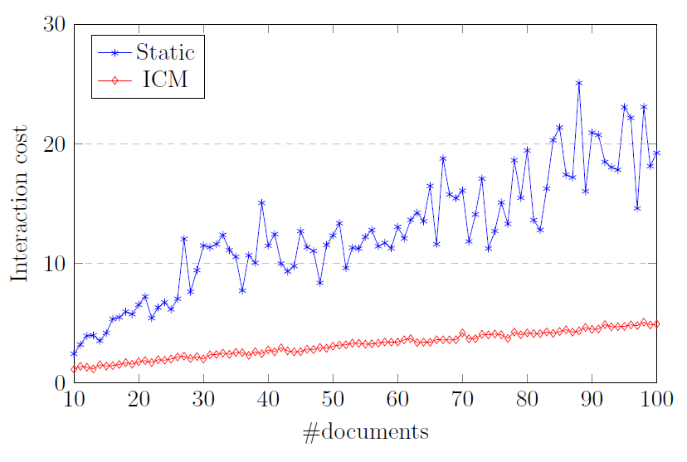
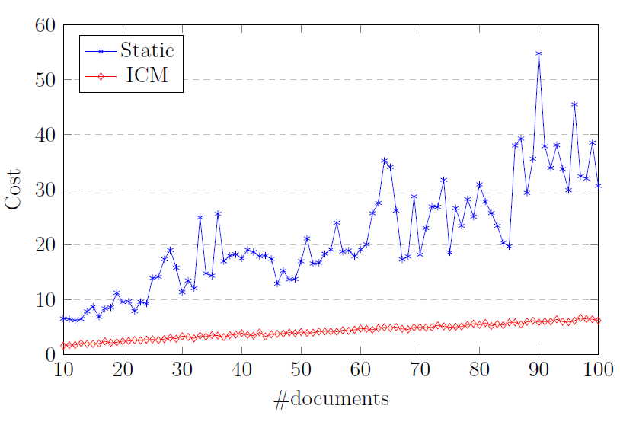
Results of simulation-based evaluation
Interface Card Model has consistently lower interaction cost than the static interface
Medium Screen
Small Screen

Slide 83
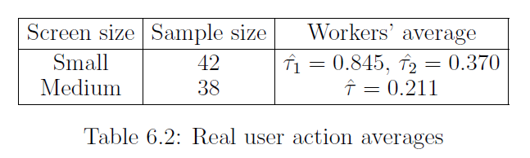
Validation from real user experiment
Real user experiment
  ICM is more efficient than static interface
  The difference is higher on small screen than on medium screen
Insights about real user behavior
  Users can well utilize the tag list on the medium screen, but cannot make full use of the tag list on the small screen

Slide 84
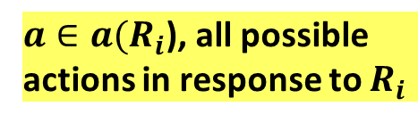
An Agent Model for Simulating Users: Duality of User & System Decision Making
Situation S
IR System
User
S₁
R₁
M*₁
P(M₁|U,H,R₁,S₁)
A user’s latent model of the
interaction environment
M= (M_{Response}, M_{Collection}, M_{System}, M_{Situation})
L(a,M*₁)
A₂
$a∈a(R_{i}$), all possible actions in response to $R_{i}$
S₂
R₂
M*₂
P(M₂|U,H,R₂,S₂)
State = M_{i}
L(a,M*₂)
S₃
R₃
A₃
…
User’s decision process (behavior) can be modeled by a POMDP as well with M_{i} as State

Slide 85
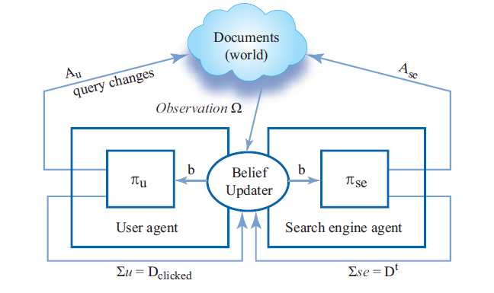
Session Search as a Dual-Agent Stochastic Game (DASG) [Luo et al. 14]

Slide 86
Two New Ideas in the DASG Model
Idea 1: Joint modeling of the decision processes of both users and search engines, capturing duality of user and system decision making
Idea 2: Explicitly modeling communications between a user and a search engine
Facilitating optimization of human-machine collaboration, communication, and cognition

Slide 87
Summary: High-Level Take-Away Messages
Answer: I3A: Intelligent Interactive Information Agent Model
Q1: How can we mathematically model the general IIR problem?
Q2: How can we develop a general system/algorithm to solve the general IIR problem optimally?
Q3: How should we evaluate a general IIR system?
➔ IIR = Cooperative Game
➔ IIR Algorithm = Sequential Decision Optimization
➔ IIR Evaluation = Simulated Interaction with Simulated User

Slide 88
Summary: I3A Model
A general formal model for IIR:
  Optimization of 4 C’s: Collaboration, Communication, Cognition, and Cost
  Mathematically model everything about the user and the retrieval situation
  Adaptively optimize responses to user actions over the horizon of all future user actions and system responses
Can be instantiated in many ways: Interface Card Model
  Covers IIR-PRP as a special case
  Computes an adaptive interface using an algorithm
A unified formal framework to integrate research in user studies, evaluation, retrieval models, and efficient implementation of IR systems

Slide 89
Major Challenges for Future Research
1. How to evaluate an IIR system (with controlled experiments)?
  How to build realistic user simulators? User search logs? User study designed specifically for eliciting user behavior? How to evaluate simulators [Labhishetty & Zhai 21]?
  How to measure task performance and measure user effort?
  How to incorporate retrieval situation/context into an evaluation framework?
2. How to formally (mathematically) represent and model a user?
  How to leverage theory from Psychology to design a formal user model?
  How to represent a user’s state of knowledge? Formally define the anomalous state of knowledge (ASK)?
  How to model many other aspects of a user (e.g., search style, browsing behavior, situational constraints, cognitive state, …)
  How to model shared characteristics of users? Structure on users?

Slide 90
Major Challenges for Future Research (cont.)
3. How to infer and update a user model over time?
  Given all the observed data about a user, how can we infer knowledge about the user and update the user model over time?
  How can we recognize and correct errors in a user model (misunderstanding of users)?
4. How to define and model a user’s task?
  What is exactly a user task?
  How do we assess whether a user task has been completed? Assess progress toward task completion?
  How do we go beyond supporting query formulation to task specification?

Slide 91
Major Challenges for Future Research (cont.)
5. How do we design an “IR game” with richer user actions and system responses?
  How can we systematically enumerate the possibilities of “interface cards”? Are there a finite number of basic interface elements that would be sufficient when combined in a flexible way?
  How can we design interfaces to encourage/optimize user-system collaboration? (Interface = Language for communication between users and system)
  How do we design interfaces to enable multi-mode interactions (e.g., speech + touch screen)?
  How can we design interfaces to enable a system to explain its responses to users?
  How can we parameterize an interface to enable automated optimization of interface using an algorithm?
6. How should we formalize the optimization problem of IIR?
  How do we formally define the multiple objectives (task performance, user effort, system cost, …)?
  How do we set up the optimization problem so as to make it feasible to solve it?

Slide 92
Major Challenges for Future Research (cont.)
7. How can we efficiently solve the optimization problem of IIR?
  POMDP and reinforcement learning are generally complex to compute. How can we simplify the objective function and make approximations?
  How can we leverage advances in machine learning to improve modeling and algorithms for IIR?
  How can we engage users to help simplify the optimization problem (resolve uncertainties)? How to simplify the exploration-exploitation tradeoff?
8. How can the system dynamically adapt the interface to each individual user in a context-sensitive and task-sensitive way?
  Novice vs. expert users?
  Search while sitting in a train vs. being at home?
  Medical diagnosis task vs. search to help solve a homework problem?
  How can the system adapt the interface while minimizing the cognitive load on users? How can the system “train” a user to recognize changes in the interface?

Slide 93
Major Challenges for Future Research (cont.)
9. How can the system provide help for users all the time?
  Many “help me to do X” buttons?
  “Reporting problem” button on every interface page?
  How to maximize the flexibility for a user to dynamically reconfigure an interaction interface (let the user “program” the interface)?
  How to sense a user’s emotion during IIR? How to detect “struggling” state of a user?
10. How to support multi-mode interactions and go beyond search to support user tasks?
  Opportunities to both leverage advances in HCI and contribute to HCI

Slide 94
Thank You!
Questions/Comments?
czhai@illinois.edu
http://czhai.cs.illinois.edu/

Slide 95
References (not all cited in the talk)
[Agarwal et al. 09] Deepak Agarwal, Bee-Chung Chen, and Pradheep Elango. 2009. Explore/Exploit Schemes for Web Content Optimization. In Proceedings of ICDM 2009
[Azzopardi et al. 10] Leif Azzopardi, Kalervo Järvelin, Jaap Kamps, and Mark D Smucker. 2011. Report on the SIGIR 2010 workshop on the simulation of interaction. In ACM SIGIR Forum, Vol. 44. ACM New York, NY, USA, 35–47.
[Azzopardi 11] Leif Azzopardi. 2011. The economics in interactive information retrieval. In Proceedings of ACM SIGIR 2011, pp. 15-24.
[Azzopardi 14] Leif Azzopardi, Modelling interaction with economic models of search, Proceedings of ACM SIGIR 2014.
[Azzopardi & Zuccon 18] Azzopardi, L., & Zuccon, G. (2018). Economics models of interaction: a tutorial on modeling interaction using economics. In A. Oulasvirta, P. O. Kristensson, X. Bi, & A. Howes (Eds.), Computational Interaction Oxford.
[Baskaya et al. 13] Feza Baskaya, Heikki Keskustalo, and Kalervo Järvelin. 2013. Modeling behavioral factors ininteractive information retrieval. In Proceedings of ACM CIKM 2013, 2297-2302.
[Bast & Weber 06] Bast, Holger, and Ingmar Weber. "Type less, find more: fast autocompletion search with a succinct index." In Proceedings of the 29th annual international ACM SIGIR conference on Research and development in information retrieval, pp. 364-371. 2006.
[Belkin 80] Belkin, N.J. "Anomalous states of knowledge as a basis for information retrieval". The Canadian Journal of Information Science, 5, 1980, pages 133-143.

Slide 96
References (cont.)
[Belkin et al. 82] Belkin, N.J., Oddy, R.N., Brooks, H.M. "ASK for information retrieval: Part I. Background and theory". The Journal of Documentation, 38(2), 1982, pages 61-71.
[Belkin 96] Belkin, N. J. (1996). Intelligent information retrieval: Whose intelligence? Proceedings of the Fifth International Symposium for Information Science, Konstanz: Universitätsverlag Konstanz, 25-31.
[Belkin et al. 09] Nicholas J. Belkin, Michael Cole, and Jingjing Liu, A Model for Evaluation of Interactive Information Retrieval, SIGIR Workshop on the Future of IR Evaluation, July 23, 2009, Boston.
[Broder 02] Andrei Broder. A taxonomy of web search. SIGIR Forum, 36(2):3–10, 2002.
[Carterette et al. 15] Carterette, Ben, Ashraf Bah, and Mustafa Zengin. "Dynamic test collections for retrieval evaluation." Proceedings of the 2015 international conference on the theory of information retrieval. ACM, 2015.
[Chen et al. 20] Chen, Hongshen, Zhaochun Ren, Pengjie Ren, Dawei Yin, and Xiaodong He. "AIIS: The SIGIR 2020 Workshop on Applied Interactive Information Systems." In Proceedings of ACM SIGIR 2020, pp. 2448-2450. 2020.
[Chuklin et al. 15] Chuklin, Aleksandr, Ilya Markov, and Maarten de Rijke. "Click models for web search." Synthesis Lectures on Information Concepts, Retrieval, and Services 7.3 (2015): 1-115.
[Clarke et al. 13] Charles LA Clarke, Luanne Freund, Mark D Smucker, and Emine Yilmaz. 2013. SIGIR 2013 workshop on modeling user behavior for information retrieval evaluation. In Proceedings of SIGIR 2013.
[Collins-Thompson et al. 11] Kevyn Collins-Thompson, Paul N. Bennett, Ryen W. White, Sebastian de la Chica, and David Sontag. 2011. Personalizing web search results by reading level. In Proceedings of ACM CIKM 2011, 403-412.
[Collins-Thompson et al. 17] Collins-Thompson, Kevyn, Preben Hansen, and Claudia Hauff. "Search as learning (dagstuhl seminar 17092)." In Dagstuhl reports, vol. 7, no. 2. Schloss Dagstuhl-Leibniz-Zentrum fuer Informatik, 2017.

Slide 97
References (cont.)
[Cool & Belkin 11] Cool, C. & Belkin, N. J. (2011). Interactive information retrieval: history and background. In I. Ruthven & D. Kelly (Eds.) Interactive Information Seeking, Behaviour and Retrieval (pp 1-14). London: Facet Publishing.
[de Vries et al. 04] A. P. de Vries, G. Kazai, and M. Lalmas. Tolerance to irrelevance: A user-effort oriented evaluation of retrieval systems without predefined retrieval unit. In Proc. RIAO, pages 463–473, 2004.
[Diaz 09] Fernando Diaz. 2009. Integration of news content into web results. In Proceedings of WSDM 2009, pp. 182-191.
[Ellis 89] D. Ellis. A behavioural approach to information retrieval system design. Journal of Documentation, 45(3):171–212, 1989.
[Fuhr 08] Norbert Fuhr. 2008. A probability ranking principle for interactive information retrieval. Inf. Retr. 11, 3 (June 2008), 251-265.
[Guan et al. 13] Dongyi Guan, Sicong Zhang, Hui Yang: Utilizing query change for session search. ACM SIGIR 2013: 453-462
[Harman 11] Harman, Donna. "Information retrieval evaluation." Synthesis Lectures on Information Concepts, Retrieval, and Services 3, no. 2 (2011): 1-119.
[Hearst 09] Marti A. Hearst. 2009. Search User Interfaces (1st ed.). Cambridge University Press, New York, NY, USA. https://searchuserinterfaces.com/
[Hofmann et al. 11] Katja Hofmann, Shimon Whiteson, Maarten de Rijke: Balancing Exploration and Exploitation in Learning to Rank Online. ECIR 2011: 251-263
[Hofmann 13] Katja Hofmann, Fast and Reliable Online Learning to Rank for Information Retrieval, Doctoral Dissertation, 2013.
[Hopfgartner et al. 18] Frank Hopfgartner, et al. Evaluation-as-a-Service for the Computational Sciences: Overview and Outlook. J. Data and Information Quality 10(4): 15:1-15:32 (2018)

Slide 98
References (cont.)
[Ingwersen 96] Peter Ingwersen, Cognitive Perspectives of Information Retrieval Interaction: Elements of a Cognitive IR Theory. Journal of Documentation, v52 n1 p3-50 Mar 1996
[Ingwersen & Järvelin 06] Ingwersen, Peter, and Kalervo Järvelin. The turn: Integration of information seeking and retrieval in context. Vol. 18. Springer Science & Business Media, 2006.
[Jagerman et al. 18] Rolf Jagerman, Krisztian Balog, Maarten de Rijke: OpenSearch: Lessons Learned from an Online Evaluation Campaign. J. Data and Information Quality 10(3): 13:1-13:15 (2018)
[Jiang et al. 17] Zhengbao Jiang, Ji-Rong Wen, Zhicheng Dou, Wayne Xin Zhao, Jian-Yun Nie, and Ming Yue. 2017. Learning to Diversify Search Results via Subtopic Attention. In Proceedings of the 40th International ACM SIGIR Conference on Research and Development in Information Retrieval (SIGIR '17). ACM, New York, NY, USA, 545-554. DOI: https://doi.org/10.1145/3077136.3080805
[Jin et al. 13] Xiaoran Jin, Marc Sloan, and Jun Wang. 2013. Interactive exploratory search for multi page search results. In Proceedings of WWW 2013, pp. 655-666.
[Joachims et al. 05] Thorsten Joachims, Laura Granka, Bing Pan, Helene Hembrooke, and Geri Gay. 2005. Accurately interpreting clickthrough data as implicit feedback. In Proceedings of ACM SIGIR 2005, pp. 154-161. DOI=http://dx.doi.org/10.1145/1076034.1076063
[Rones et al. 06] Jones, Rosie, Benjamin Rey, Omid Madani, and Wiley Greiner. "Generating query substitutions." In Proceedings of the 15th international conference on World Wide Web, pp. 387-396. 2006.
[Karimzadehgan & Zhai 13] Maryam Karimzadehgan, ChengXiang Zhai. A Learning Approach to Optimizing Exploration-Exploitation Tradeoff in Relevance Feedback, Information Retrieval , 16(3), 307-330, 2013.

Slide 99
References (cont.)
[Kelly 09] Kelly, Diane. Methods for evaluating interactive information retrieval systems with users. Now Publishers Inc, 2009.
[Knepshield & Belkin 99] Savage-Knepshield, P.A. & Belkin, N.J. (1999) Interaction in information retrieval: trends over time. JASIST, 50(12):1067–1082.
[Kotov & Zhai 11] Kotov, Alexander, and ChengXiang Zhai. "Interactive sense feedback for difficult queries." In Proceedings of the 20th ACM international conference on Information and knowledge management, pp. 163-172. 2011.
[Kuzi et al. 19] Kuzi, Saar, Abhishek Narwekar, Anusri Pampari, and ChengXiang Zhai. "Help me search: Leveraging user-system collaboration for query construction to improve accuracy for difficult queries." In Proceedings of the 42nd International ACM SIGIR Conference on Research and Development in Information Retrieval, pp. 1221-1224. 2019.
[Labhishetty & Zhai 21] Labhishetty, Sahiti, ChengXiang Zhai. An Exploration of Tester-based Evaluation of User Simulators for Comparing Interactive Retrieval Systems, In Proceedings of ACM SIGIR 2021, to appear.
[Li et al. 09] Lihong Li, Jason D. Williams, and Suhrid Balakrishnan, Reinforcement Learning for Spoken Dialog Management using Least-Squares Policy Iteration and Fast Feature Selection, in Proceedings of the Tenth Annual Conference of the International Speech Communication Association (INTERSPEECH-09), 2009.
[Liu et al. 07] Yiqun Liu, Yupeng Fu, Min Zhang, Shaoping Ma, and Liyun Ru. 2007. Automatic search engine performance evaluation with click-through data analysis. In Proceedings of the 16th international conference on World Wide Web (WWW '07). ACM, New York, NY, USA, 1133-1134. DOI: https://doi.org/10.1145/1242572.1242731
[Liu et al. 14] Liu, Yiqun, et al. "Overview of the NTCIR-11 IMine Task." NTCIR. 2014.
[Liu et al. 16] Y. Liu, X Xie, C Wang, JY Nie, M Zhang, S Ma, Time-aware click model, ACM Transactions on Information Systems (TOIS) 35 (3), 2017.

Slide 100
References (cont.)
[Luo et al. 14] J. Luo, S. Zhang, G. H. Yang, Win-Win Search: Dual-Agent Stochastic Game in Session Search. ACM SIGIR 2014.
[Marchionini 06] Gary Marchionini. 2006. Exploratory search: from finding to understanding. Commun. ACM 49, 4 (April 2006), 41-46. DOI: https://doi.org/10.1145/1121949.1121979
[Meho & Tibbo 03] Lokman I. Meho and Helen R. Tibbo. Modeling the information-seeking behavior of social scientists: Ellis’s study revisited. Journal of the American Society for Information Science and Technology, 54(6): 570–587, 2003.
[Moffat & Zobel 08] Alistair Moffat and Justin Zobel. 2008. Rank-biased precision for measurement of retrieval effectiveness. ACM Trans. Inf. Syst. 27, 1, Article 2 (December 2008), 27 pages. DOI: https://doi.org/10.1145/1416950.1416952
[Pääkkönen et al. 17] Pääkkönen, Teemu, Jaana Kekäläinen, Heikki Keskustalo, Leif Azzopardi, David Maxwell, and Kalervo Järvelin. "Validating simulated interaction for retrieval evaluation." Information Retrieval Journal 20, no. 4 (2017): 338-362.
[Pandey et al 07] S. Pandey, D. Chakrabarti, and D. Agarwal. 2007. Multi-armed bandit problems with dependent arms. In Proceedings of ICML 2007.
[Radlinski & Craswell 17] Filip Radlinski and Nick Craswell. 2017. A Theoretical Framework for Conversational Search. In Proceedings of the 2017 Conference on Conference Human Information Interaction and Retrieval (CHIIR '17). ACM, New York, NY, USA, 117-126. DOI: https://doi.org/10.1145/3020165.3020183
[Robertson 77] S. E. Robertson. The probability ranking principle in IR. S. E. Robertson. Journal of Documentation, 1977.

Slide 101
References (cont.)
[Sanderson 10] Sanderson, Mark. Test collection based evaluation of information retrieval systems. Now Publishers Inc, 2010.
[Seo & Zhang 00] Young-Woo Seo and Byoung-Tak Zhang. 2000. A reinforcement learning agent for personalized information filtering. In Proceedings of the 5th international conference on Intelligent user interfaces (IUI '00). 248-251.
[Shen et al. 05] Xuehua Shen, Bin Tan, and ChengXiang Zhai, Implicit User Modeling for Personalized Search , In Proceedings of the 14th ACM International Conference on Information and Knowledge Management ( CIKM'05), pages 824-831.
[Shen & Zhai 05] Xuehua Shen, ChengXiang Zhai, Active Feedback in Ad Hoc Information Retrieval, Proceedings of the 28th Annual International ACM SIGIR Conference on Research and Development in Information Retrieval ( SIGIR'05), 59-66, 2005.
[Shen et al. 06] Dou Shen, Jian-Tao Sun, Qiang Yang, and Zheng Chen. 2006. Building bridges for web query classification. In Proceedings of the 29th annual international ACM SIGIR 2006, pp. 131-138.
[Singh et al. 02] Satinder Singh, Diane Litman, Michael Kearns, and Marilyn Walker. Optimizing dialogue management with reinforcement learning: experiments with the NJFun system. Journal of Artificial Intelligence Research, 16:105-133, 2002.
[Smucker & Clarke 12] Mark D. Smucker and Charles L.A. Clarke. 2012. Time-based calibration of effectiveness measures. In Proceedings of ACM SIGIR 2012; 95-104.
[Sondhi et al. 18] Parikshit Sondhi, Mohit Sharma, Pranam Kolari, ChengXiang Zhai: A Taxonomy of Queries for E-commerce Search. SIGIR 2018: 1245-1248

Slide 102
References (cont.)
[Taylor 68] Taylor, R.S. (1968) Question-negotiation and information seeking in libraries. College & Research Libraries, 29, 178–194.
[Teevan et al. 05] Teevan, Jaime, Susan T. Dumais, and Eric Horvitz. "Personalizing search via automated analysis of interests and activities." In Proceedings of ACM SIGIR 2005.
[Teevan et al. 10] Jaime Teevan, Susan T. Dumais, Eric Horvitz: Potential for personalization. ACM Trans. Comput.-Hum. Interact. 17(1) (2010)
[Theocharous et al. 15] G. Theocharous, P. Thomas, & M. Ghavamzadeh. “Ad Recommendation Systems for Life-Time Value Optimization”. WWW 2015 Workshop on Ad Targeting at Scale.
[Thomas et al. 14] Paul Thomas, Alistair Moffat, Peter Bailey, and Falk Scholer. 2014. Modeling decision points in user search behavior. In Proceedings of the 5th Information Interaction in Context Symposium (IIiX '14). 239-242.
[Varian 16] Varian, H. R. How to build an economic model in your spare time. The American Economist 61, 1 (2016), 81-90.
[Voorhees 05] Voorhees, Ellen M., and Donna K. Harman, eds. TREC: Experiment and evaluation in information retrieval. Vol. 63. Cambridge, MA: MIT press, 2005.
[Walker 71] D.E. Walker (ed.). Interactive bibliographic search: the user/computer interface, AFIPS Press, 1971.
[Wang et al. 13a] Hongning Wang, Yang Song, Ming-Wei Chang, Xiaodong He, Ryen W. White, and Wei Chu. 2013. Learning to extract cross-session search tasks, WWW’ 2013. 1353-1364.
[Wang et al. 13b] Chao Wang, Yiqun Liu, Min Zhang, Shaoping Ma, Meihong Zheng, Jing Qian, Kuo Zhang. Incorporating Vertical Results into Search Click Models. Proceedings of ACM SIGIR 2013.

Slide 103
References (cont.)
[Wang et al. 16] Yue Wang, Dawei Yin, Luo Jie, Pengyuan Wang, Makoto Yamada, Yi Chang, and Qiaozhu Mei. 2016. Beyond Ranking: Optimizing Whole-Page Presentation. In Proceedings of WSDM 2016.
[Wang et al. 19] Huazheng Wang, Sonwoo Kim, Eric McCord-Snook, Qingyun Wu, and Hongning Wang. 2019. Variance Reduction in Gradient Exploration for Online Learning to Rank. In Proceedings of ACM SIGIR 2019.
[Wei et al. 17] Wei, Zeng, Jun Xu, Yanyan Lan, Jiafeng Guo, and Xueqi Cheng. "Reinforcement learning to rank with Markov decision process." In Proceedings of the 40th International ACM SIGIR Conference on Research and Development in Information Retrieval, pp. 945-948. ACM, 2017.
[Witten et al. 99] Ian H. Witten, Alistair Moffat, and Timothy C. Bell. 1999. Managing Gigabytes (2nd Ed.): Compressing and Indexing Documents and Images. Morgan Kaufmann Publishers Inc., San Francisco, CA, USA.
[Yang et al. 16] Grace Hui Yang, Marc Sloan, and Jun Wang. 2016. Dynamic Information Retrieval Modeling. Morgan & Claypool Publishers
[Zhai 02] ChengXiang Zhai, Risk Minimization and Language Modeling in Information Retrieval, Ph.D. thesis, Carnegie Mellon University, 2002.
[Zhai 16] ChengXiang Zhai. Towards a game-theoretic framework for text data retrieval, IEEE Data Eng. Bull. 39(3): 51-62 (2016).
[Zhai et al. 03] ChengXiang Zhai, William W. Cohen, and John Lafferty, Beyond Independent Relevance: Methods and Evaluation Metrics for Subtopic Retrieval , Proceedings of the 26th Annual International ACM SIGIR Conference on Research and Development in Information Retrieval ( SIGIR'03 ), pages 10-17, 2003.

Slide 104
References (cont.)
[Zhai & Lafferty 06] ChengXiang Zhai, John D. Lafferty: A risk minimization framework for information retrieval. Inf. Process. Manage. 42(1): 31-55 (2006)
[Zhang et al. 2017] Yinan Zhang, Xueqing Liu, ChengXiang Zhai: Information Retrieval Evaluation as Search Simulation: A General Formal Framework for IR Evaluation. ICTIR 2017: 193-200
[Zhang & Zhai 15] Yinan Zhang, ChengXiang Zhai, Information Retrieval as Card Playing: A Formal Model for Optimizing Interactive Retrieval Interface. In Proceedings of ACM SIGIR 2015, pp. 685-694.
[Zhang et al. 20] Zhang, Weinan, Xiangyu Zhao, Li Zhao, Dawei Yin, Grace Hui Yang, and Alex Beutel. "Deep Reinforcement Learning for Information Retrieval: Fundamentals and Advances." In Proceedings of the 43rd International ACM SIGIR Conference on Research and Development in Information Retrieval, pp. 2468-2471. 2020.
[Zhao et al. 18] Xiangyu Zhao, Long Xia, Liang Zhang, Zhuoye Ding, Dawei Yin, and Jiliang Tang. 2018. Deep reinforcement learning for page-wise recommendations. In Proceedings of the 12th ACM Conference on Recommender Systems (RecSys '18). ACM, New York, NY, USA, 95-103. DOI: https://doi.org/10.1145/3240323.3240374

